Slide 1
Data Communication CS601

Slide 2
CS601-Data Communication
VU
Table of Contents
Lecture No. 1 3 Lecture No. 2 12 Lecture No. 3 17 Lecture No. 4 22 Lecture No. 5 28 Lecture No. 6 33 Lecture No. 7 39 Lecture No. 8 44 Lecture No. 9 49 Lecture No. 10 52 Lecture No. 11 56 Lecture No. 12 61 Lecture No. 13 66 Lecture No. 14 70 Lecture No. 15 75 Lecture No. 16 79 Lecture No. 17 84 Lecture No. 18 89 Lecture No. 19 95 Lecture No. 20 98 Lecture No. 21 101 Lecture No. 22 108 Lecture No. 23 114 Lecture No. 24 118 Lecture No. 25 124 Lecture No. 26 130 Lecture No. 27 135 Lecture No. 28 142 Lecture No. 29 146 Lecture No. 30 156 Lecture No. 31 160 Lecture No. 32 165 Lecture No. 33 169 Lecture No. 34 174 Lecture No. 35 179 Lecture No. 36 183 Lecture No. 37 188 Lecture No. 38 193 Lecture No. 39 199 Lecture No. 40 205 Lecture No. 41 210 Lecture No. 42 218 Lecture No. 43 227 Lecture No. 44 233 Lecture No. 45 239

Slide 3
CS601-Data Communication
VU
LECTURE #1
Course Outline
*The course will consist of :
–45 lectures
–10-14 assignments
–2exams (1 midterm and 1 final)
–GMDB
*Grading Criteria:
–One Midterm: 35 %
–Final Exam: 45%
–Assignments: 15%
–GMDB: 5%
Textbook
*“Data Communications and Networking” 4th Edition by Behrouz A. Forouzan
*“Data and Computer Communication” 6th Edition by William Stallings

Slide 4
CS601-Data Communication
VU
INTRODUCTION TO DATA COMMUNICATION
DEFINITION OF DATA COMMUNICATION
“Data Communication is the exchange of Information from one entity to the other using a Transmission Medium”.
DEFINITION OF DATA COMMUNICATION (Cont’d)
As you can clearly notice, the definition of Data Communication although Simple leaves many questions unanswered:
Exchange??????
Information?????
Entities???????
Transmission????
Medium????
We will try to answer all these Questions in this Course
History of Data Communication
Data communications history represents a blend of histories, including:
The history of the telecommunications industry
The history of data communications, and
The history of the Internet
Telegraph 1837 Samuel Morse
Modern telecommunication industry began in 1837 with the invention of the telegraph by Samuel Morse
This led to building a telecommunications infrastructure of poles and wires as well as to the development of communication hardware and protocols
Telephone 1876 Alexander Graham Bell
Invention of telephone by Alexander Graham Bell in 1876 and the development of wireless communication technology by Guglielmo Marconi in the 1890s set the stage for today’s communication industry
❖ By 1950’s
By 1950s, telephone and telegraph companies had developed a network of communication facilities throughout the industrialized world
❖ 1970’S
Although development of databases, languages, operating systems, and hardware was strong from 1950s to 1970s, large-scale data communication systems did not emerge until the 1970s.
This was stimulated by 3 major developments:
Large-scale integration of circuits reduced cost and size of terminals and communication equipment

Slide 5
CS601-Data Communication
VU
New software systems that facilitated the development of data communication networks
Competition among providers of transmission facilities reduced the cost of data circuits
TODAY’S EVERGHANGING & BUSY WORLD
Today’s fast world demands better, secure and most of all FAST ways of communication
Gone are the days when you had to wait a couple of weeks to get a letter from
USA
Why wait ONE week when you can get the information you require in just a split of a second, using what we know by the name of “DATA COMMUNICATION”.
HOW TO ACHIEVE THIS?
How to achieve this ACCURACY, SECURITY and SPEED for the transfer of this information?
What HARDWARE and the SOFTWARE is needed?
And, what should be the MEANS of sending this info?
ARE SOME OF TOPIC WE WILL BE EXPLORING DURING THE COURSE OF OUR STUDY
DATA COMMUNICATION
When we communicate , we share information
Information can be LOCAL or REMOTE
Between Individuals LOCAL communication occurs face to face
REMOTE communication occurs over a long distance
When we refer to COMPUTER SYSTEMS, Data is represented in the form of Binary Units (Bits) in the form of Zeros (0’s) and One’s (1’s)
Also the entities can most of the times be considered to be COMPUTERS
Data Communication Definition (Modified)
Therefore, our earlier definition can easily be modified to:
“Data Communication is the exchange of data (in the form of 0’s and 1’s) between two devices (computers) via some form of the transmission medium.”
LOCAL and REMOTE Data Communication
LOCAL
Data communication is considered to be local if the communicating devices are present in the same building or a similarly restricted geographical area

Slide 6
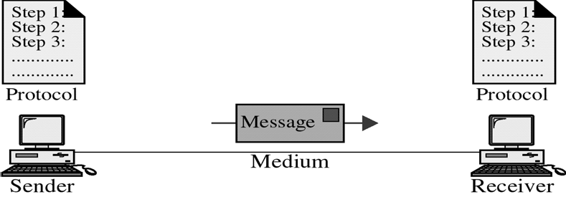
CS601-Data Communication
VU
REMOTE
Data Communication is considered remote, if the devices are farther apart.
VAGUE DEFINITIONS
We will clarify
Data Communication System
For Data Communication to occur, the communicating devices must be a part of a communication system made up of some specific kind of hardware and software
This type of a system is known as a
“DATA COMMUNICATION SYSTEM”
Effectiveness of Data Comm. System
Effectiveness depends upon three fundamental characteristics:
Delivery
Accuracy
Timeliness (Better NEVER than LATE)
Example of the POSTAL MAIL
Components of Data Comm. Systems
Components of Data Com Systems
Any system is made up of more than one component. Similarly, a data communication system is made up of 5 components as shown in the fig:
Message
Sender
Receiver
Medium
Protocol

Slide 7
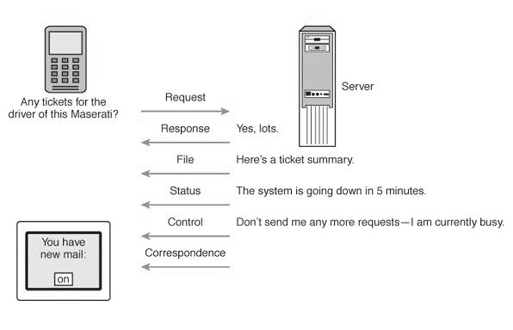
CS601-Data Communication
VU
MESSAGE
Information or Data to be communicated
Can be text, numbers, video or any combination of these
In short anything that can be represented using binary bits
Data Communication Messages
Files (meaningful collections of records)
Data/information requests (database queries, Web page requests, etc.)
Responses to requests and commands or error messages
Status messages (about the network’s functional status)
Control messages transmitted between network devices to control network traffic
Correspondence among network users
MESSAGE TYPES
❖ SENDER
SENDER
Device that sends the data message
Can be a Computer , Workstation, Video camera etc
As already discussed, the data from the sender might not be in the appropriate format for the transmission medium and will need to be processed
RECEIVER
Device that receives the message
Can be a computer, workstation, Television etc
At times, the data received from the transmission medium may not be in a proper form to be supplied to the receiver and it must be processed

Slide 8
CS601-Data Communication
VU
MEDIUM
Physical path that a message uses to travel from the Sender to the Receiver
Can be a Copper Cable (Telephone), Coaxial Cable (Cable TV), Fiber Optic Cable, LASERS or Radio Waves (Wireless Medium)
We will see that Data needs to be transferred in the form of ELECTROMAGNETIC signals and The Transmission Medium should be capable of carrying these EM Signals
Transmission Media
Transmission Media
Medium | Speed | Cost
Twisted Wire | 300bps-10Mbps | Low
Microwave | 256Kbps-100Mbps | Low
Coaxial Cable | 56Kbps-200Mbps | Low
Fiber Optic Cable | 500Kbps-10Gbps | High
PROTOCOL
Set of Rules Governing Communication
Represents an Agreement between communication devices
Without Protocol, two devices may be connected but they will not be able to communicate
EXAMPLE: Consider the communication between two individuals. They can only communicate provided they both speak the same language.
A little more complex Comm. System

Slide 9
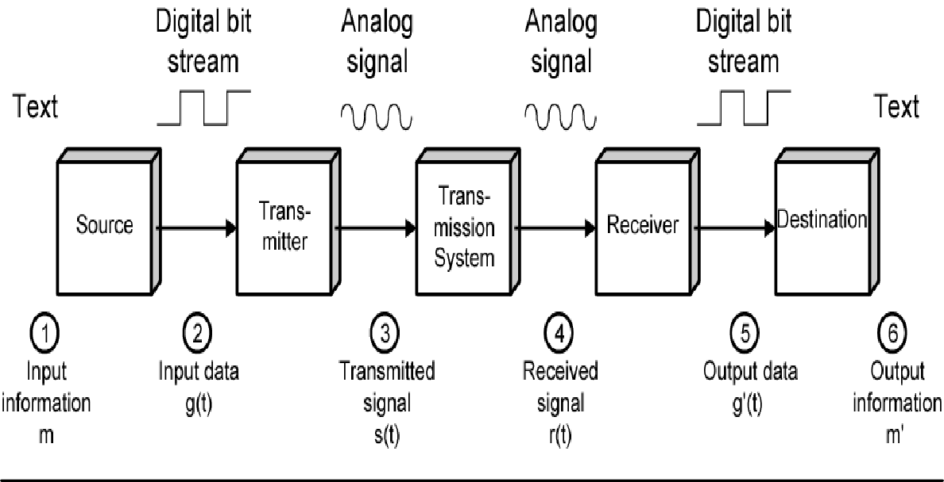
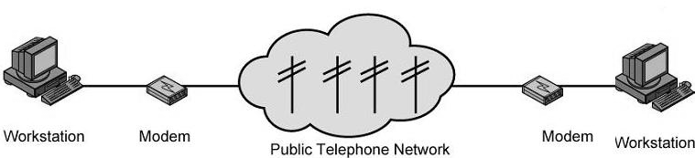
CS601-Data Communication
VU
EXAMPLE – ELECTRONIC MAIL
Explanation In Terms of a little more complex Comm. System
❖ SENDER SIDE
➢ Input device and transmitter are components of a Personal Computer
User of a PC wishes to send a message ‘m’
User activates electronic mail package e.g. hotmail
Enters the message via input device (keyboard)
Character string is buffered in main memory as a sequence of bits ‘g’
PC is connected to some trans system such as a Telephone Network via an I/O Transmitter like Modem
Transmitter converts incoming stream ‘g’ into a signal ‘s’
RECEIVER SIDE
The transmitted signal ‘s’ is subject to a number of impairments depending upon the medium
Therefore, received signal ‘r’ may differ from ‘s’.
Receiver attempts to estimate original ‘s’ based on its knowledge of the medium and received signal ‘r’
Receiver produces a bit stream g’(t)
Briefly buffered in the memory
Data is presented to the user via an output device like printer, screen etc.

Slide 10
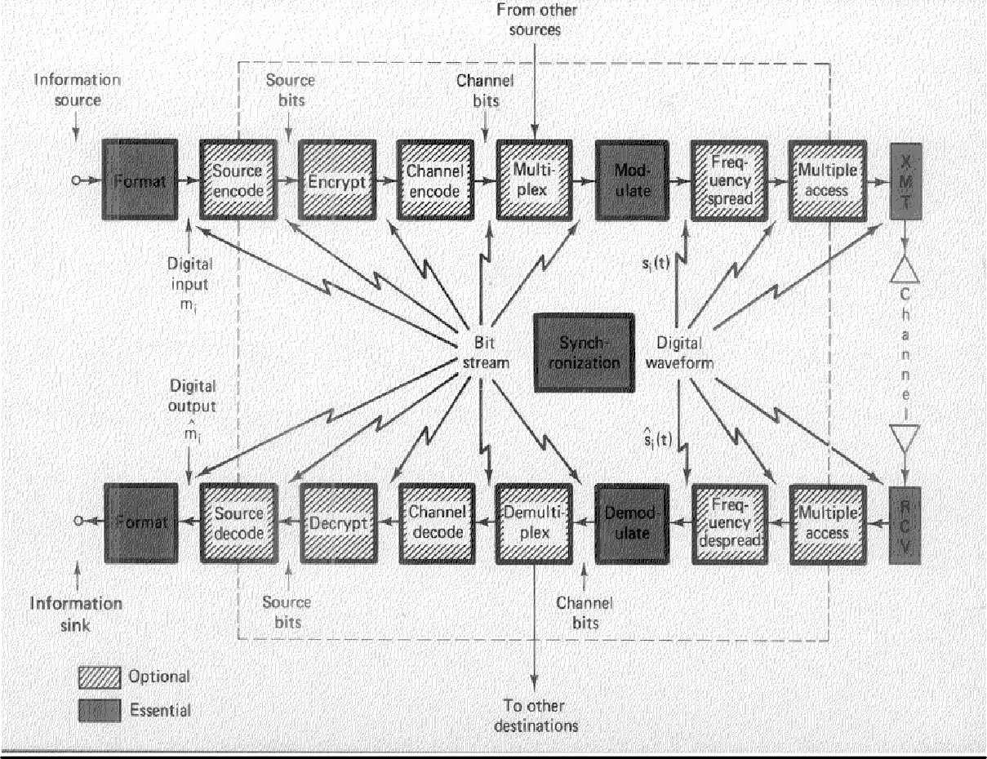
CS601-Data Communication
VU
The data viewed by user m’ will usually be an exact copy of the data sent ‘m’
EXAMPLE-Telephone System
Input to the Telephone is a message ‘m’ in the form of sound waves
The sound waves are converted by telephone into electric signals of the same frequency
These signals are transmitted w/o any modification over the telephone line
Hence g(t) and s(t) are identical
S(t) will suffer some distortion so that r(t) will not be the same as s(t)
o
R(t) is converted back to sound waves with no attempt of correction or improvement of signal quality
o Thus m’ is not an exact replica of m
An Actual Digital Data Communication System Key Data Communication Terminology
Session: communication dialog between network users or applications Different Types of this session for Info Exchange
Network: interconnected group of computers and communication devices We will look into it in a little bit
Node: a network-attached device Node can be any device in the network

Slide 11
CS601-Data Communication
VU
Summary
Data Communication
Brief History of Communication
Data Communication System
Key Data Communication Terminology
Reading Sections
Section 1.2, “Data Communications and Networking” 4th Edition by Behrouz A. Forouzan
Sections 1.1, 1.2, “Data and Computer Communication” 6th Edition by William Stallings

Slide 12
CS601-Data Communication
VU
LECTURE #2
KEY DATA COMMUNICATION TERMINOLOGY
Link: connects adjacent nodes
Wires, Cables, Any thing that physically connects two nodes
Path: end-to-end route within a network
Circuit: the conduit over which data travels
Packetizing: dividing messages into fixed-length packets prior to transmission over a network’s communication media
Routing: determining a message’s path from sending to receiving nodes
The transmission medium may itself be a network, so route needs to be specified
Network
“A NETWORK is a set of devices (Nodes) connected by Communication Links”
Node: Can be a Computer, Printer or any other device capable of sending or receiving
The links connecting Nodes are called COMMUNICATION CHANNELS Networks- Why we need them?
Networks- Why we need them?
It is often impractical for devices to be directly connected for two major reasons:
The devices are very far apart. They are expensive to connect just two devices with one in Lahore and other in Islamabad
Large set of devices would need impractical number of connections e .g. Telephone Lines in the world and all the computers owned by a single organization
Solution to the Problem=Networks
Solution is to connect all devices to a central system known as a NETWORK in which all terminals or computers share the links.
Two Main Classifications of the Networks

Slide 13
CS601-Data Communication
VU
LANS
WANS
DISTRIBUTED PROCESSING
Instead of a single large machine being responsible for all aspects of a process , each separate computer handles a subset of the task
Example – Project Given as a part of the Course
Example – Office Work
Advantages of Distributed Processing
Security
A system designer can limit the kind of interaction that a given user can have with the entire system.
For example : Bank’s ATM
Distributed Data bases
No one system need to provide storage capacity for the entire database
For example WWW gives user access to pages stored anywhere on Internet
Faster Problem Solving
Multiple computers working on a problem can solve a problem faster than a computer working alone
Security through Redundancy
Multiple computers running the same program provide security through redundancy
If one computer hardware breaks down then others cover up.
Collaborative Processing
Both multiple computers and multiple users can interact for a task
Network Criteria

Slide 14
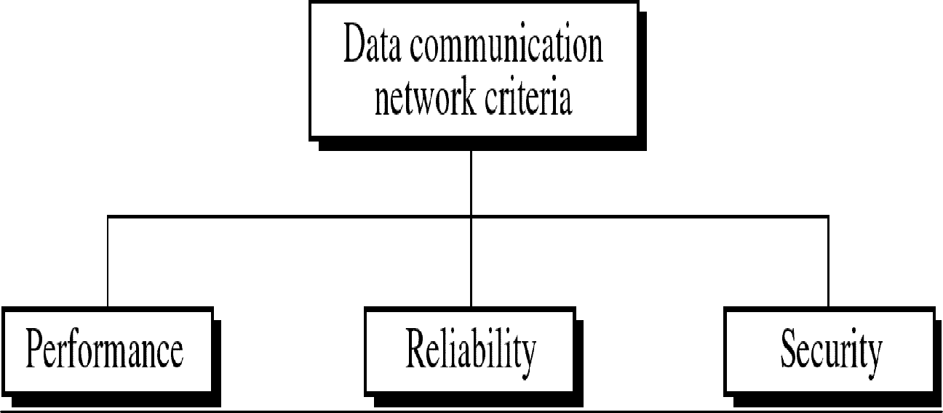
CS601-Data Communication
VU
Performance
Can be measured in many ways including Transit and Response Time
Depends on a no. of Factors:
Number of USERS
Type of Transmission Medium
Hardware
Software
Network Criteria
Number of USERS
Large Number of concurrent users slow network
Design of a network
Peak Load Periods
Network Criteria
Type of Transmission Medium
Medium defines speed at which data can travel
Fiber Optic Cable
100Mbps and 10 Mbps
Hardware
Software
Hardware
Effect speed and the capacity of transmission
Fast computer with large storage capacity
Software
Network Criteria
Software

Slide 15
CS601-Data Communication
VU
Software processes data at sender , receiver and intermediate nodes
All communication steps need software:
Moving message from node to node
Transforming,
Processing at the sender and receiver
Error Free Delivery
Well designed software can speed up the process
Reliability
Depends on a no. of Factors:
Frequency of Failure
Recovery Time of a Network after Failure
Catastrophe
Fire , Earthquake or Theft
Security
Unauthorized Access
Sensitive data
Protection at multiple levels:
Lower level: Passwords and user ID codes
Upper Level: Encryption
Viruses
Network Applications
Marketing and Sales
Marketing
Collect, exchange and analyze data relating to the customers needs
Product development cycles
Sales
Tele shopping,
On line reservation systems
Financial Services
Online Banking
Foreign Exchange Transfers
Rates
Manufacturing

Slide 16
CS601-Data Communication
VU
Computer Aided Design
Computer Assisted Manufacturing
Network Applications
Electronic Messaging
Teleconferencing
Conferences to occur w/o participants at the same place
Chat
Voice Conferencing
Video Conferencing
Cable Television
Summary
Key Data Communication Terminology
Networks and why we need them?
Distributed Processing
Network Criteria
Network Applications
Reading Sections
Section 1.3, “Data Communications and Networking” 4th Edition by Behrouz A. Forouzan
Sections 1.3, “Data and Computer Communication” 6th Edition by William Stallings

Slide 17
CS601-Data Communication
VU
LECTURE #3
Communication Tasks
There are some key tasks that must be performed in a data communication system Elements can be added, deleted, or merged together
Transmission System utilization | Interfacing
Signal Generation | Synchronization
Exchange Management | Error Detection and Correction
Flow Control | Addressing
Routing | Recovery
Security | Network Management
Transmission System Utilization
Need to make efficient use of Transmission facilities that are shared among a no. of communicating devices
For Example:
Techniques like Multiplexing to allow multiple users to share total capacity of a Transmission Medium
Congestion Control: TX. System should not be overwhelmed by traffic
Interfacing
A device must have an Interface with the Transmission System/Transmission Medium
Signal Generation
Electromagnetic Signals travel over Transmission Medium. Once an interface is established, Signal generation is required
Properties of Signals
Capable of being propagated over TX. Medium
Interpretable as data at the Receiver
Synchronization
The transmission and the reception should be properly synchronized. Synchronization means that the receiver must be able to determine, when to

Slide 18
CS601-Data Communication
VU
expect a new transmission and when to send acknowledgements. In other words transmitter and receiver should have an agreement on the nature as well as timing of the signals
Exchange Management
If the data needs to be exchanged in both directions over a period of time, both parties must cooperate as follows
Whether both devices must transmit simultaneously or take turns
Amount of Data to be sent at one time
Format f the Data
What to do when an Error Arises
Error Detection and Correction
In all comm. Systems, there is a potential risk for errors and impairments.
Tx. Signals are distorted to some extent before reaching their destination. Error Detection & Correction needs to be employed in Data Processing Systems where a change in say the contents of a file cannot be tolerated
Flow Control
To make sure that source does not overwhelm destination by sending data faster than it can be handled and processed
Addressing & Routing
If TX facility is shared by two or more devices, source must specify the identity or the address of the destination system and if Tx. System is itself a system, a proper route must be allocated that the data will take in order to reach the desired destination
Recovery
If a data transmission is interrupted due to a fault somewhere in the system, recovery techniques are needed. The objective is either to resume activity at the point of interruption and to restore the state of the system to what it was prior to the interruption
Security
Security is very important issue in a Data Communication System. The sender needs to be assured that
Only the Intended receiver receives the data
Data is delivered unaltered
Introduction to Protocol
In computer Networks, communication occurs between two entities in different systems.
Entity is anything sending and receiving information
SYSTEM is a physical object containing more than one entities

Slide 19
CS601-Data Communication VU
Now, two entities in different systems cannot just send data and expect to be understood. For communication to occur, these entities must agree on a PROTOCOL
PROTOCOLS
As discussed earlier, “Protocol is a set of rules governing communication”
Two computers cannot just send bit streams to each other and expect to be understood
Entities must agree on a PROTOCOL
Same Example French and German
Protocol defines:
What is Communicated?
How it is Communicated?
When it is Communicated?
KEY elements of a PROTOCOL
Syntax:
Represents the Structure or the format of the Data
Meaning the order in which data is presented
For Example
First eight bits to be Sender address
Next eight to be Receiver’s Address
The Rest to be Data
Semantics:
Refer to the Meaning of each section of bits
How is a particular pattern to be interpreted?
What action should be taken based on interpretation?
For Example
Does an address identify the route to be taken or the final destination of the message?
Timing
Refers to 2 characteristics:
When data should be sent?
How fast it should be sent?
For Example
If sender produces data at 100 Mbps
But Receiver can only process data at 1 Mbps
The TX. will overload receiver and data will be lost

Slide 20
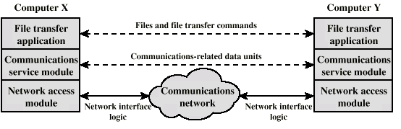
CS601-Data Communication
VU
Protocol Architecture
Instead of having a single Module for performing communication, there is a structured set of modules that implement communications function”
This structure is called Protocol Architecture
Let’s explain it by an example of File transfer system.
Simplified File Transfer Architecture
•
In the above example File transfer could use three modules
File transfer application
Communication service module
Network access module
File transfer application
File Transfer contains all of the logic is unique to the file transfer application such as:
Transmitting passwords
File Commands
Checking File System on other machine if it is ready
Check File System Compatibility
File records
Communication service module
Instead of allowing File Transfer Module to deal with actual transfer of data and commands, we can have a separate module for this transfer. This module must make sure that the receiver system is ready to receive and look into the reliable exchange of data
Network access module
Nature of the exchange between systems is independent of the network that connects them. That allows us to have a 3rd module that handles the details of the Network interface and interacts with the network. If Network to be used changes, only Network access Module has to change

Slide 21
CS601-Data Communication
VU
Characteristics of a Protocol
Direct or indirect
Monolithic or structured
Symmetric or asymmetric
Standard or nonstandard
Direct
Systems share a point to point link or
Data can pass without intervening active agent
Simple Protocol
Indirect
Switched networks or
Interne works or internets
Data transfer depend on other entities
Complex Protocol
Monolithic or Structured
Communications is a complex task
To complex for single unit
Structured design breaks down problem into smaller units
Layered structure
Symmetric or Asymmetric Symmetric
Communication between peer entities
Asymmetric
Client/server
Standard or Nonstandard
Nonstandard protocols built for specific computers and tasks
Summary
Communication Tasks
Protocols
Protocol Architecture
Characteristics of a Protocol
Reading Sections
Section 1.4 “Data Communications and Networking” 4th Edition by Behrouz A. Forouzan
Sections 1.1,2.1 “Data and Computer Communication” 6th Edition by William Stallings

Slide 22
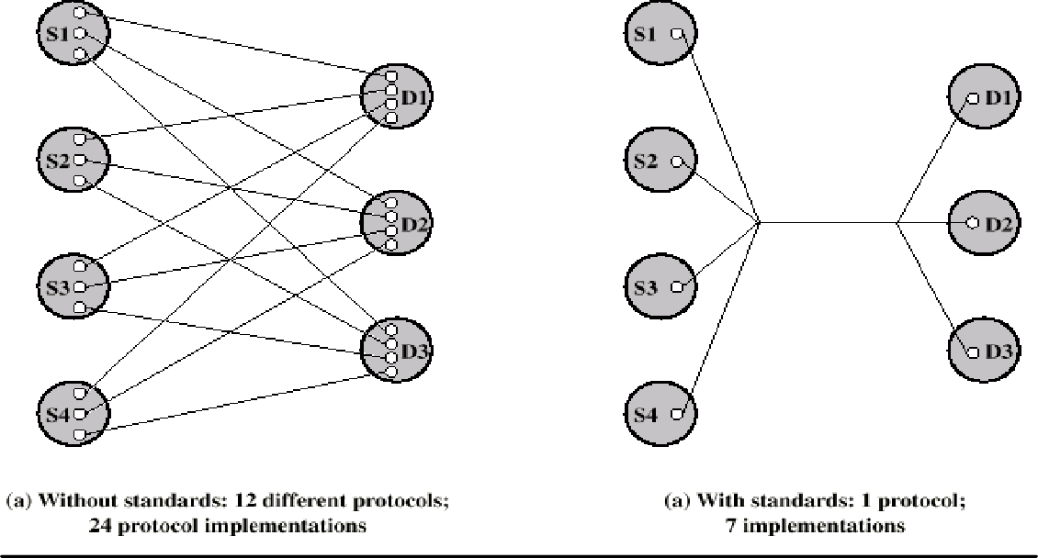
CS601-Data Communication
VU
LECTURE #4
Standards
“A standard provides a model for development that makes it possible for a product to work regardless of the individual manufacturer|”
A great deal of coordination and cooperation is required by the devices to communicate
A device prepared by a specific manufacturer may not be compatible with the devices prepared by other manufacturers
Unavailability of standards creates problems and puts a halt to product growth
An example of non-standardized products is AUTOMOBILES
Why Standards are Essential?
Standards are therefore essential in:
o Creating and Maintaining an Open and competitive Market Manufacturers
for Equipment of Data and
o Guaranteeing National and International Interoperability
Telecommunications Technology and Equipment
Let us understand this using an EXAMPLE
NOTE
K sources and L receivers leads to K*L protocols and 2*K*L implementations
If common protocol used, K + L implementations needed

Slide 23
CS601-Data Communication
VU
Categories of Data Communication Standards
Standards
De jure (By Law)
De facto (By Fact)
Proprietary
Non Proprietary
De facto (By fact or By Convention)
Standards not approved by an organized body but have been adopted as standards through their widespread use
De jure (By Law or By Regulation)
Standards that have been legislated by an officially recognized regulation body Subdivision of De Facto Standards
PROPRIETARY (Closed Standards)
Standards that are originally invented by a Commercial Organization as a basis for the operation of its products they are wholly owned by that company. They are also called Closed Standards because they close off Communication between systems
NON- PROPRIETARY (Open Standards)
They are originally developed by groups or committees that have passed them into public domains. They are also called Open Standards because they open Communication between different systems
Standard Organizations
Standards are developed mainly by 3 entities:
Standard Creation Committees
Forums
Regulatory Agencies

Slide 24
CS601-Data Communication
VU
Standard Creation Committees
They are Procedural Bodies and they are so slow moving and cannot co-op with the fast growing communication industry.
ISO
International Standard’s Organization
Voluntary Organization
Created in 1947
Members are from Standard Creation Committees of different countries
Includes representatives from 82 countries
Open System Interconnection (OSI) Model
ITU-T
By 1970s a lot of countries were defining standards but there was no International compatibility
United Nations made as a part of their ITU
Consultative Committee for International Telegraphy and Telephony (CCITT)
IN 1993 , ITU-Telecomm Standards Sector
Important ITU-T Standards
V Series (V32, V33, V42, Define Data Transmission over phone lines
X Series(X.25, 400, 500): Define Transmission over Public Digital Network
ISDN: Integrated Services Digital Network
The American National Standard Institute (ANSI)
Private-Non Profit Cooperation not affiliated with US Government
Members include professional societies, industrial associations, govt. and regulatory bodies
Submits proposal to ITU-T and is a voting member for USA in ISO
The Institute of Electrical and Electronics Engineers (IEEE)
Largest professional engineering society in the world
Also oversees the development of Telecommunication and Wireless International Standards
Special committee for LANS out of which emerged Project 802 (802.3, 802.4, 802.5)
Forums
Special Interest Groups with representatives from interested corporations they facilitate and fasten standardization process by working with universities, and users to test, evaluate and standardize new technologies

Slide 25
CS601-Data Communication
VU
Each Forum Concentrate on a specific technology and present their conclusions to the standard bodies
Frame Relay Forum
ATM Forum
Internet Society & IETF
Regulatory Agencies
All communication technology is subject to regulation and laws by government agencies. The purpose is to protect Public Interest by regulating Radio, Television and Cable Communications.
FCC
Before we go into the details of how data are transmitted from one device to the other, it is important to understand:
The relationship between communication devices.
How the devices connect with each other in a System?
How do they do the exchange of information?
Five Concepts provide the basis
Line Configuration
Topology
Transmission Mode
Categories of networks
Internetworks
LINE CONFIGURATION
“Line Configuration refers to the way two or more devices attach to a Link”
A link is the physical communication path that transfers data from one device to the other. Link can be thought of as a Line drawn between two points. For communication to occur, two devices must be connected to each other using a link.
Line Configurations

Slide 26
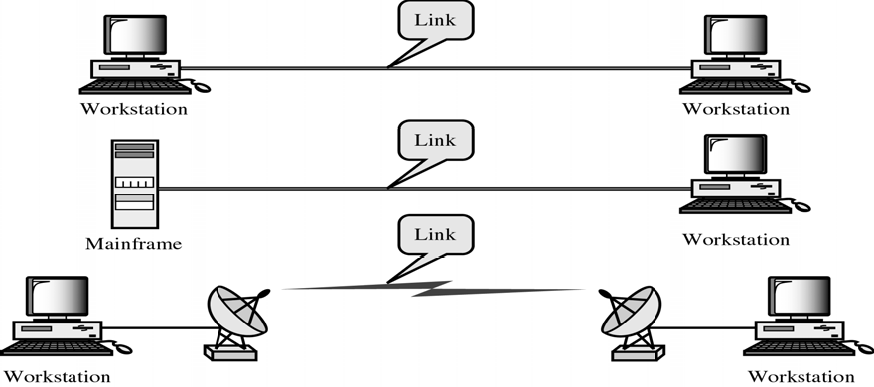
CS601-Data Communication
VU
Line Configuration
Point-to-Point
Multipoint
Spatially Shared
Time Shared
Point-to-Point Line Configuration
Dedicated Link between two devices. Entire Capacity of the channel is reserved for TX B/w these two devices. Mostly point-to-point connection use wire/cable to connect with each other. But Microwave, Satellite Links can also be used
Data and Control information pas directly between entities with no intervening agent
Examples:
TV Remote Control and TV Control Systems
Mobile Phone (when talking) and Base Station (Antenna)
Multipoint Line Configuration
More than two devices share the Link that is the capacity of the channel is SHARED now. With shared capacity, there can be two possibilities in a Multipoint Line Config:
Spatial Sharing: If several devices can share the link simultaneously, its called Spatially shared line configuration

Slide 27
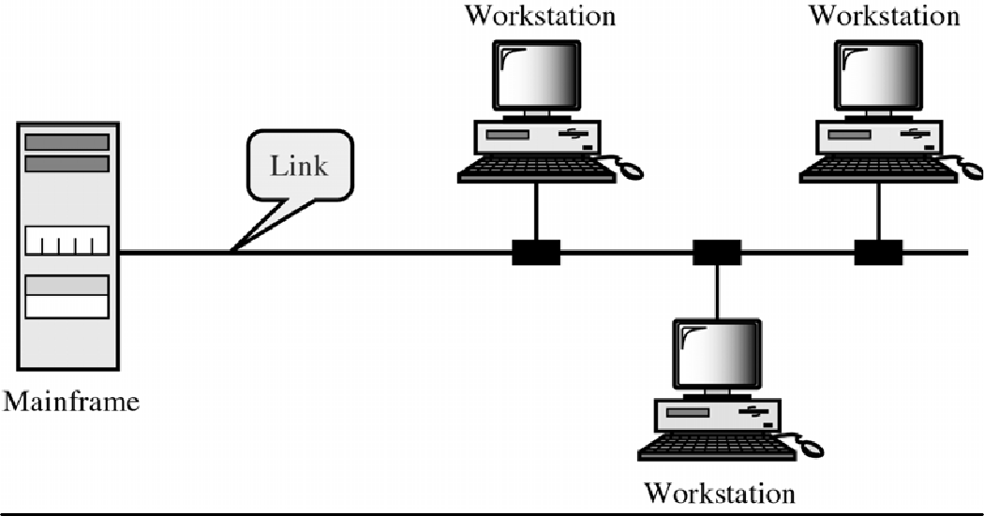
CS601-Data Communication
VU
Temporal (Time) Sharing: If users must take turns using the link , then its called Temporally shared or Time Shared Line Configuration
Summary
Standards
Standard Organizations
Line Configuration
Categories of Line Configuration
Reading Sections
Section 1.5,2.1 “Data Communications and Networking” 4th Edition by Behrouz
Forouzan

Slide 28

CS601-Data Communication
VU
LECTURE #5
TOPOLOGY
“The Topology is the geometric representation of the relationship of the links and the linking devices (Nodes) in a Network”
Or
“Topology defines the physical or the Logical Agreement of Links in a Network”
Topology of a Network is suggestive of how a network is laid out. It refers to the specific configuration and structure of the connections between the Links and the Nodes. Two or more devices connect to a Link and two or more Links form a Topology
Categories of TOPOLOGY
Topology
Mesh
Star
Tree
Bus
Ring
Question: What to consider when choosing a Topology????????
Answer: Relative status of the devices to be linked.
Two relationships are possible in a network
PEER-TO-PEER: Devices share the link equally
PRIMARY-SECONDARY: One device controls traffic and the others must transmit through it

Slide 29
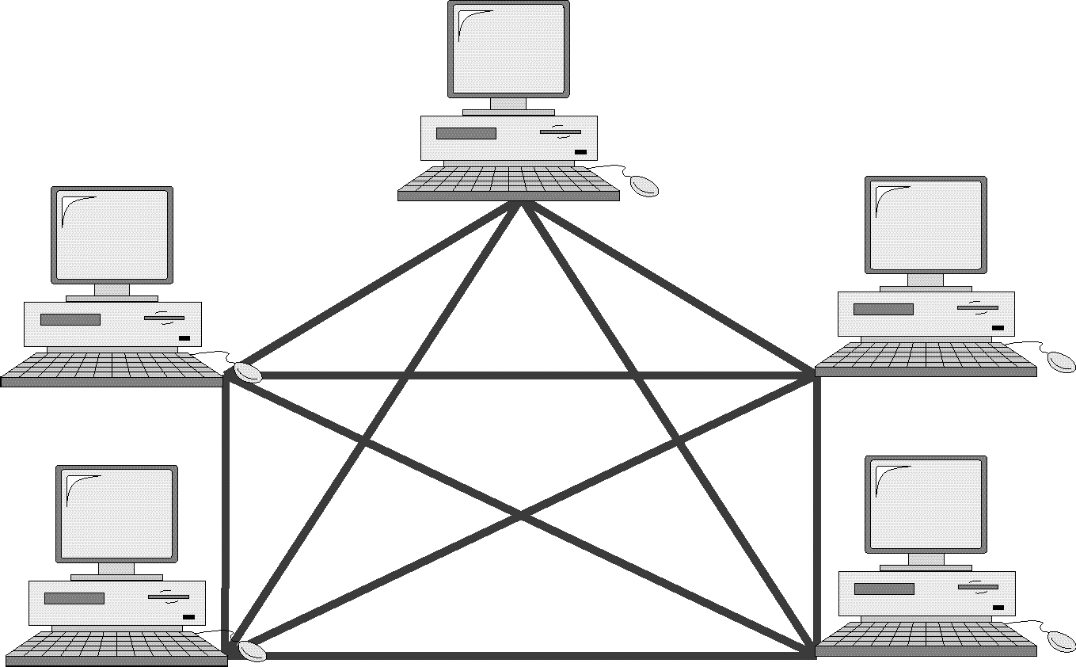
CS601-Data Communication
VU
MESH TOPOLOGY
Every device has dedicated a point-to-point link to every other device
Dedicated: Means that the link carries traffic only between these two devices
o Each device must have
n −1
I/O Ports
_{n(n −1)/2} link in the system
In figure above, we have 5 Nodes, therefore:
✓ No. of Links= 5(5-1)/2 = 10
No. of I/O Ports= 5-1 = 4
This increase exponentially with increase in No. of Nodes
e.g. for 6 nodes = 15 Links
7 Nodes=21 Links
Advantages of Mesh Topology
Use of Dedicated links guarantees that each connection can carry its own load. This eliminates Traffic Problems as in case of Shared Link
Mesh Topology is robust. If one link fails, it does not effect other links
Security & Privacy due to dedicated links
Point – to –Point links make Fault Identification easy
Disadvantages of Mesh Topology
Amount of Cabling
Makes Installation & Reconfiguration difficult
Sheer bulk of wiring can be greater than the available space
Number of I/O Ports Required
Hardware required to connect each link can be prohibitively expensive

Slide 30
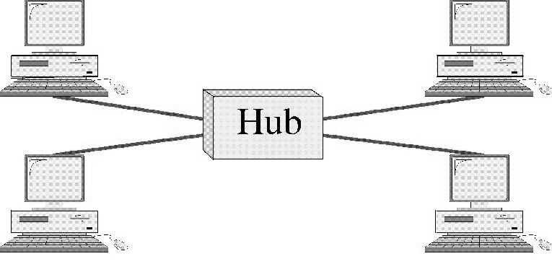
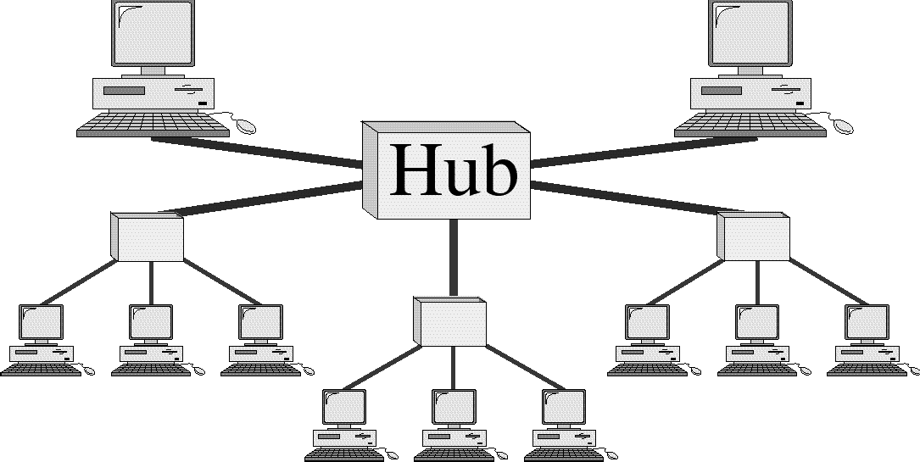
CS601-Data Communication
VU
Therefore, Mesh topology has limited use
Star Topology
Each device has a dedicated point-to-point link to a central controller ( Hub)
Devices are not directly connected to each other
Controller (Hub) acts as an exchange
If one device wants to send data to the other, it sends the data to the controller , which then relays it to the other connected device
Advantages of Star Topology
Less Cabling
Less Expensive than Mesh as each device need sonly one link and one I./O Port
Easy to Install and Reconfigure
Robust, if a link fails , only that link fails
Easy Fault Detection
Disadvantages of Star Topology
Although Cabling required is far less than Mesh
Still each node must be connected to a Hub , so Cabling is still much more than some other Topologies
Tree Topology
o A variation of Star Topology
30

Slide 31
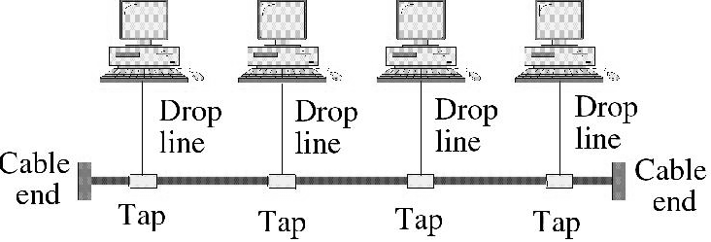
CS601-Data Communication
VU
Nodes in a Tree are linked to a central hub that controls the traffic to and from network
Difference b/w star and tree is not all the devices plug directly into the central HUB
Majority connects to secondary hub that is connected to central hub
CENTRAL HUB in Tree Topology
Central Hub in a Tree is an ACTIVE HUB
ACTIVE HUB contains a repeater
Repeater is a hardware device that regenerates the received bit pattern before sending them out.
Repeater strengthens TX. And increases the distance a signal can travel
Secondary HUB in Tree Topology
Secondary Hub in a Tree may be Active or Passive HUB
Passive Hub simply provides physical connection between attached devices
Advantages of Tree Topology
Because of Secondary Hub, More devices can be attached to a Central Hub and therefore increase the distance a signal can travel
Enables Differentiated Services: Allows to prioritize communication, e.g. computers attached to one secondary hub can be given priority over others
Therefore, TIME SENSITIVE data will not have to wait for access to the network
Rest of the advantages are almost the same as STAR
Example Tree Topology: Cable TV
CABLE TV
–Main cable from main office is divided into many branches and each branch is divided into smaller branches and so on
–Hubs are used when cable is divided
BUS TOPOLOGY
o All the previous topologies describe Point-to-point communication
o Bus Topology is Multipoint
o One long cable acts as a BACKBONE to link all devices in the network

Slide 32
CS601-Data Communication VU
Drop Lines and Taps
Drop Line is the connection between device and the main cable (Backbone)
Tap is a connector that;
Splices into the main cable or
Punctures the sheathing of a cable to create connection with the metallic core
Signal degrades as it travels, therefore there is a limit on:
The number of Taps a Bus can support and
The distance between those Taps
Advantages of BUS TOPOLOGY
Easy to install
Backbone can be laid on the most efficient path and then rest of the nodes can be connected using Drop Lines
Less cabling than Mesh , Star or Tree
Disadvantages of BUS Topology
Difficult Reconfiguration
Difficult to add new devices
adding new devices may require modification of backbone
No Fault Isolation
A fault or break in backbone can disable communication even on the same side of the problem
Damaged area reflects signals back in the direction of origin creating Noise in both directions
Summary
Topology
Categories of Topologies
Reading Sections
Section 2.2 “Data Communications and Networking” 4th Edition by Behrouz A. Forouzan

Slide 33
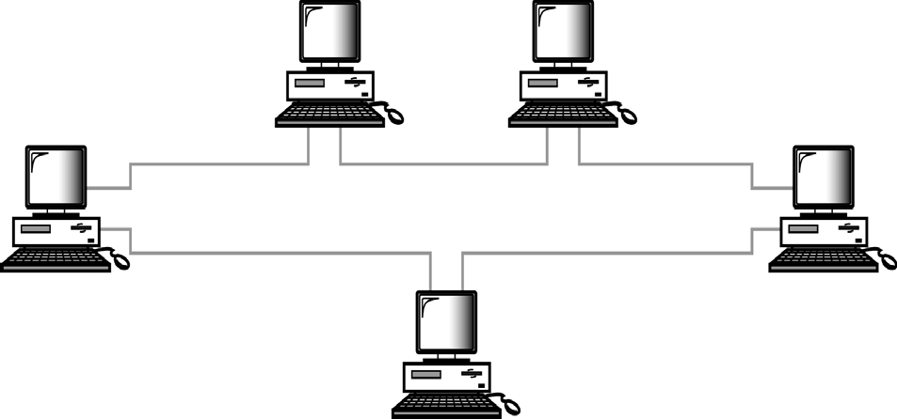
CS601-Data Communication
VU
LECTURE #6
Ring Topology
Ring Topology Diagram
Each device has point-to-point dedicated link with only two devices on either side
A signal is passed in the ring in one direction from device to device until it reaches its destination
Each device has a repeater incorporated
When a device receives a signal destined for another device, it regenerates the bits and pass them along
Advantages of Ring Topology
Easy to Install and Reconfigure
Only two connections to be moved to add or delete a device
SIMPLE Fault Isolation
Generally a signal is circulating at all times in a ring.
If one device does not receive a signal within a specified period, it can issue an alarm to tell network operator about the problem and its location
Disadvantages of Ring Topology
Unidirectional Traffic
A break in a ring I.e. a disabled station can disable the entire network
Can be solved by using:

Slide 34
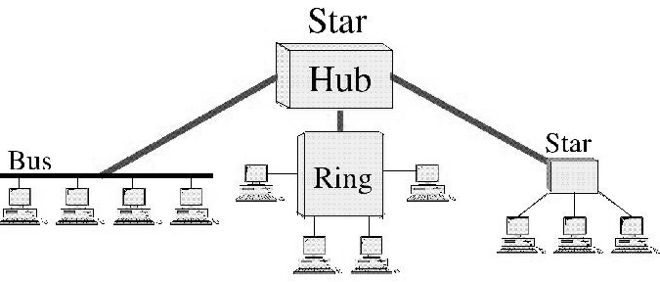
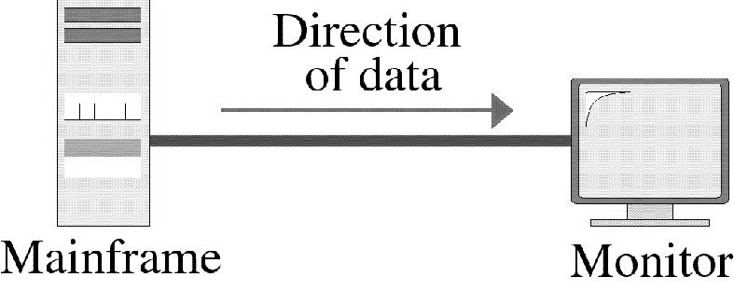
CS601-Data Communication
VU
Dual Ring or
A switch capable of closing off the Break
Hybrid Topologies
Hybrid Topologies
Several topologies combined in a larger topology
Example: One department of a business may have decided to use a Bus while other has a Ring
The two can be connected via a Central Controller in Star Topology
TRANSMISSION MODE
“Transmission Mode is used to define the direction of the signal flow between the linked
devices”
Transmission Modes
Simplex
Half-Duplex
Full-Duplex
SIMPLEX MODE
© Copyright Virtual University of Pakistan 34

Slide 35
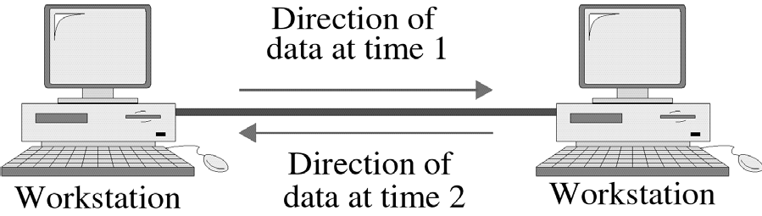
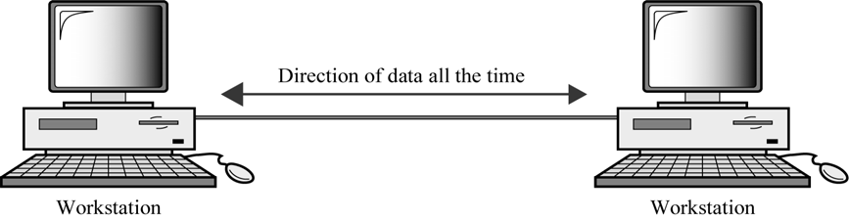
CS601-Data Communication
VU
Communication is Unidirectional
Only one of the two stations can transmit
Other can only receive
Examples: KEYBOARDS (Only Input), Monitors (Only Output)
Half – Duplex Mode
Each station can both transmit and receive but not at the same time
When one device is sending the other can only receive and vice versa
Lets understand the concept by using an example
One Lane Road with two directional traffic
When cars are traveling in one direction, cars going the other way must wait
Full Channel capacity is allocated to whatever entity that is transmitting at a specific time
Walkie Talkies
Full Duplex (Duplex)
Both stations can transmit and receive simultaneously
Two way street with traffic flowing in both directions at the same time
Signals traveling in either direction share the capacity of the link
o The sharing can take place in two ways:
© Copyright Virtual University of Pakistan
35

Slide 36
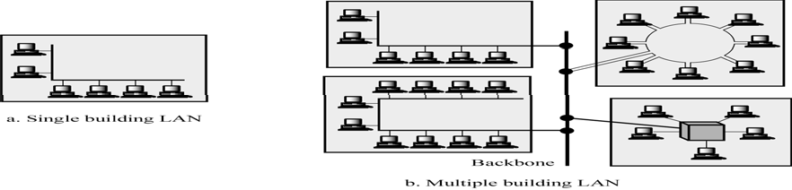
CS601-Data Communication
VU
Either the link must contain two physically separate transmission paths:
One for sending and
One for receiving
Capacity of the channel is divided between signals traveling in opposite directions
EXAMPLE
–Telephone Network
When two people are communicating via a telephone line, both can talk and listen at the same time
Categories of Networks
There are three main categories of Networks:
LANS
WANS
MANS
Into which category a network falls is determined by its SIZE, OWNERSHIP, DISTANCE IT COVERS, and its PHYSICAL ARCHITECTURE
LANS
A LAN is usually Privately owned and Links the devices in a single office, Building or a campus
Two Implications
Care must be taken in choice of a LAN, because there may be a substantial capital investment for purchase and maintenance.
Secondly, the network management responsibility falls solely on the user/company
Size of a LAN
Size of a LAN depends upon the Needs of Organization and the Type of Technology
LAN can be as simple as two PCs and a printer in someone’s home office or it can extend throughout a company and include complex equipment too
Currently LAN size is limited to a few kilometers
o Design of a LAN
36

Slide 37
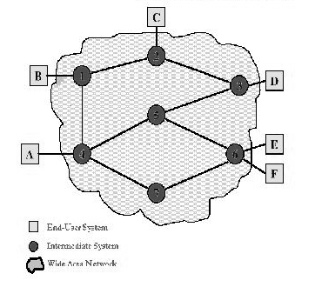
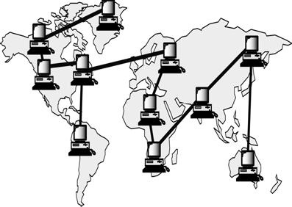
CS601-Data Communication VU
LANs are designed to allow resources to be shared between personal computers or workstations
The resources to be shared can include hardware (printer), software (an application program) or data.
Example of a LAN
A common example of a LAN found in many business environments links a work group of task related computers, for example engineering workstations or Accounting PCs. One of the PCs may be given a large capacity disk and becomes a server to others. Software stored on the server and is used by the whole group. In this case size is determined by software licenses
Transmission Media & Topology
In addition to size, LANs are distinguished from other types of networks by Transmission media and topology
In general a given LAN will use only one type of Transmission medium
The most common LAN topology Bus, Star Ring
Data Rates in a LAN
Traditionally 4 – 16 Mbps
Speeds increased and now 100Mbps and above are also possible
Giga Bit LAN technologies
WANs
Generally cover a large geographical area and it usually span an Unlimited number of miles by utilizing Public or Leased networks instead of having their own hardware as in the case of LANs
Design of a WAN
Typically , it consists of a large number of Switching Nodes
Transmission from any one device is routed through these internal nodes to the specified destination device
These nodes are not concerned with the content of the data, rather their purpose is to provide a switching facility that will move the data from node to node until it reaches its destination
How to Implement a WAN?
Traditionally WAN s have been implemented using one of the 2 technologies:
–Circuit Switching
–Packet Switching
Frame Relay and ATM Networks play important role nowadays too
37

Slide 38
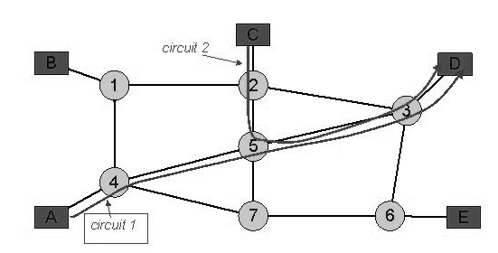
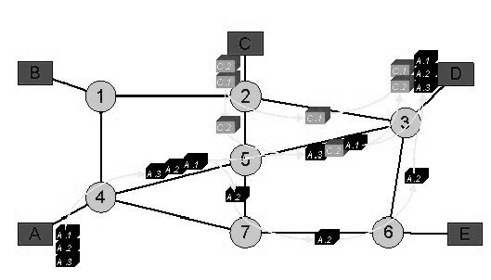
CS601-Data Communication
VU
Circuit Switching
A dedicated communication path is established between two stations through the nodes of the network
This path/CAPACITY stays up for the duration of the communication Example is Telephone Network
Packet Switching
No capacity is dedicated along a path through the network
Data Is sent out in small chunks called “Packets”
Each path is passed from node to node
At each node, entire packet is received, stored briefly and then transmitted to the next node.
Example is : Computer to Computer Communication
Frame Relay & ATM
Overhead bits for Error Protection are removed
10’s of 100’s of Mbps and also Gbps is possible
Summary
The OSI Model
Layered Architecture
Encapsulation and Decapsulation
Physical Layer
Data Link Layer
Reading Sections
Section 2.4,2.5, “Data Communications and Networking” 4th Edition by Behrouz
Forouzan
Sections 1.3, “Data and Computer Communication” 6th Edition by William Stallings

Slide 39
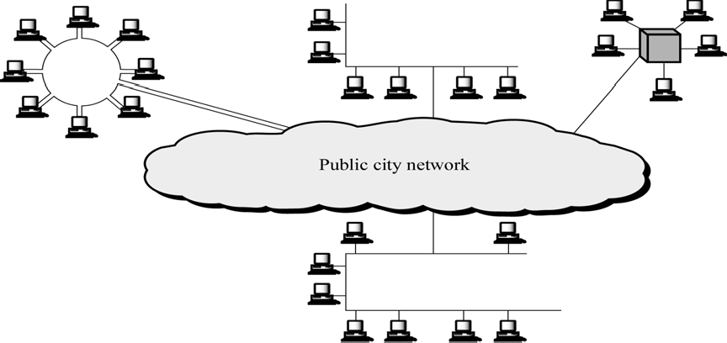
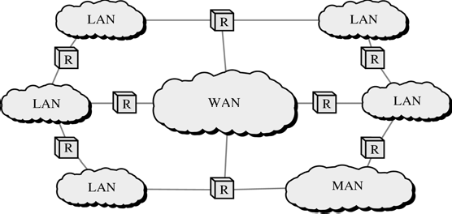
CS601-Data Communication
VU
LECTURE # 7
Metropolitan Area Networks
o Designed to extend over an entire city
It may be a single network e.g. Cable TV Network
Or
Interconnection of a No. of LANs into a larger network
Example: A company can use a MAN to connect the LANs in all of its offices throughout a city
Internetworks
When two or more networks are connected they become an internetwork or internet
Individual networks are joined together by the use of Internetworking Devices like Routers, Gateways etc.
internet: Combination of Networks
Internet: Specific World wide Network
The OSI MODEL
International Standards Organization (ISO) 1947
Multinational body dedicated to worldwide agreement on International Standards

Slide 40
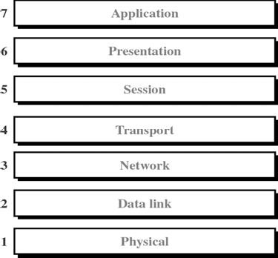
CS601-Data Communication VU
An ISO Standard that covers all aspects of Network Communication is Open System Interconnection Model (OSI)
Open System: A model that allows two different systems to communicate regardless
of their underlying network
Vendor –Specific Models close off communication
Purpose of the OSI MODEL
Open Communication between different systems without requiring changes to the underlying hardware and software.
OSI Model is not a Protocol. It is a model for understanding and designing a network architecture that is flexible, robust and interoperable
Definition of the OSI MODEL
A layered framework for the design of network systems that allows communication across all types of computer systems regardless of their underlying architecture
Layers of the OSI Model
Physical (Bits)
Data Link (Frames)
Network (Packets)
Transport (Segment)
Session (Dialog units)
Presentation (Raw Data)
Application (Text, Numbers)
Please Do not Touch Steve’s Pet Alligator
40

Slide 41
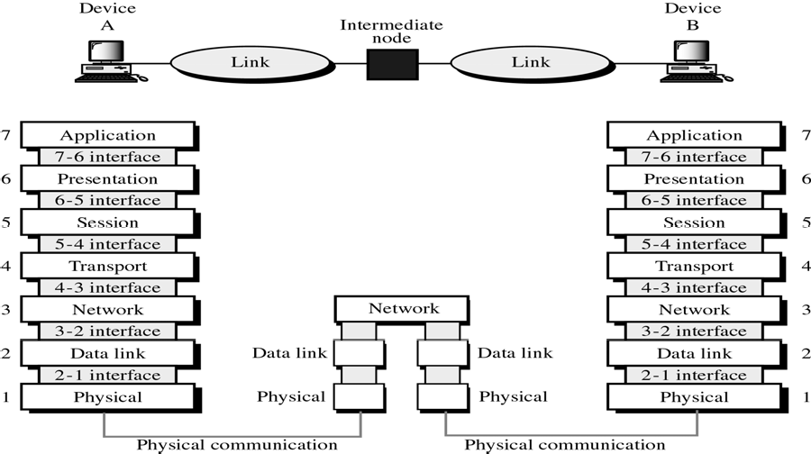
CS601-Data Communication
VU
What happen when a message travels from device A to Device B?
As the message travels from A to B , it may pas through many intermediate “Nodes”
These nodes usually involve only the first three layers of the OSI Model
In developing the OSI model, designers identified which networking functions had related uses and collected those functions into discrete groups that became the layers
Each layer defines a family of functions distinct from other layers
By defining and localizing functionality in this fashion , the designers created an architecture that is both comprehensive and flexible
The OSI model allows complete transparency b/w otherwise incompatible systems
Peer-to-Peer Processes
Within a single machine, each layer provides services to the layer above it and all upon the services from the layer below it.
For example Layer 3
Between machines, layer x on one machine communicates with layer x on the other machine.
The communication is governed by Protocols
The processes on each m/c that communicate at a given layer are called Peer –to peer processes
Headers and trailers
Control data added to a data parcel
Sender appends header and passes it to the lower layer
Receiver removes header and passes it to upper layer
Headers are added at layer 6,5,4,3,2. Trailer is added at layer 2

Slide 42
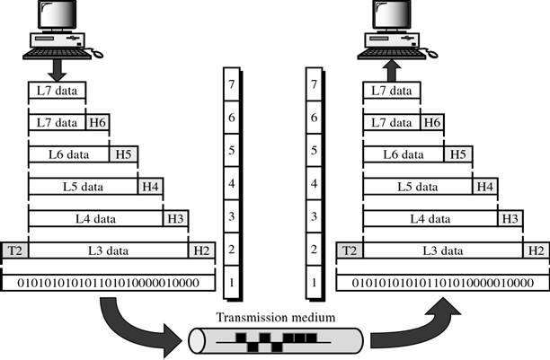
CS601-Data Communication
VU
Passing of data and network information down through the layers of sending machine AND Back up through the layers of the receiving machine is made possible by an
INTERFACE
Each interface defines what information and services a layer must provide for the layer above it
Interface provides MODULARITY
Each layer works as a separate module
Any modification or replacements can be made without changes in surrounding layers
Organization of Layers
Network Support Layers
–Deals with the Physical aspect of moving data from one device to another
–Layers 1, 2, 3
User Support Layers
–Allows interoperability among unrelated software systems
–Layers 5, 6, 7
Organization of Layers
Layer 4
–Ensures end-to-end reliable transmission
Upper OSI Layers always implemented in Software
Lower Layers are a combination of software and hardware
Physical layer is mostly Hardware
The OSI Model

Slide 43
CS601-Data Communication
VU
Summary
Categories of Networks (MANs)
Internetworks
The OSI Model
Reading Sections
Section 2.5, 3.1, 3.2 “Data Communications and Networking” 4th Edition by Behrouz A. Forouzan

Slide 44
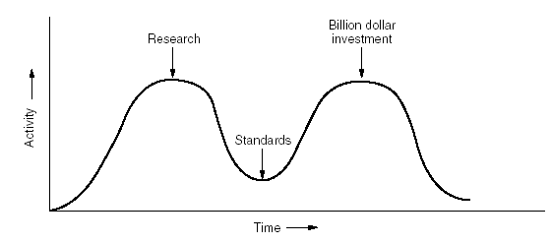
CS601-Data Communication
VU
LECTURE # 8
Critique of OSI Model
Reasoning for OSI not getting Widespread
Bad Timing(slide) (Apocalypse of Two Elephants)
–David Clarke of MIT
–If standards are written too early: subject is badly understood and bad standards
–If standards are written too late so many companies may have already made investments in doing the same thing with different other ways
Bad Technology
–Flow control, error control, addressing is multiple
–Session and Presentation(EMPTY), Network and DL(Full)
Bad Implementations
Apocalypse of Two Elephants
Physical (Layer 1)
Coordinates the functions required to transmit a bit stream over a physical medium
Deals with mechanical and electrical specifications of Tx. Medium and Interface
Also defines procedures and functions that physical devices and interfaces need to perform for TX. To occur (Figure)

Slide 45
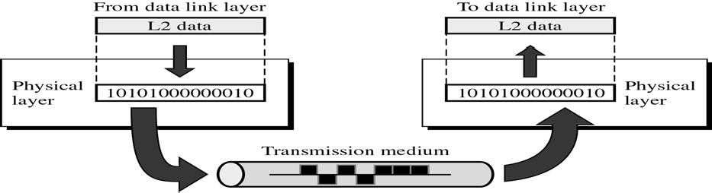
CS601-Data Communication
VU
Figure
Functions of Physical Layer
Physical Characteristics of Interface & Media
Defines characteristics of Interface b/w device and Tx Medium
Interface is a plug gable connector that joins one or more signal conductors
Also defines the type of transmission medium
Representation of Bits/Encoding
The physical layer data consists of a stream of bits (sequence of 1’s and 0’s)
To be transmitted the bits must be ENCODED into signals: Electrical or Optical
Physical layer decides the type of ENCODING
Data Rate / Transmission Rate
Date Rate ( Bits per second) also decided by the Physical Layer
So , Physical layer defines the Duration of a Bit
Means how long will a bit last
Synchronization of Bits
Sender and Receiver must be synchronized at the bit level
Sender and Receiver clocks must be synchronized
It is done by Physical layer
Line Configuration
Physical Layer is also concerned with Line Configuration
Line Configuration represents the connection of device with the Medium
Point-To-Point or Multipoint
Physical Topology
Mesh, Star, Ring, Bus etc.

Slide 46
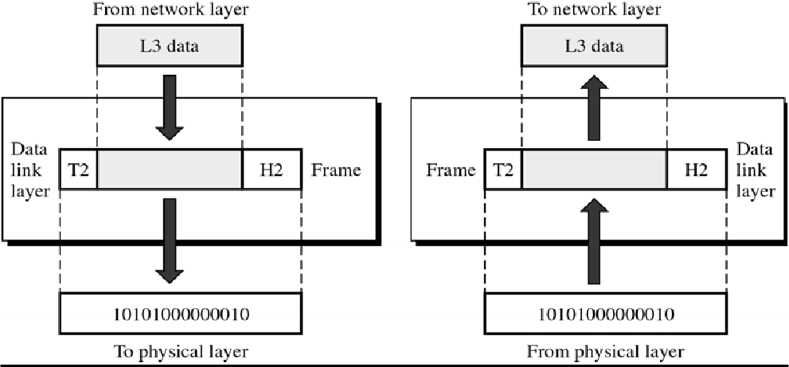
CS601-Data Communication
VU
Transmission Mode
Physical Layer also defines the direction of Transmission between the devices
Simplex. Half Duplex, Full Duplex
Data Link Layer (Layer 2)
Transforms physical layer which is raw transmission facility to a reliable link
Responsible for Node to Node Delivery
Makes physical layer look error free to the upper layer
Figure
Functions of Data Link Layer
Framing
The data link divides the stream of bits from Network layer into manageable data units called “FRAMES”. This process is known as Framing.
Physical Addressing
Frames need to be transmitted to different systems on a network
Data Link layer adds a HEADER to Frame
Header defines the physical address of sender(Source address) and/or receiver address (Destination address)
If frame is intended for a device outside the network, the receiver address is the address of the device that connects one network to the other
Flow Control
Data Link layer imposes Flow Control mechanisms to prevent overwhelming the receiver

Slide 47
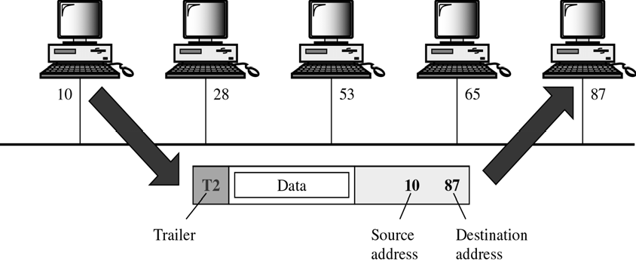
CS601-Data Communication
VU
Error Control
Data link layer adds reliability to physical layer by adding mechanisms to detect and retransmit lost or damaged frames
Also uses a mechanism to prevent duplication of frames
Error Control bits are added to the form in the TRAILER
Access Control
Two or more devices may be connected to a single link
Data link protocols are necessary to determine which device will have the control of the link at a given time
EXAMPLE
Node with physical address 10 sends a frame to a node with physical address 87
Two nodes are connected by a link.
At the DL level, this frame contains physical address in the Header, This is the only address needed at this level
Rest of header contains other info as needed
Trailer contains extra bits needed for error detection
NETWORK LAYER
❖
Responsible for Source-to-Destination delivery
DL Layer oversees the delivery of data between 2 systems on the same network
Network Layer ensures that each packet gets from its point of origin to its final destination
Node –to Node vs Source to Destination
If the two systems are connected to the same network, there is no need for Network layer and node –to node delivery is enough
If two systems are connected to two different networks, there is often a need for Source-to destination delivery

Slide 48
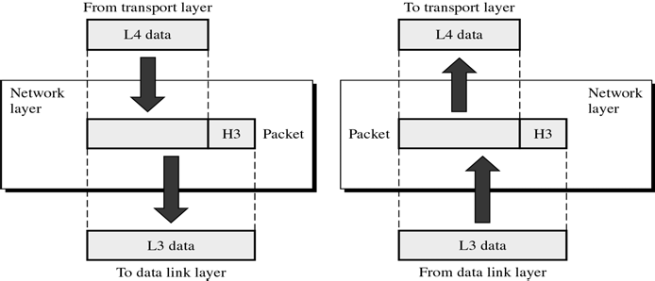
CS601-Data Communication
VU
Function of Network Layer
Logical Addressing
Physical addressing implemented by Data link layer handles addressing problem locally
If a packet is going from one network to another, we need another addressing system to help distinguish source & destination systems
Network layer adds Header to the data coming from upper layers that among other things include LOGICAL ADDRESS of the sender and receiver
Routing
When independent networks or links are connected together to create an “internetwork”, the internetworking devices route packets to their final destination
Routers are those internetworking devices
One of the functions of Network layer is to define this route
Example Network Layer
•We want to send data from a node with network address ‘A’ and physical address 10, located on one LAN to
•A node with network address P and physical address 95 located on another LAN
•Because the two nodes are present on two different networks, we cannot use physical address only
•We need a Network address that can pass us from the Network boundaries
•The packet therefore contains the logical address which remains the same from source to destination
•The physical address will change when packet moves from one network to the other
•The box with R is a Router
Summary
The OSI Model
Function of Layers
Reading Sections
Section 3.1,3.2, “Data Communications and Networking” 4th Edition by Behrouz
Forouzan

Slide 49
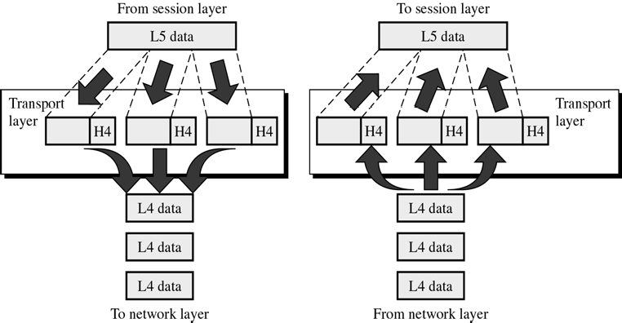
CS601-Data Communication
VU
LECTURE #9
Transport Layer
Responsible for Source-to-Destination delivery of Entire Message
Network Layer oversees source-to-destination delivery of the entire packets but it does not recognize any relationship b/w those packets
Network layer treats each packet independently
Transport Layer ensures that whole message arrives at the destination intact
Functions of Transport Layer
Service Point Addressing
Computers run several programs at the same time
Source-to-Destination delivery means delivery not only from only from one computer to the other but also from a specific process on one computer to a specific process on the other
Transport layer header includes a type of address called Service Point Address or PORT Address
Network layer each packet to the correct computer while Transport layer gets entire message to the correct process on that comuter
Segmentation and Reassembly
Message is divided into transmittable segments
Each segment contains a sequence number
These sequence no.s enable Transport layer at the receiving m/c to reassemble message correctly at the destination and to identify and replace lost packets

Slide 50
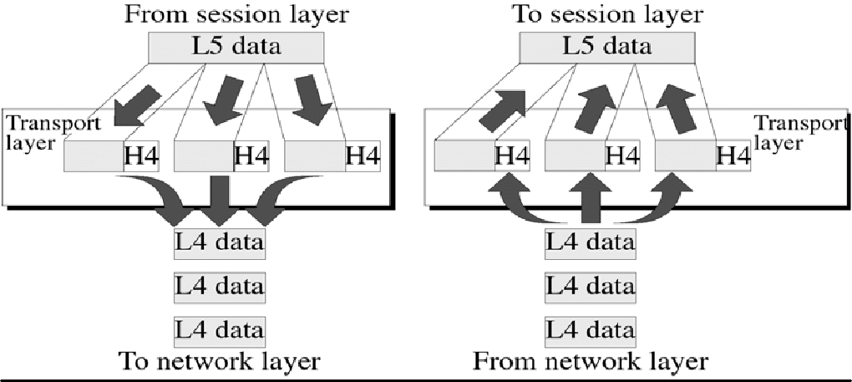
CS601-Data Communication
VU
Connection Control
Transport layer can be either connection-less or connection-oriented
Connectionless
Treats each segment as an independent packet and delivers it to the transport layer of the destination m/c
Connection-Oriented
A connection is established first with Transport layer before delivering the packet.
After all data is Tx. , the connection is disconnected
Flow Control
Like Data link layer, Transport layer is also responsible for Flow control
Flow control is performed end-to-end rather than across a single link
Error Control
Like data link layer, Transport layer is responsible for the Error Control
Error control is performed end-to-end
This layer makes sure that entire message reaches Rx Transport layer w/o error
Error can be a result of Lost, damaged or duplicated data and usually Re Tx is done
Example Figure
Session Layer
o Session layer is the Network Dialog Controller
o Establishes, Maintains, and Synchronizes
the interaction
between
communicating systems
50

Slide 51
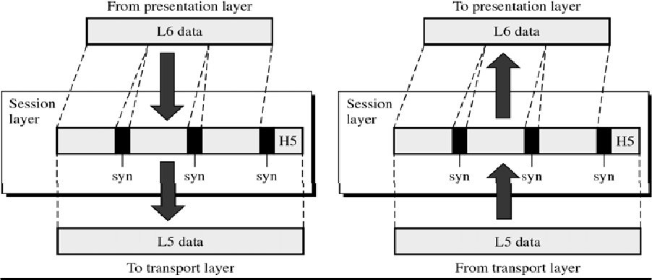
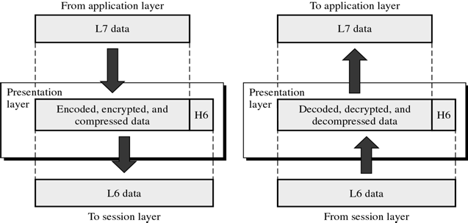
CS601-Data Communication
VU
Function of Session Layer
Dialog Control
Session layer allows two systems to enter into a dialog.
It allows communication between two processes to take place either in half duplex or full duplex mode
Synchronization
Session layer allows a process to add check points (synchronization points) in a stream of data
If a system is sending a file of 2000 pages, it is advisable to insert check points after every 100 page to ensure that each 100 page unit is received and acknowledged independently
In this case, if a crash happens during the transmission of page 523 , retransmission at page 501
Page 1-500 need not be retransmitted
Presentation Layer
o This layer is concerned with Syntax and Semantics of info exchange between two systems
Summary
The OSI Model
Functions of Layers
Reading Sections
Section 3.2 “Data Communications and Networking” 4th Edition by Behrouz A. Forouzan

Slide 52
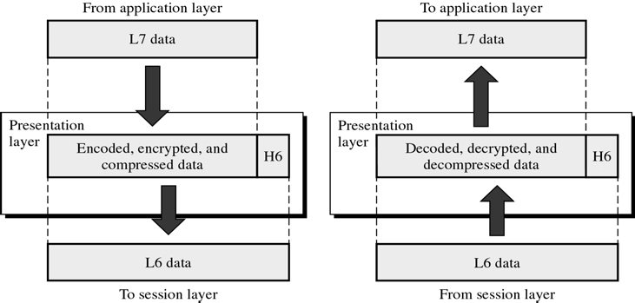
CS601-Data Communication
VU
LECTURE #10
Presentation Layer
o This layer is concerned with Syntax and Semantics of info exchange between two systems
Functions of Presentation Layer
Translation
The processes (running programs) in two systems are usually exchanging info in the form of character strings, numbers and so on…..
The info should be changed to bit streams before being transmitted
Because different computers use different ENCODING SYSTEMS, presentation layer is responsible for interoperability b/w these different encoding methods
The presentation layer at the sender changes the info from its sender- dependent format to the common format
The presentation at the receiver changes info from common to the receiver dependent format
Encryption
To carry sensitive info , a system must be able to assure privacy
Encryption means that sender transforms original info to another form and sends the resulting message out over the network
Decryption reverses the original process to transform message back to its original form
Compression
Data compression reduces the number of bits to be transmitted

Slide 53
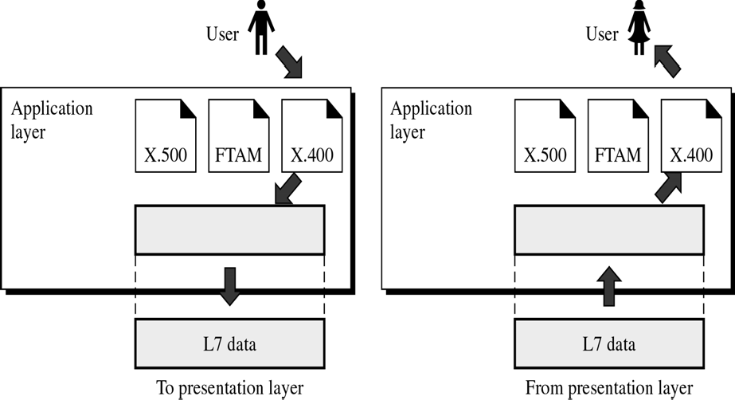
CS601-Data Communication
VU
Data compression becomes particularly important in transmission of multimedia such as text, audio and video
Application Layer
Enables the user either human or software to access the network
It provides user interface and support for the services such as Electronic mail, Remote File access and Transfer, Shared Database Management and other services
Application Layer Figure
o In the figure, of many application services available, only three services are shown
–X-400 (message Handling Services)
–X-500 (Directory Services)
–File Transfer, Access& Management (FTAM)
In this example user uses X-400 to send an e-mail message
No headers or trailers are added at this layer
Application Layer Functions
Network Virtual Terminal
NVT is a software version of a physical terminal and allows a user to log on to a remote host
To do so the application created emulation of terminal at the remote host
Users computer talks to the software terminal which in turn talks to the host
*& vice versa
Remote host believes it is communication with one of its own terminals and allow you to log on

Slide 54
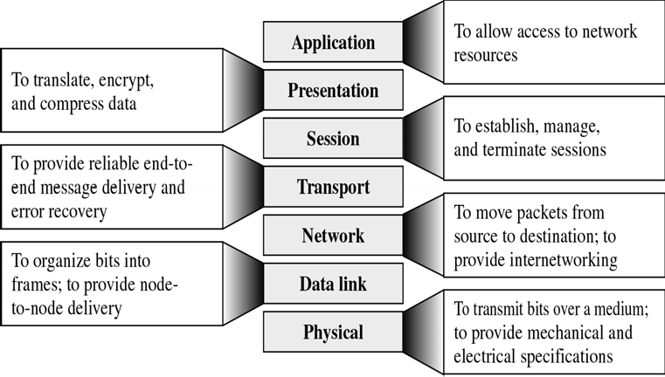
CS601-Data Communication
VU
File Transfer, Access & Manage.(FTAM)
This application allows a user to access file on the remote computers to make changes or read data
The purpose of this access is to Retrieve files from a remote computer and to manage or control files in that remote computer
Mail Services
This application provides the basis for email forwarding and storage
Directory Services
Provides distributed database sources and access for global info about various objects and services
Summary of Layer Functions
TCP/IP Protocol Suite
Transmission Control Protocol / Internetworking Protocol
Developed Prior to OSI Model
Widely used in the Internet Today
Layers in TCP/IP Protocol Suite
Physical (physical standards)
Data Link (N/w Interface)
Network (Interconnectivity)
Transport(Transport Functions)
Application(Session , Pres, app of OSI)

Slide 55
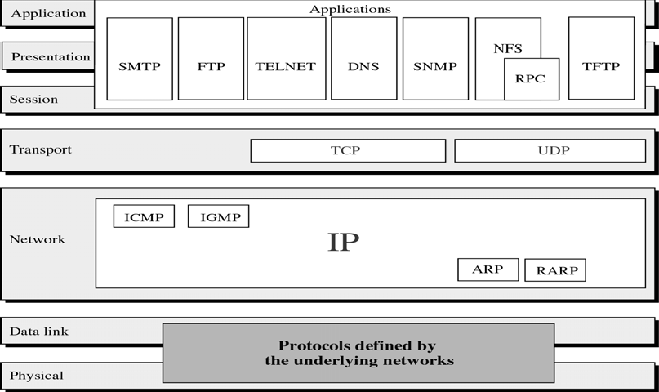
CS601-Data Communication
VU
TCP/IP Protocol Suite
Summary
*The OSI Model
*Functions of Layers
*TCP/IP Protocol Suite
Reading Sections
*Section 3.2, 3.3 “Data Communications and Networking” 4th Edition by Behrouz A. Forouzan

Slide 56
CS601-Data Communication
VU
LECTURE #11
Signals
Need For Signals
One of the major concerns of Physical layer is moving information in the form of electromagnetic signals across a TX medium
Information can be voice, image, numeric data, characters or any message that is readable and has meaning to the destination user (human or m/c)
Generally, the info usable to a person or application is not in a form that can be transmitted over a network
For Example, you cannot roll up a photograph, insert it into the wire and transmit it across the city
You can transmit however an encoded description of the photograph
The binary digits must be converted into a form that TX. Medium can accept
TX. Media work by conducting energy along a physical path. So the data stream of 1s and 0s must be turned into energy in the form of EM signals
Analog and Digital
Both data and signals that represent them can take either analog or digital form
ANALOG
Analog refers to something that is continuous in time
Continuous– A set of specific points of data and all possible points b/w them
DIGITAL
Digital refers to something that is discrete
Discrete– A set of specific points of data with no points in between
Data can be Analog or Digital
Example of ANALOG Data is Human voice
When somebody speaks, a continuous wave is created in the air.
This can be captured by a Microphone and converted to an Analog Signal
An example of DIGITAL data is Data stored in the memory of a computer in the form of 1s and 0s. It is usually converted to a digital signal when it is transferred from one position to the other inside or outside the computer
Signals can be Analog or Digital
ANALOG Signal

Slide 57
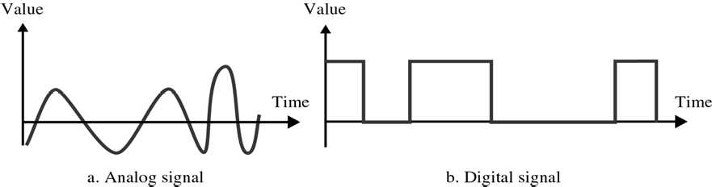
CS601-Data Communication
VU
It is a continuous waveform that changes smoothly over time
As the wave moves from value ‘ A’ to value ‘B’, it passes through and includes an infinite number of values along its path
DIGITAL Signal
A digital signal is discrete. It can have only a limited number of defined values, often as simple as 1s and 0s
The transition of a digital signal from value to value is instantaneous like a light being switched ON and OFF
Analog and Digital Signals
We illustrate signals usually by plotting them on a pair of perpendicular axis
Vertical axis represent the value or the strength of the signal
Horizontal axes represent the passage of time
The curve representing the Analog signal is smooth and continuous, passing through an infinite number
The vertical lines of the digital signal shows the sudden jump the signal makes from value to value. The flat highs and the lows represent that those values are fixed
In short, Analog signal varies continuously w.r.t Time whereas Digital signal varies instantaneous
Periodic and Aperiodic Signals
Signals (Analog or Digital)
Periodic
Aperiodic

Slide 58
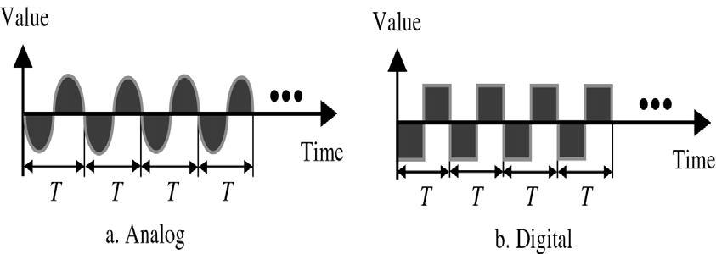
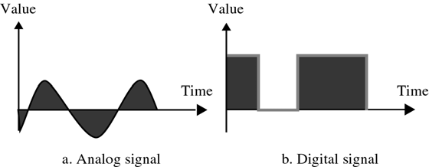
CS601-Data Communication
VU
Periodic Signals
A signal is called Periodic if it completes a pattern within a measurable time frame called a Period and then repeats that pattern over identical subsequent Periods
The completion of one full pattern is called a CYCLE
Period: Time required (in Seconds) to complete one full cycle, represented by ‘T’
Aperiodic Signals
o An Aperiodic or Non-Periodic signal is the one that changes constantly without exhibiting a pattern or cycle that repeats over time
Fourier Transform
It has been proved by a technique called FOURIER TRANSFORM that any Aperiodic signal can be decomposed into an infinite number of Periodic Signals
ANALOG SIGNALS
Analog signals can be classified as Simple or Composite
Simple Analog Signal(Sine Wave)
–Cannot be decomposed into simpler signal
Composite Analog Signal
–Composed of multiple sine waves
Sine Waves
Sine Waves are the most fundamental form of Periodic Analog Signals
The curve oscillates over the course of a cycle smoothly and consistently

Slide 59
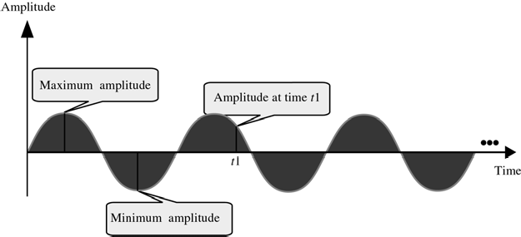
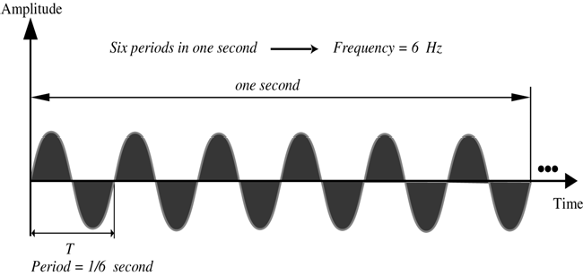
CS601-Data Communication
VU
Each cycle consists of a single arc above the time axis followed by a single arc below it
Sine Waves can be fully described by three characteristics:
Amplitude
Period/Frequency
Phase
Amplitude
Amplitude of a signal is the value of the signal at any point on the wave
It is equal to the vertical distance from a given point on the wave form to the horizontal axis
The maximum amplitude of the sine wave is equal to the highest value it reaches on the vertical axis
Amplitude measured in Volts, Amperes or Watts
Period & Frequency
Period: Amount of time ( in seconds) a signal need to complete one cycle
Frequency: Number of cycles completed in one second
Unit of Period: Period is expressed in seconds
Communication industry uses 5 units to measure period
Frequency is measured in hertz, There are 5 units used in Hertz

Slide 60
CS601-Data Communication
VU
Seconds Hertz Milliseconds Kilohertz Microseconds Megahertz Nanoseconds Gigahertz Picoseconds Terahertz
Summary
Signals
Analog and Digital
Analog and Digital Data & Signals
Periodic & Aperiodic Signals
Sine Waves and its Characteristics
Reading Sections
*Section 4.1, 4.2, 4.3“Data Communications and Networking” 4th Edition by Behrouz A. Forouzan
60

Slide 61
CS601-Data Communication
VU
LECTURE #12
Problems 4.3
A Sine wave has a frequency of 6 Hz. What is its period? Solution
T = ¹ = ¹ = 0.17 sec
f 6
Problems 4.5
A Sine wave completes one cycle in 4 seconds. What is its frequency? Solution:
f = ¹ = ¹ = 0.25Hz T 4
Another Way to look at Frequency
Measurement of the rate of change
The rate at which a sine wave moves from its lowest to its highest point is its frequency
A 40 Hz signal has half the frequency of a 80 Hz signal, therefore each cycle takes twice as long to complete one cycle I.e. to go from its lowest to its highest
Change in a short Time = High Frequency
Two Extremes Frequency
What if a signal does not change at all?
What if it maintains a constant voltage level the entire time?
In such cases , Frequency is going to be zero
If a signal does not change, it will never complete any cycles, and frequency is no. of cycles in 1 second so Freq = 0
No change at all ⇒
– Zero frequency
o Instantaneous changes ⇒
– Infinite frequency
Phase
Phase describes the position of the waveform relative to time zero
If we think of the wave as something that can be shifted backward or forward along the time axis
Phase describes the amount of that shift
It indicates the status of the first cycle
Phase is measured in Degrees or Radians
360 degrees – 2 pi Radians
A phase shift of 360 degrees correspond to a shift of a complete period
A phase shift of 180 degree correspond to a shift of half a period
A phase shift of 90 degree correspond to a shift of quarter a period

Slide 62
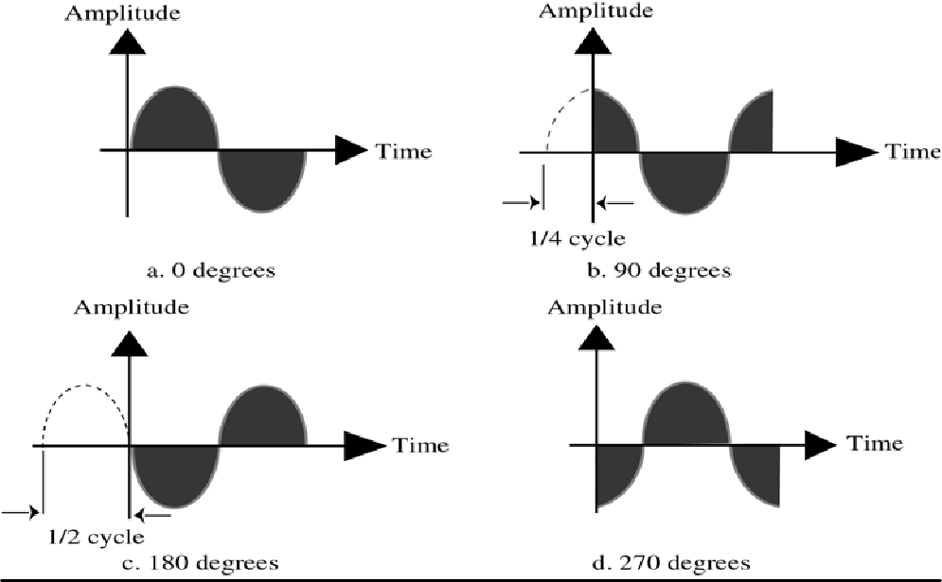
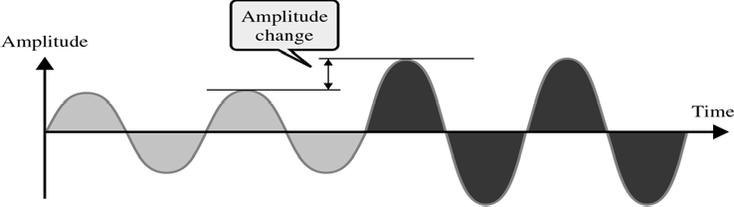
CS601-Data Communication
VU
Problem 4.7
A sine wave is offset Solution
1
of a cycle with respect to time zero. What is its phase?
6
One Cycle = 360 Degrees
1
6
of a cycle =³⁶⁰ = 60 Degrees
6
Control of Signals
Signal can be controlled by three attributes:
Amplitude
Frequency
Phase
Control of Signals- Amplitude
Control of Signals- Frequency

Slide 63
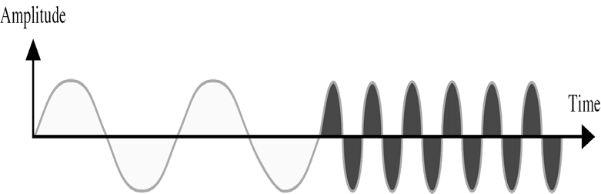


CS601-Data Communication
VU
Control of Signals- Phase
Time and Frequency Domain
Time Domain plots show changes in signal amplitude w.r.t Time
It is an Amplitude versus Time Plot
Phase and Frequency are not explicitly measured on a Time domain plot
To show the relationship between amplitude and Frequency, we can use what is called a Frequency Domain Plot
Time and Frequency Domain Example

Slide 64

CS601-Data Communication
VU
Figure compares the time domain (instantaneous amplitude w.r.t Time) and the Frequency domain (Max amplitude w.r.t Frequency)
Low Frequency signal in frequency domain corresponds to a signal with longer period in Time domain & vice versa.
A signal changing rapidly in Time domain corresponds to High frequency in Frequency domain
Figure shows 3 signals with different frequencies and its time and frequency domain presentations
Composite Signals
Second type of Analog Signals, that is composed of multiple sine waves
So far we have been focused on simple periodic signals or sine waves
Many useful sine waves do not change in a single smooth curve b/w minimum and maximum amplitude.
They jump, slide , wobble and spikeAs long as as any irregularities are consistent, cycle after cycle, a signal is still Periodic
It can be shown that any periodic signal no matter how complex can be decomposed into a collection of sine waves, each having a measurable amplitude, frequency & phase
We need FOURIER ANALYSIS to decompose a composite signal into its components

Slide 65

CS601-Data Communication
VU
Figure shows a periodic signal decomposed into two sine waves
First sine wave (middle one) has a frequency of ‘6’ while the second sine wave has a frequency of ‘0’
Adding these two signals point by point results in the top graph
Original signal looks like a sine wave that has its time axis shifted downward
This shift is because of DC Component or zero frequency component in the signal
If you look at the signal in time domain, a single point is there while in frequency domain , two component freq.'s are there
Summary
Sine Waves and its Characteristics
Control of Signals
Time and Frequency Domain
Composite Signals
Reading Sections
Section 4.4, 4.5 “Data Communications and Networking” 4th Edition by Behrouz
Forouzan

Slide 66


CS601-Data Communication
VU
LECTURE #13
Frequency Spectrum / Bandwidth
Frequency Spectrum: of a signal is the collection of all the component frequencies it contains
It is shown using a Frequency domain graph
Bandwidth: of a signal is the width of the frequency spectrum
In other words ,Bandwidth refers to the range of the component frequencies and Frequency Spectrum refers to the elements within that range
How to calculate Bandwidth?
To calculate Bandwidth, subtract the lowest frequency from the highest frequency
*
SLIDE
Example 4.8
If a periodic signal is decomposed into five sine waves with frequencies 100, 300, 500, 700, and 900 Hz, what is the Bandwidth?
Solution
B = f_{h} − f_{l} = 900 −100 = 800Hz
Other Definitions of Bandwidth
3 dB Bandwidth or Half Power Bandwidth
H ( f )

Slide 67



CS601-Data Communication
VU
For the magnitude spectra of
, the range of the spectrum that does not
fall lower than 1 times the max. _{H ( f )}
2
Equivalent Noise Bandwidth
The width of a fictitious rectangular spectrum created to have the same power in the rectangular band as the power of the signal in positive frequencies
Null-to-Null Bandwidth or Zero Crossing Bandwidth
If the maximum frequency in a spectrum is
^{f} o ,the
first null above and
below f _{o} will be Null Bandwidth
f₁ f₂
and
, where
f₁ − f₂
is the Null-to-
Power Bandwidth
Frequency Band in which 99% of the total power resides

Slide 68


CS601-Data Communication
VU
Digital Signals
In addition to being represented by Analog Signals, data can also be represented by a Digital signal
Bit Interval and Bit Rate
Most digital signals are aperiodic and thus Period and Frequency are not the appropriate terms to describe them
Bit Interval (seconds)
Time required to send one single bit
Bit Rate (bps)
Number of bits sent per second
Frequency Spectrum of a Digital Signal
Frequency spectrum of a digital signal contains an infinite number of frequencies with different amplitudes
Ideally we want to send all the components but if we send only those components
whose amplitudes are significant , we can still recreate the digital signal with reasonable accuracy at the receiver

Slide 69

CS601-Data Communication
VU
Summary
Frequency Spectrum and Bandwidth
Other Definitions of Bandwidth
Digital Signals
Reading Sections
* Section 4.4, 4.5, 4.6 Behrouz A. Forouzan
“Data Communications and Networking” 4th Edition by

Slide 70

CS601-Data Communication
VU
LECTURE #14
Conversions
Introduction
Information must be transformed into signals before it can be transported across the communication media
How info is transformed depends on its original format and on the format used by the communication device
If you want to send a letter by a smoke signal, you need to know which smoke patterns make which words in your message before building the fire
Words are the Information and the puffs of smoke are representation of that information
Introduction to the type of Conversions
Data stored in the computer is in the form of 0’s and 1’s. To be carried from one place to the other, data is usually converted to digital signals
This is called “Digital-to-Digital Conversion” or “Encoding digital data into
digital signals”
Sometimes we need to convert an analog signal to the digital signal
For Example, conversion of Telephone conversation to digital signal for a no. of different reasons such as to decrease the effect of noise
This is called “Analog-to-Digital Conversion” or “Digitizing an Analog
Signal”
We might want to send a digital signal coming out of computer through a medium designed for analog signals
For example, To send data from one place to the other using a Telephone line
This is called “Digital-to-Analog Conversion” or “Modulating a digital Signal”
Often an analog signal is sent over long distances using analog media
For Example, voice or music from a radio station which is an analog signal is transmitted through the air, however the frequency of voice or music is not suitable for this kind of Tx.
The signal should be carried by a higher frequency signal
This is called “Analog-to-Analog Conversion” or “Modulating an analog Signal”
Types of Conversions
Digital-to-Digital Conversion
o Digital-to-Digital conversion/encoding is the representation of digital information by digital signal
70

Slide 71


CS601-Data Communication
VU
For Example when you Tx data from Computer to the Printer, both original and transmitted data have to be digital
In this type of encoding, 1’s and 0’s generated by the computer are translated into voltage pulses that can be propagated over the wire
o Figure shows the relationship between digital information, digital-to-digital encoding hardware , and the resultant digital signal
Types of Digital-to-Digital Encoding
Digital/Digital Encoding
Unipolar
Polar
Bipolar
UNIPOLAR
Encoding is simple , with only one technique in use
Simple and Primitive
Almost Obsolete Today
Study provides introduction to concepts and problems involved with more complex encoding systems
Digital Transmission system works by sending voltage pulses on the Tx. Medium
One voltage level stands for binary 0 while the other stands for binary 1
It is called Unipolar because it uses only one polarity

Slide 72
CS601-Data Communication
VU
This polarity is assigned to to one of the two binary states usually a ‘1’
The other state usually a 0 is represented by zero voltage
Figure shows the idea: 1’s are encoded as +ve values, and 0’s are encoded as –ve values
Pros and Cons of Unipolar Encoding
PROS
Straight Forward and Simple
Inexpensive to Implement
CONS
DC Component
Synchronization
DC Component
Average Amplitude of a unipolar encoded signal is non-zero
This is called DC Component I.e. a component with zero frequency
When a signal contains a DC Component, it cannot travel through a Tx. Medium that cannot handle DC components
Synchronization
When the signal is unvarying, Rx. Cannot determine the beginning and ending of each bit
Synchronization Problem can occur when data consists of long streams of 1’s or 0’s
Therefore, Rx has to rely on a TIMER
Consider we have a bit rate of the signal to be 1000bps
1000 bits in 1 second
1 bit in 0.001 second
So if a +ve voltage lasts 0.005 sec, it reads five 1’s
Sometimes it stretches to 0.006 seconds and an extra one bit is read by the Rx
Solution:
– Separate Parallel Line
Carries a clock pulse and allows receiver to resynchronize its timer to that of the signal
Doubling no. of Tx lines increase Cost and proves uneconomical
POLAR
Encoding has 3 subcategories:
Non Return to Zero (NRZ),-- Return to Zero (RZ)
Bi phase
Two of which have multiple variations of their own
Polar encoding uses two voltage levels
–One positive and one negative

Slide 73

CS601-Data Communication
VU
By using two voltage levels, average voltage level on the line is reduced and DC Component problem of unipolar encoding is alleviated
Types of Polar Encoding
Non Return to Zero (NRZ)
o In NRZ Encoding, the level of signal is either positive or negative
 |  | NRZ
NRZ-L |  |  |  |  | NRZ-I
NRZ-L
Level of the signal depends on the type of bit it represents
A +ve voltage usually means the bit is a 1 and a –ve voltage means the bit is a 0 (vice versa)
*Problem with NRZ-L: When long streams of 0’s or 1’s are there in data, Rx receives a continuous voltage and should determine how many bits are sent by relying on its clock , which may or may not be synchronized with the sender clock
NRZ-I
The inversion of the level represents a 1 bit

Slide 74

CS601-Data Communication
VU
A bit 0 is represented by no change
NRZ-I is superior to NRZ-L due to synchronization provided by signal change each time a 1 bit is encountered
The string of 0’s can still cause problem but since 0’s are not as likely, they are less of a problem
Summary
Introduction to the Encoding Techniques
Digital-To-Digital Encoding
Types of Digital-To-Digital Encoding
UniPolar Encoding
Polar Encoding
– NRZ
Reading Sections
Section 5.1, “Data Communications and Networking” 4th Edition by Behrouz A. Forouzan

Slide 75

CS601-Data Communication
VU
LECTURE #15
Conversions
Return to Zero (RZ)
Any time, data contains long strings of 1’s or 0’s, Rx can loose its timing
In unipolar, we have seen a good solution is to send a separate timing signal but this solution is both expensive and full of error
A better solution is to somehow include synch in encoded signal somewhat similar to what we did in NRZ-I but it should work for both strings of 0 & 1
One solution is RZ encoding which uses 3 values : Positive, Negative and Zero
Signal changes not b/w bits but during each bit
Like NRZ-L , +ve voltage means 1 and a –ve voltage means 0, but unlike NRZ- L, half way through each bit interval, the signal returns to zero
A 1 bit is represented by positive to zero and a 0 is represented by negative to zero transition
The only problem with RZ encoding is that it requires two signal changes to encode one bit and therefore occupies more BANDWIDTH
But of the 3 alternatives we have discussed, it is most effective
Biphase Encoding
Best existing solution to the problem of Synchronization
Signal changes at the middle of bit interval but does not stop at zero
Instead it continues to the opposite pole
 |  |  | Biphase Encoding
Manchester |  |  |  |  | Differential Manchester

Slide 76


CS601-Data Communication
VU
Manchester
o Uses inversion at the middle of each bit interval for both synchronization and bit representation
*Negative-to-Positive Transition= 1
*Positive-to-Negative Transition = 0
*By using a single transition for a dual purpose, Manchester acheives the same level of synchronization as RZ but with only two levels of amplitude
Differential Manchester
Inversion at the middle of the bit interval is used for Synchronization but presence or absence of an additional transition at the beginning of bit interval is used to identify a bit
A transition means binary 0 & no transition means binary 1
Requires 2 signal changes to represent binary 0 but only one to represent binary 1
Bipolar Encoding
Like RZ, it uses three voltage levels:
Unlike RZ, zero level is used to represent binary 0
Binary 1’s are represented by alternate positive and negative voltages
Types of Bipolar Encoding

Slide 77


CS601-Data Communication
VU
Alternate Mark Inversion (AMI)
Simplest type of Bipolar Encoding
Mark € Comes from Telegraphy (1)
Alternate Mark Inversion means Alternate ‘1’ Inversion
Pseudoternary
By inverting on each occurrence of 1, AMI accomplishes 2 things:
–The DC component is zero
–Long sequence of 1’s stay synchronized
No mechanism of ensuring synch is there for long stream of 0’s
Two variations are developed to solve the problem of synchronization of sequential 0’s
–B8ZS € used in North America
–HDB3 € used in Europe & Japan
Both modify original pattern of AMI only on case of long stream of zeroes
B8ZS
Convention adopted in North America to provide synch for long string of zeros
Difference b/w AMI and B8ZS occurs only when 8 or more consecutive zeros are encountered
Forces artificial signal changes called VIOLATIONS
Each time eight 0’s occur , B8ZS introduces changes in pattern based on polarity of previous 1 (the ‘1’ occurring just before zeros)

Slide 78

CS601-Data Communication
VU
HDB3
Alteration of AMI adopted in Europe and Japan
Introduces changes into AMI, every time four consecutive zeros are encountered instead of waiting for eight zeros as in the case of B8ZS
As in B8ZS, the pattern of violations is based on the polarity of the previous 1 bit Unlike B8ZS, HDB3 also looks at the no. of 1’s that have occurred since the last substitution
Summary
Types of Digital-To-Digital Encoding
Polar Encoding
Return to Zero (RZ) Encoding
Biphase Encoding
Bipolar Encoding
Reading Sections
Section 5.1, “Data Communications and Networking” 4th Edition by Behrouz A. Forouzan

Slide 79

CS601-Data Communication
VU
LECTURE #16
Conversions
Types of Digital-to-Digital Encoding
 |  |  | Digital/Digital Encoding
Unipolar |  |  |  | Polar |  |  |  | Bipolar
Example 5.1
* Using B8ZS, encode the bit stream 10000000000100. Assume that the polarity of the first 1 is positive.
Analog-to-Digital Conversion
We sometimes need to digitize an analog signal
To send human voice over a long distance, we need to digitize it, since digital signals are less prone to Noise
This is called Analog-to-Digital Conversion or Digitizing an Analog
Signal
This type of conversion requires a reduction of potentially infinite number of values in the analog signal so that it can be converted to digital bit stream with minimum loss of information.

Slide 80


CS601-Data Communication
VU
CODEC € Coder Decoder
Digital signal signals can take any of the forms discussed previously
Problem is how to convert analog signal from infinite number of values to discrete no. of values without scarifying quality
Pulse Amplitude Modulation
First step in Analog-to-Digital Conversion
This technique takes an Analog signal, Samples it, and Generates a series series of Pulses based on the results of Sampling
Sampling means measuring amplitudes of signal at equal intervals
The original signal is sampled at equal intervals
PAM uses a technique called Sample & Hold means At a given moment , signal level is read, then held briefly
The pulses are of any amplitude (still analog not digital). To make them digital, we need PCM
Pulse Code Modulation
Modifies pulses created by PAM to a complete digital signal
Four Separate Processes:
PAM
Quantization
Binary Encoding
Digital/Digital Encoding
Quantization
PCM’s first step is Quantization
“Quantization is a method of assigning integral values in a specific range to sampled instances”
80

Slide 81



CS601-Data Communication
VU
Figure shows a simple method of assigning sign and magnitude values to quantized samples
Results of Binary Encoding
Each value is translated into its seven bit binary equivalent. The eight bit indicates the sign
Result of PCM
Figure shows the result of PCM of original signal encoded finally into a unipolar signal
Only first 3 values are shown
Full PCM Process

Slide 82


CS601-Data Communication
VU
Sampling Rate
The accuracy of any digital reproduction of an analog signal depends upon the o. of samples taken
How many samples are sufficient?
<Nyquist theorem>
The sapling rate must be at least twice the highest frequency

Slide 83
CS601-Data Communication
VU
Bit Rate
Sampling Rate given by Nyquist Theorum
No. of bits per sample chosen according to the Precision needed at the receiver end.
BitRate = SamplingRate × No.ofbits / sample
Summary
Analog-to-Digital Conversion
Pulse Code Modulation (PCM)
Pulse Amplitude Modulation (PAM)
Quantization
Binary Encoding
Digital-To-Digital Conversion
Reading Sections
Section 5.2, “Data Communications and Networking” 4th Edition by Behrouz A. Forouzan

Slide 84

CS601-Data Communication
VU
LECTURE #17
Conversion
Digital To Analog Conversion
Process of changing one of the characteristics of an analog signal based on the info in a digital signal
When you Tx data from one computer to the other using a public telephone line
Original data is digital but because telephone wires carry analog signal, original data must be converted
Digital data must be modulated on an analog signal that has been manipulated to look like two distinct values corresponding to binary 1 to binary 0
o Figure shows the relationship b/w digital info the digital to analog conversion hardware & resultant analog signal
Variation in Characteristics of Sine Wave
A sine wave is defined by 3 characteristics:
Amplitude
Frequency
Phase
o By changing one aspect of a simple electrical signal back & forth,we can use it to represent digital data
When we vary any one of these characteristics ,we create a second version of that wave
If we than say that the original wave represents binary 1,the variation can represent binary 0 or vice versa
So by changing one aspect of a simple electrical signal back & forth,we can use it to represent digital data
Mechanisms for Modulating Digital Data to Analog Signals
Any of the three characteristics listed above can be altered in this way, giving us at least 3 mechanisms for modulating digital data into analog signals
Amplitude shift keying(ASK)
Frequency shift keying(FSK)
Phase shift keying (PSK)

Slide 85

CS601-Data Communication
VU
Fourth Mechanism
In addition, there is a fourth and better mechanism that combines changes in both amplitude and phase called Quadratue Amplitude Modulation(QAM)
QAM is the most efficient of these options and is the mechanism used in all modern modems
Types of digital to analog modulation
Aspects of Digital to Analog Conversion
Before we discuss specific methods of digital to analog modulation,two basic issues must be defined:
Bit/Baud rate
Carrier signal
Bit Rate & Baud Rate
o Two terms used frequently in data communication
–Bit rate
–Baud rate
*Bit rate: no of bits transmitted during one second
*Baud rate: no of signal units per second that are required to represent that bit
Bit Rate & Baud Rate
In discussion of computer efficiency, bit rate is more important –we want to know how long it takes to process each piece of info
In data transmission, however ,we are more concerned with how efficiently we can more that data from place to place, whether in pieces or blocks
The fewer signal units required, the most efficient the system and less bandwidth required to transmit more bits ,so we are more concerned with baud rate
The baud rate determines the B.W required to send the signal
Relationship b/w bit rate &band rate

Slide 86
CS601-Data Communication
VU
Bit rate equals the baud rate times the no. of bits represented by each signal units
The baud rate equals the bit rate divided by the no. of bits represented by each signal shift
Bit rate is always greater than or equal to Baud rate
Analogy for Bit rate &Baud rate
In transportation a band is analogous to a car,a bit is analogous to a passenger
A car can carry one or more passengers
If1000 cars can go from one point to another carrying only one passenger(only driver),than 1000 passengers are transported
However, if each car carries four passengers, then 4000 passengers are transported
Note that the number of cars, not the numbers of passengers determines the traffic and therefore the need for wider highway
Similarly, the baud determines the required bandwidth, not the bit rate
Example 5.6
An analog signal carries 4 bits in each signal element.If 1000 signal elements are sent per second, find the Baud Rate and Bit Rate?
Solution:
–Baud Rate= Number of Signal Elements
–Baud Rate =1000 bauds/second
–Bit Rate=Baud Rate * Number of bits per signal element
–Bit Rate= 1000 * 4 = 4000 bps
Carrier Signals
In analog TX. The sending device produces a high frequency signal, that acts as a basis for the information signal
This base signal is called the Carrier Signal or Carrier Frequency
The receiving device is tuned to the frequency of the carrier signal that it expects from the sender
I=Digital info is then modulated on the carrier signal by modifying one or more of its characteristics (Amplitude, Frequency, Phase)
This kind of modification is called Modulation and info signal is called a Modulating Signal
Amplitude Shift Keying (ASK)
In ASK, the strength of carrier signal is varied to represent binary 1 or 0
Both frequency and phase remain constant, while the amplitude changes
Which voltage represents 1 and which represents 0 can be chosen by System Designer
A bit duration is the period of time that defines one bit
The peak amplitude of the signal during each bit duration is constant and its value depends on the bit (1 or 0)

Slide 87


CS601-Data Communication
VU
o Speed of transmission during ASK is limited by the physical characteristics of Tx. Medium
Effect Of Noise on ASK
ASK is highly susceptible to noise interference
NOISE: Unintentional voltages introduced onto a line by various sources such as Heat or Electromagnetic Radiation from other sources
These unintentional voltages combine with signal to change the amplitude
A 1 can be changed to 0 and a 0 to a 1
ASK relies solely on Amplitude for recognition
Noise usually affects the amplitude, therefore ASK is the modulating method, that is most affected by Noise
On-Off Keying (OOK)
A popular ASK Technique
In OOK, one of the bit values is represented by no voltage
The advantage is the reduction in the amount of energy required to transmit Information
Bandwidth for ASK
Bandwidth of a signal is total range of frequencies occupied by that signal
When we decompose an ASK modulated signal, we get a spectrum of many simple frequencies
The most significant ones are those b/w, fc-Nbaud/2 and fc+Nbaud /2 with carrier frequency fc at the middle
o Bandwidth requirements for ASK are calculated using the formula:

Slide 88
CS601-Data Communication VU
BW=(1+d) * Nbaud
BW = Bandwidth
Nbaud= Baud Rate
d= factor related to condition of line (min.value = 0)
Example 5.8
Find minimum bandwidth required for an ASK signal TX at 2000 bps. TX. Mode is half duplex
Solution:
–In ASK, Baud Rate= Bit Rate
–Therefore, Baud Rate = 2000
–Also ASK requires a minimum bandwidth equal to its Baud Rate
–Therefore Minimum BW = 2000 Hz
Summary
Digital-to Analog Conversion
Bit Rate and Baud Rate
Carrier Signals
Amplitude Shift Keying (ASK)
Reading Sections
Section 5.3, “Data Communications and Networking” 4th Edition by Behrouz A. Forouzan

Slide 89


CS601-Data Communication
VU
LECTURE #18
Frequency Shift Keying (FSK)
Frequency of signal is varied to represent binary 1 or 0
The frequency of the signal during each bit duration is constant and depends on the bit (0 or 1)
Both peak amplitude and phase remains constant
Effect of Noise on FSK
Avoids most of the Noise problems of ASK
Because Rx device is looking for specific frequency changes over a given number of periods, it can ignore voltage spikes
The limiting factors of FSK are the physical capabilities of the carrier
BW of FSK
Although FSK shifts between two carrier frequencies, it is easier to analyze as two co-existing frequencies
BW required for FSK is equal to the Baud rate of the signal plus the frequency shift
Frequency Shift=Difference b/w two carrier frequencies
BW= (fc1 – fc0) +Nbaud

Slide 90

CS601-Data Communication
VU
Example 5.11
Find the minimum BW for an FSK signal transmitted at 2000 bps. TX is in half duplex mode and carrier must be separated by 3000 Hz
Solution:
For FSK, if fc1 and fc2 are the carrier frequencies, then: BW=Baud Rate + (fc1 – fc0)
Baud rate is the same as bit rate
BW=2000 + (fc1 – fc0) = 2000 + 3000 = 5000 Hz
Phase Shift Keying (PSK)
In PSK, phase of carrier is varied to represent binary 1 or 0
Both peak amplitude and frequency remains constant as the phase changes
For Example: if we start with a phase of 0 degrees to represent binary 0 , then we can change the phase to 180 degrees to send binary 1
The phase of signal during duration is constant and its value depends upon the bit (0 or
2PSK
The above method is often called 2 PSK, or Binary PSK, because two different phases ( 0 and 180 degrees) are used
Figure makes this point clear by showing the relationship of phase to bit value
A second diagram called constellation diagram or phase state diagram shows same relationship by illustrating only the phases
Effect of Noise on PSK
PSK is not susceptible to the noise degradation that affects ASK, nor to the bandwidth limitations of FSK
Smaller variations in signal can be detected reliably by the receiver
4PSK
90

Slide 91


CS601-Data Communication
VU
Based on the above two facts, instead of utilizing only two variations of a signal, each representing one bit, we can use four variations and let each phase shift represent two bits
4PSK
BW for PSK
Minimum bandwidth required for PSK transmission is the same as ASK
As we have seen max bit rate in PSK is much greater than that of ASK
So while max baud rate of ASK and PSK are the same for a given BW, PSK bit rate using the same BW can be two or more times greater
8 PSK

Slide 92


CS601-Data Communication
VU
QAM
Limitations of PSK:
–PSK is limited by the ability of the equipment to distinguish small differences in phase
–This factor limits its potential bit rate
–So far we have been changing only of the characteristics of the sine wave, But what if we alter two
What should these two characteristics be?
BW limitations make combination of FSK with other changes practically useless
Why not combine ASK and PSK?
‘x’ variation in phase and ‘y variations in amplitude result into a total of x * y variations and corresponding no. of bits per variation
Quadrature Amplitude Modulation (QAM)
Variation of QAM
Variations of QAM are numerous
Any measurable amount changes in amplitude can be combined with any measurable no. of changes in Phase
4 QAM & 8 QAM (Figure)
In both case no. of amplitude shifts is more than the no. of phase shifts
Because amplitude changes are susceptible to Noise , number of phase shifts used by QAM is always larger than the amplitude shifts

Slide 93


CS601-Data Communication
VU
Time domain plot of 8 QAM
Three possible variations of 16 QAM
Bandwidth for QAM
BW required for QAM is the same as in the case of ASK and PSK
QAM has the same advantages as PSK over ASK
Bit Baud Comparison
Bit Baud Comparison
Consult book section 5.3
Example 5.11
A constellation diagram consists of eight equally spaced points on a circle. If bit rate is 4800 bps, what is the Baud Rate?
Solution:
Constellation indicates 8 PSK with the points 45 degree apart Baud Rate= 4800 / 3 = 1600 baud

Slide 94
CS601-Data Communication
VU
Summary
Digital-to Analog Conversion
Frequency Shift Keying (FSK)
Phase Shift Keying (PSK)
Quadrature Amplitude Modulation (QAM)
Reading Sections
Section 5.3, “Data Communications and Networking” 4th Edition by Behrouz A. Forouzan

Slide 95



CS601-Data Communication
VU
LECTURE #19
Conversions
Analog To Analog Conversion
Representation of Analog information by an Analog signal
For Example: Radio
Analog To Analog Conversion Methods
Amplitude Modulation (AM)
Amplitude of carrier signal is changed according to the amplitude of modulating signal
Frequency and phase of the carrier remain the same
AM Bandwidth
Bandwidth of AM signal (modulated signal) = 2 * bandwidth of modulating signal
Significant spectrum of AM audio = 5 KHz
⇒ 10 KHz bandwidth for an AM station

Slide 96



CS601-Data Communication
VU
AM Band Allocation
Example 5.18
We have an audio signal with a BW of 4 KHz. What is the BW needed, if we modulate the signal using AM?
Solution:
–AM signal requires twice the BW of original signal
–BW = 2 * 4 KHz = 8 KHz
Frequency Modulation (FM)
Frequency of carrier signal is changed according to the amplitude of modulating signal
Amplitude and Phase of the carrier signal remain constant

Slide 97


CS601-Data Communication
VU
FM Bandwidth
Bandwidth of FM signal (modulated signal) = 10 * bandwidth of modulating signal
Significant spectrum of FM audio = 15 KHz
⇒ Minimum 150 KHz bandwidth
FM Band
FM Band Allocation
Example 5.19
We have an Audio signal with a BW of 4 MHz. What is the BW needed if we modulate the signal using FM?
Solution:
–BW = 10 * 4 MHz = 40 MHz
Phase modulation (PM)
Simpler hardware requirements
Phase is modulated with the amplitude
Amplitude & Frequency of the carrier signal remain constant
Summary
Analog-to Analog Conversion
Frequency Shift Keying (FSK)
Phase Shift Keying (PSK)
Quadrature Amplitude Modulation (QAM)
Reading Sections
Section 5.4, “Data Communications and Networking” 4th Edition by Behrouz A. Forouzan

Slide 98


CS601-Data Communication
VU
LECTURE #20
Introduction
Q: How do we relay encoded data from the generating device to the next device?
A: Interface
–Defined by several popular standards
–Physical layer of the OSI model
–Mechanical/electrical/functional specifications
Digital Data Transmission
Do we send one bit at a time or do we group bits into larger groups and if so, How?
Parallel Transmission
Binary data consisting of 1s and 0s may be organized into groups of ‘n’ bits each
By grouping we can send data ‘n’ bits at a time instead of one bit
Serial Transmission
One bit follows another, so we need only one channel rather than ‘n’ to transmit data between two devices
Conversion devices are required at the interface

Slide 99


CS601-Data Communication
VU
Advantage
–COST
Types of Serial Transmission
*There are two types of Serial Transmission:
–Asychronous Transmission
–Synchronous Transmission
Asynchronous Transmission
It is so named because the timing of the signal is unimportant. Instead information is received and translated by agreed upon patterns
Start and Stop Bits
Asynchronous Transmission
*Advantages
–Cheap
–Effective
*Disadvantages
–Slow
Synchronous Transmission
*Data is transmitted as an unbroken string of 1’s and 0’s and the receiver separates that string into the bytes or characters it need to reconstruct the information

Slide 100

CS601-Data Communication
VU
Synchronous Transmission
*Advantage
–Speed
Summary Introduction to Interfaces
*Digital Data Transmission
*Parallel Transmission
*Serial Transmission
*Asynchronous Transmission
*Synchronous Transmission
Reading Sections
*Section 6.1,6.2, “Data Communications Behrouz A. Forouzan
and Networking” 4th Edition by
100

Slide 101

CS601-Data Communication
VU
LECTURE #21
DTE-DCE Interface
There are 4 basic functional units involved in communication of data:
–A DTE and DCE on one end
–A DTE and DCE on the other end
DTE: Any device that is a source of or destination of digital data
DCE: Any device that transmits/receives signal through network
The DTE generates the data and passes it along with any control information to a DCE
The DCE converts the signal to a format appropriate to the TX medium and introduces it onto the network link
When the signal arrives at the receiving end this process is reversed
DTE
DTE includes any unit that functions either as a source of or as a destination for binary digital data
At the physical layer, it cab a terminal, microcomputer, computer , printer or any other device that generates or consumes digital data
DTEs do not often communicate with each other directly with each other
Think of DTE as your Brain.
Your and your friends brains are DTEs
The vocal chords or mouth are DCEs
Air is TX Meduium
DCE
DCE includes any functional unit that transmits or receives data in the form of an analog or digital signal through a network
At the physical layer, a DCE takes data generated by a DTE, converts it to the appropriate signal and then introduces it to the comm link
Commonly used DCEs at the physical layer include MODEMS

Slide 102

CS601-Data Communication
VU
In any n/w , a DTE generates digital data and passes it on to a DCE, the DCE converts the data to a form acceptable to the TX medium and sends the converted signal to another DCE on the network
The second DCE takes the signal off, converts it to a suitable form for its DTE and delivers it
To make this communication possible, the sending and receiving DCEs must use the same modulation method
*The two DTEs need not be coordinated with each other but they need to be coordinated with their respective DCEs and the DCEs must be coordinated so that data translation occurs w/o loss of integrity
Standards
Many standards have been developed to define the connection b/w the DTE and a DCE
Though the solution differ, each standard provides a model for mechanical, electrical and functional characteristics of the connection
Electronic Industries Organization (EIA) and ITU-T
EIA 232 Interface
Standard developed by EIA
Defines Mechanical, Electrical and Functional characteristics of the interface b/w DTE and a DCE
Originally issued in 1962 as the RS 232 standard
Revised several times, recent version EIA 232-D
Defines not only the type of connectors to be used but also the specific cable and plugs and the functionality of each pin
Mechanical Specifications
EIA 232 standard defines interface as a 25-wire cable with a male and a female DB 25 pin connector attached to either end.
The length of the cable may not exceed 15 meters(50 feet)
A DB 25 connector is a plug with 25 pin or receptacles each of which is attached to a single wire with a specific function
With this design, EIA has created the possibility of 25 separate interactions b/w a DTE and a DCE
Fewer are actually used but standard allows for future inclusion of functions

Slide 103


CS601-Data Communication
VU
EIA 232 calls for a 25 wire cable terminated at one end by by a male connector and at the other end by a female connector
Male refers to a plug with each wire in the cable attaching to a pin
Female refers to a receptacle with each wire in cable connecting to a metal tube or sheath
Electrical Specifications (Sending data)
EIA 232 states that data must be tx as binary 1’s and 0’s using NRZ-L encoding with 0 defines as a positive and 1 defined as a negative voltage
However rather than defining a single range bounded by highest and lowest amplitudes, EIA 232 defines two distinct ranges , one for +ve voltages and one for -ve
The receiver accepts any voltage that falls within these ranges as valid signals
To be recognized as data, the amplitude of the signal must fall b/w 3 and 15 volts or b/w –3 and –15 volts
Degradation of noise will in misinterpretation of bits
A square wave is shown to be converted into a curve by noise and it covers many voltages
If the rx were looking for a fixed voltage, or only for pulses that held a single voltage for their entire duration,degradation would have made it unrecoverable.
Electrical Specifications (Control & Timing)
Only 4 wires out of 25 in EIA 232 are used for data functions.
Remaining 21 are reserved for functions like Control, Timing,
Grounding and Testing
Any of the functions is considered ON if it transmits a voltage of atleast +3 and OFF if it tx a voltage with a value less than -3
The specification for control signals is conceptually reversed from that for data transmission
A positive voltage means ON and a negative voltage means OFF

Slide 104


CS601-Data Communication
VU
Electrical Specifications (BIT rate)
A final important function of electrical specifications is definition
of Bit Rate
EIA 232 allows for a maximum bit rate of 20Kbps although in practice it is often is exceeded
Functional Specifications
Two different implementations of EIA 232 are available:
–DB 25
–DB 9
DB 25 connector defines the functions assigned to each of the 25 pins in the DB 25 connector
Functional Specifications
Figure shows the ordering and functionality of each pin of a male connector
Female connector will be a mirror image of the male so that pin 1 in the plug matches tube 1 in the receptacle and so on
Each comm function has a mirror or answering function for traffic in the opposite direction to allow for full duplex operation
For Example, pin 2 is for transmitting data and pin 3 is for receiving data
Pin 9 and 10 are for future use
Pin 11 is yet unassigned
DB9 IMPLEMENTATION
Most of the pins in DB 25 implementation are not necessary ina single asynchronous connection
A simpler 9 pin version of EIA 232 is shown in the figure
Functioning Steps
*Step 1: Preparation

Slide 105

CS601-Data Communication
VU
–Preparation of the interface between DTE and DCE
*Step 2: Readiness
–Checks if all four devices are ready
*Step 3: Set up
–Set up the connection between two DCEs
*Step 4: Data Transfer
–DTE -> DCE -> DCE -> DTE
*Step 5: Clearing
–Turning OFF the connection
Functioning Example
Step1: Preparation of interfaces for TX. The two grounding circuits,1(shield) and 7 (ground) are active b/w the two devices
Step 2 ensures that all four devices are ready for TX. First the sending DTE activates pin 20 and sends a Dte ready message to its DCE . DCE answers by activating pin6 .
Same sequence is performed by remote computer
Step3: sets up the physical connection b/w the sending and the receiving modems.
First the DTE activates pin 4 and sends its DCE a request to send message. The DCE transmits a carrier signal to the idle receiving modem
When receiving modem detects the carrier signal, it activates pin 8, telling its computer that a TX is about to begin .
After tx the carrier signal, sending DCE activates pin 5 sending its DTE a clear to send message. The remote computer and modem do the same step
Step4: Data transfer procedure
Initiating computer transfers its data stream to its modem over circuit 2accompanied by the timing pulse of circuit 24.
Modem converts digital data to an analog signal and sends it over the network
Responding modem retreives the signal, converts it back to digital and passes it to DTE via circuit 3 and timing pulse of 17
Step5: Once both computers have completed their transmission, both computers deactivate their request-to-send circuits , modems turn off their carrier signals, their received line signal detectors and their clear to send circuits

Slide 106

CS601-Data Communication
VU
NULL MODEM
Suppose you need to connect two DTEs in the same building, for example two workstations
Modems are not needed to connect two compatible devices directly
The TX never needs to cross analog lines, such as telephone lines and therefore does not need to be modulated
But you do need an interface to handle the exchanging , just as EIA 232 DTE-
DCE cable does
The solution is a NULL Modem
A null modem provide DTA –DTE interface w/o DCEs
But why use a Null Modem
If all you need is the interface, why not just a a standard EIA 232 cable?
Part a shows a connection using a telephone network
Part b shows what happens when we use the same connections between two DTEs
The receive circuit is void because it has been isolated completely for the TX
The tx cct 2 endsup full of collision noise
NULL MODEM Crossing Connections
Whereas EIA 232 DTE-DCE interface cable has a female connector at the DTE and a male connector at the DCE end, a null modem has female connectors at both ends to allow it to connect to the EIA 232 DTE ports which a male

Slide 107

CS601-Data Communication
VU
Summary
*DTE-DCE Interface
*DTE-DCE Interface Standards
*EIA-232
*Null Modem
Reading Sections
Section 6.2,6.3, “Data Communications and Networking” 4th Edition by Behrouz A. Forouzan

Slide 108

CS601-Data Communication
VU
LECTURE #22
Other Interface Standards
Both Data Rate and Cable LENGTH are restricted by EIA 232
Data rate to 20 Kbps and Cable length to 50 feet
To meet need of users requiring more speed or distance , the EIA and ITU-T has introduces additional standards: EIA 49, EIA 530 and X.21
EIA 449
Mechanical specifications of EIA 448 define a combination of two connectors , on with 37 pins ( DB 37) and one with 9 pins (DB 9) for a combined 46 pins
The functional specifications of EIA 449 give the DB 37 pins properties similar to those of the DB 25.
The major functional difference b/w 25 and 37 pin connectors is that all functions
relating to the secondary channel have been removed from DB 37
Because the secondary channel is seldom used, EIA 449 separates those functions out and puts them in the second, 9 pin connector (DB9)
In this way, a second channel is available to systems that need it
EIA 449 (PINS)
To maintain compatibility with EIA 232, EIA 449 defines two categories of pins to be used in exchanging data, control, and timing information
Category 1 pins
Category 2 pns
Category 1 and 2 pins
Category 1 includes those pins whose functions are compatible with EIA 232
Category 2 pins are those that have no equivalent in EIA 232 or have been redefined
DB9 connector here is different from the one that is previously discussed
Electrical Specifications RS423, RS 422
EIA 449 uses two standards to define its electrical specifications:
RS-423: Unbalanced Mode
RS-422: Balanced Mode
RS 423 Unbalanced Mode
Unbalanced Circuit Specification
Unbalanced means that it defines only one line for propagating a signal
All signals in this standard use a common return or a ground to complete the circuit

Slide 109


CS601-Data Communication
VU
o In unbalanced mode, EIA 449 calls for the use of only the first pin of each pair of category 1 pins and all category 2 pins
RS 422 Balanced Mode
Balanced circuit specification
Defines two lines for the propagation of each signal
Signal again uses a common return
EIA utilizes all pairs of pins in category 1 but does not use the category 2 pins
The ration of data rate to distance is much higher in this case than EIA 232
In balanced mode two lines carry same signal which are not identical to each other
Signal on one line is the complement of the other
Canceling of Noise in the Balanced Mode
When plotted, complement of the signal looks like the mirror image of the signal
EIA 530

Slide 110

CS601-Data Communication
VU
EIA 449 provides much better functionality than EIA 232
However it requires a DB 37 connector that industry has been reluctant to use because of the widespread use of DB 25
To encourage acceptance of EIA 449, EIA developed a version of EIA- 449 that uses DB 25 pins
Pin functions of EIA 530 are essentially those of EIA 449 CATEGORY 1 pins plus three pins from category 2
EIA 530 does not support a secondary circuit
❖ X.21
Eliminates most of control pins of EIA standards
–Control signals are encoded to control characters
–Send control characters within the data line
–More control information for digital telephony
For digital communication between devices over a network, rather than just between DTE and DCE
DB-15, Work with balanced circuits at 64Kbps
MODEMS
Most familiar type of a DCE
We require modem to connect to the internet
MODEM is a composite word for modulator and Demodulator
Modulator converts a digital signal into an analog signal using ASK, FSK,
PSK or QAM
A demodulator converts an analog signal into a digital signal
While a demodulator resembles an analog-to-digital converter, it is not infact a converter of any kind
It does not sample the signal to create a digital signal
It just reverses the process of modulation that is it performs demodulation
Shows the relationship of a modulator with a demodulator
Two PCs at the end are DTEs, and the modems are the DCEs
110

Slide 111

CS601-Data Communication
VU
DTE creates a digital signal and relays it to the Modem via an interface via an interface
Modulated signal is received by the demodulation function of the second modem
This modem takes this ASK, FSK, PSK or QAM signal and decodes it into whatever format its computer can accept
It then relays the digital signal to the computer via an interface
Each DCE must be compatible with both its own DTE and the other DCE
Transmission Rate
Modems are often described as high speed or low speed to indicate how many bits per second a specific device is capable of transmitting or receiving
Limitations on the transmission rate of the Modem
Bandwidth
Data rate of a link depends upon the type of encoding uses and the bandwidth of the medium
The medium bandwidth is related to the inherent limitation of the physical property of the medium
Every line has a range of frequencies it can pass
If the frequency of a signal is too ow, it cannot overcome the capacitance of the line
If frequency is too high, it can be impeded by the inductance of the line
So every line has an upper limit and a lower limit on frequencies of the signals
This limited range is called Bandwidth
Telephone Line Bandwidth
Traditional telephone lines can carry fre’s b/w 300 Hz and 3300 Hz giving them a BW of 3000Hz
All of this range is used for transmitting voice where a great deal of interference and distortion can be accepted w/o any loss of intelligibility
Data signal require a high degree of accuracy , so edges of this range are not used for data comm
Effective BW of telephone line used for data transmission is 2400 Hz covering a range from 600 Hz to 3000Hz
Modem Speed
o Each type of Analog conversion manipulates signal differently:

Slide 112


CS601-Data Communication
VU
ASK manipulated Amplitude
FSK manipulates Frequency
PSK manipulates Phase
QAM manipulate both phase and amplitude
Modem Speed-ASK
BW required for ASK is equal to the baud rate of the signal
Assuming that entire link is being used by one signal, as in Simplex or Half Duplex, the maximum baud rate for ASK modulation is equal to the entire BW of the transmission medium
Because the effective BW of a telephone line IS 2400 Hz, the maximum baud rate is also 2400
Baud rate and bit rate are equal for ASK, so maximum bit rate is also 2400 bps
Modem Speed-ASK (Full Duplex)
For full duplex TX, only half of the total bandwidth cab be used in either directions
Therefore the maximum speed for ASK in full duplex mode is 1200 bps
Noise problem makes it impractical for use in Modems
Modem Speed-FSK
BW required for FSK is equal to the baud rate of the signal plus the frequency shift
So maximum baud rate becomes equal to the BW transmission medium minus the frequency shift

Slide 113

CS601-Data Communication
VU
Maximum Baud rate is therefore 2400 minus the frequency shift
And bit rate is also 2400 minus frequency shift
In full duplex mode it is equal to 1200 minus the frequency shift
Modem Speed-PSK & QAM
Minimum BW for PSK or QAM is the same as for ASK but the bit rate can be greater depending upon the number of bits that can be represented by each signal unit
Modem Speed-PSK & QAM on two wire Twisted pair Telephone line Comparisons of bit rates: HDX and FDX
 | 2-PSK | 2400 | 1200
 | 4-PSK,4-QAM | 4800 | 2400
 | 8-PSK,8-QAM | 7200 | 3600
 | 16-QAM | 9600 | 4800
 | 32-QAM | 12000 | 6000
Summary
* EIA-449
* EIA-530
* X.21
Modems
Reading Sections
Section 6.4, 6.5, “Data Communications and Networking” 4th Edition by Behrouz
Forouzan

Slide 114

CS601-Data Communication
VU
LECTURE #23
Modem Standards
Bell modems
–First commercial modems by Bell Telephone Co.
–Developed in early 1970s
ITU-T modem standards
–V-series: Today’s most popular modem standards
–Bell modem compatible: V.21/22/23/26/27/29
Intelligent modems
–Hayes (or Hayes-compatible) modems
–Modem is controlled by instructions (AT commands)
–Automatic answering, dialing, etc.
BELL Modems

Slide 115


CS601-Data Communication
VU
ITU-T Modems
Traditional Modems
Traditional modems are limited to a data rate of 33.6 Kbps as determined by
Shannon’s formula Data rate ∝ Signal-to-noise ratio
New modems with bit rated of 56 Kbps are wide spread now
TX of data from A to B
Digital data is modulated by the modem at site A
Analog data is sent from the modem to to the switching station at site A using the local loop

Slide 116

CS601-Data Communication VU
At the switching station, analog data is converted digital using PCM
Digital data travels through the digital network of telephone company and arrives at the switching station of site B
At the switching station , digital data is converted to analog using inverse PCM
Analog data is sent from switching station at site B to the modem using the local loop
Analog data is demodulated by modem at site B
The limiting factor is step 3. Here the analog signal is quantized to create digital signal. The quantization noise resulting from this process limits the data rate to 33.6 Kbps
The TX of data from site B to site A follows the same steps and again the limiting factor is quantization.
*RESULT:
The maximum data rate in each direction is limited to 33.6 Kbps
56K Modems
If one side is an ISP and the signal does not have to pass through a PCM converter , quantization is eliminated in one direction and data rate can be increased to 56 Kbps
Uploading
Transmission of data from the subscriber to the ISP(UPLOADING) follows the following steps:
Digital data is modulated by Modem at site A
Analog data is sent from the modem to the switching station at site A on the local loop
At the switching station, data is converted to digital signal using PCM
Digital data travel through the digital network of the telephone network of the telephone company and is received by the ISP computer
The limiting factor is again step 3
However user does not need high data rate since in this direction only small blocks of data is sent
DOWNLOADING

Slide 117
CS601-Data Communication
VU
Tx of data from ISP to the modem at site A follows these steps:
Digital data is sent by the computer of ISP through the digital telephone network
At the switching station, digital data is converted to analog using inverse PCM
Analog data is sent from the switching station at site A to the modem on the local loop
Analog data is demodulated by modem at site A
Note that in this direction there is no quantization of data using PCM.
The limitation when uploading is not an issue an here a
Data can be sent at 56 Kbps
This is what user is looking for since larger files are typically downloaded from internet
*RESULT
The maximum data rate in the uploading direction is still 33.6 Kbps but the data rate in downloading direction is now 56 Kbps
Why 56Kbps?
–Switching stations of the telephone company use PCM/Inverse PCM for digitizing voice
–8000 samples/sec * 7 bits/sample = 56 Kbps
Summary
*MODEM Standards
–Bell Modems
–ITU-T Modems
*Traditional MODEMS
*56k MODEMs
*Cable Modems
Reading Sections
*Section 6.4, 6.5, 6.6,“Data Communications and Networking” 4th Edition by Behrouz A. Forouzan

Slide 118

CS601-Data Communication
VU
LECTURE #24
Cable Modems
Data rate limitation of traditional modems is mostly due to the narrow BW of the local loop telephone line (4Khz)
If higher BWs are available, one can design a modem that can handle much higher data rates
Fortunately, cable TV provides residential premises with a coaxial cable that has a BW of up to 750 MHz and sometimes even more
This BW is normally divided into 6MHz bands using FDM
Each band provides a TV Channel
Two bands can be left aside to allow a user to download and upload the information from the internet
Instead of the traditional cable box, we show a splitter
The splitter directs the TV bands to the TV set and the Internet access bands to the PC
DOWNLOADING: Downloading requires a 6 MHz BW in the range above 40MHz. The demodulation technique used is 64 QAM (6 bits at a time)
This means that a user can download info at a rate of 6MHz * 6 = 36Mbps
However PCs are not yet capable of receiving data at this rate
Currently rate is b/w 3 and 10 Mbps
UPLOADING: Requires a 6MHz BW in a range below 40MHz
At this low frequency, home appliances can create a noise environment that effects modulation
The modulation technique uses is QPSK (4 bits at a time)
This means that user can Upload info at a rate of 6 MHz * 2=12 MHz
Presently uploading rate is b/w 500Kbps and 1Mbps
Electromagnetic Energy

Slide 119


CS601-Data Communication VU
Signals are transmitted from one device to another in the form of electromagnetic energy
Electromagnetic signals can travel through Vacuum, Air or other transmission media
Electromagnetic energy, a combination of electrical and mechanical fields vibrating in relation to each other includes power, voice, video, radio waves, infrared light, visible light and ultra violet light
Each of the above constitute a portion of the Electromagnetic Spectrum:
Not all the portions of the spectrum are currently usable for Telecommunications
Voice-band frequencies are generally tx as current over metal cables, such a twisted pair or coaxial cable
Radio frequencies can travel through air or space but require specific transmitting and receiving mechanisms
Visible light, the third type of Electromagnetic energy currently used for communications is harnessed using fiber optic cable
Classes of Transmission Media
Two classes of Transmission Media:
–Guided Media
–Unguided Media
Guided Media
Guided Media, are those media that provide a conduit from one device to another

Slide 120



CS601-Data Communication
VU
Twisted Pair Cable
o Twisted pair comes in two forms:
–Unshielded Twisted Pair (UTP) cable
–Shielded Twisted Pair (STP) cable
Frequency range for Twisted Pair Cable
Unshielded Twisted Pair (UTP) Cable
UTP cable is the most common type of Telecommunication Medium in use today
Although mostly used in Telephone systems,, its frequency range is suitable for transmitting both data and voice
A twisted pair consists of two conductors (usually copper) , each with its own colored plastic insulation.
The plastic insulation is color banded for identification
120

Slide 121

CS601-Data Communication
VU
o Colors are used both to identify the specific conductors in a cable and to indicate which wires belong in pairs and how they relate to other pairs in a large bundle
Parallel Flat Wire
In the past, two parallel flat wires were used for communication.
However, EM interference from devices such as motor can create noise over those wires
Effect of noise on Parallel Flat Wire
If the two wires are parallel, the wire closest to the source of the noise gets more interference and ends up with a higher voltage level than the wire further away
This results in an uneven load and a damaged signal
Noise Effect on Twisted-Pair
If the two wires are twisted around each other at regular intervals (b/w 2 & 12 twists per foot), each wire is closer to the noise source for half the time and is away for the other half
Twisting does not always eliminate the impact of Noise but it does significantly reduce it

Slide 122


CS601-Data Communication
VU
With twisting, therefore the cumulative effect of the interference is equal on both wires
Each section of wire has a “Load” of 4 when it is on the top of the twist and ‘3’ when it is on the bottom
The total effect of the noise at the receiver is therefore 0 (14-14)
Advantage of UTP
Advantages of UTP are:
–Cost
–Ease of Use
Its cheap, flexible and easy to install
Higher grades of UTP are used in many LAN technologies including Ethernet and Token Ring
Cable with 5 UTP of wires
Categories of UTP Cable
EIA has developed standards to grade UTP cables by quality.
Categories are determined by cable quality, with 1 as the lowest and 5 as the highest
Each EIA category is suitable for certain uses and not for others
*Category 1
–Basic Twisted pair cabling used in Telephone system
–Fine for voice but inadequate for all but low-speed data communication
*Category 2

Slide 123

CS601-Data Communication
VU
–The next higher grade, suitable for voice and for data transmission of up to 4Mbps
*Category 3
–Required to have at least 3 twists per foot
–Can be used for for data tx ofup to 10Mbps
–Now the standard cable for most telephone lines
*Category 4
–Must have at least 3 twists per foot
–Possible tx rate of 16 Mbps
*Category 5
–Used for data transmission of up to 100 Mbps
UTP Connectors
UTP is mostly connected to the networked devices via a type of snap-in plug like that used with telephone jacks
Connectors are either male (plug) or female (the receptacle)
Male connectors snap into female connectors and have a repressible tab (key) that locks them in place
Each wire in the cable is attached to one conductor (or pin) in the connector
The most frequently used of these plugs is an RJ 45 connector with 8 conductors, one for each wire of 4 twisted pairs
Summary
Cable Modems
Electromagnetic Spectrum
Transmission Media and its Types
Guided Media
Twisted Pair
Coaxial Cable
Optical Fiber
Reading Sections
Section 6.6, 7.1, “Data Communications and Networking” 4th Edition by Behrouz
Forouzan

Slide 124


CS601-Data Communication
VU
LECTURE #25
Shielded Twisted Pair (STP)
o Has a metal foil or braided-mesh covering that encases each pair of insulated conductors
The metal casing prevents the penetration of EM noise
It also can eliminate a phenomenon called Crosstalk, which is the undesired effect of one circuit (or channel) on another circuit (or channel)
It occurs when one one line picks up some of the signals traveling down another line.
This effect can be experienced during telephone conversations when one can hear other conversations in the background
Shielding each pair of twisted pair can eliminate most crosstalk
STP Cable has the same quality considerations and uses the same connectors as UTP but the shield must be connected to a ground
STP is more expensive than UTP but is less susceptible to noise
Coaxial Cable
Instead of having two wires, coaxial cable has a central core conductor of solid or stranded wire (usually copper) enclosed in an insulating sheath
This is in turn encased in an outer conductor of metal foil, braid or a combination of the two
The outer metallic wrapping serves both as a shield against Noise and as the second conductor which completes the circuit
This outer conductor is also enclosed in an insulating sheath and the whole cable is protected by a plastic cover
Frequency Range of Coaxial Cable
Coax carries signals signals of higher frequency ranges than twisted pair cable

Slide 125

CS601-Data Communication
VU
Coaxial Cable Standards
Different coaxial cable designs are categorized by their Radio government ( RG ) ratings
Each RG number denotes a unique set of physical specifications, including
–the wire gauge of inner conductor
– the thickness and type of inner insulator
–Construction of the shield
–Size and type of outer casing
Each cable defined by RG rating is adapted for a specialized function:
*RG-8
–Used in Thick Ethernet
*RG-9
–Used in Thick Ethernet
*RG-11
–Used in Thick Ethernet
*RG-58
–Used in Thin Ethernet
*RG-59
–Used for TV
Coaxial Cable Connectors
Over the years, a no. of connectors have been designed for use with coaxial cable
Most common of the connectors is called “BARREL connector” because of its shape
Of the barrel connectors, the most popular is the Bayonet Network Connector (BNC)
BNC connector pushes on and locks into place with half turn
Other types of barrel connectors either screw together and so require more effort to install or push on w/o locking which is less secure
Coaxial cables are familiar in Cable TV and VCR hookups that employ both threaded and alip on style
Two other commonly used connectors are T-connectors and Terminators
*A T-connector (used in Thin Ethernet) allows a secondary cable or cables to branch off from a main line
*Terminators are required for bus topologies where one main cable acts as a backbone with branches to several devices but does not itself terminate in a device

Slide 126

CS601-Data Communication
VU
If main cable is left un terminated, any signal tx over the line echoes back and interferes with the original signal
A terminated absorbs the wave at the end and eliminates this echo
Optical Fiber
Until this point we have discussed conductive (metal) cables that transmit signals in the form of current
*Optical fiber is made of glass or plastic
*It transmits signals in the form of light
The Nature of Light
The speed of light
–300,000 Km/sec in a vacuum
–Depends on the density of the medium through which it is traveling
–The higher the density, the slower the speed
Refraction
Light travels in a straight line as long as it is moving through a single uniform structure
If a ray of light traveling through one substance enters another (more or less dense) substance, its speed changes abruptly causing the ray to change direction
This phenomenon is called Refraction
Example of Refraction
o A pencil sticking out of a glass of water appears bent because the light by which we see it changes direction as it moves from air to water
Direction of Refraction
Direction in which a light is refracted depends upon the density of a medium
A beam of light moves from a less dense into a more dense medium bend towards vertical axis
Incident angle is ‘I’ and Refracted angle is ‘R’

Slide 127


CS601-Data Communication
VU
Critical Angle
We have a beam of light moving from a more dense to a less dense medium
We gradually increase the angle of incidence measured from vertical axis
As angle of incidence increases, so does the angle of refraction
The angle at which refracted line lies on the horizontal axis is called
Critical Angle
Reflection
When angle of incidence becomes greater than critical angle, reflection occurs
Light no longer passes into the less denser medium but is reflected back into the same medium
The Angle of Incidence (I) = Angle of Reflection (R)
Optical Fibers & Reflection
Optical fibers use Reflection to guide light through a channel
A glass or plastic CORE is surrounded by a CLADDING of less dense glass or plastic
The difference in the density of CORE and CLADDING is such that the beam of light moving through the core is reflected off the cladding
Information is encoded onto a beam of light as a series of ON-OFF flashes that represent 1 and 0 bits

Slide 128



CS601-Data Communication
VU
Propagation Modes
Fiber Technology supports two modes for the propagation of light
Multimode
Single Mode
Each of these modes require fiber with different physical characteristics
There are two further sub categories of Multimode Fiber:
Multimode Step-Index Fiber
Multimode Graded-Index Fiber
Multimode Fiber
Multiple beams from a light source move through the core in different paths
Two types of the Multimode fiber:
Multimode Step Index Fiber
Multimode Graded Index Fiber
Multimode Step-Index Fiber
Density of the CORE remains constant from the center to the edges
A beam of light moves through this constant density in a straight line until it reaches the interface of the core and the cladding
At the interface, there is an abrupt change to lower density, that alters the angle of the beam’s motion
Step Index€ Suddenness of this change
Some beams travel straight and reach the destination without reflecting
Some strike the interface of core and cladding at an angle smaller than critical angle and penetrate cladding and are lost

Slide 129

CS601-Data Communication VU
Others hit edge of the core at angles greater than critical angle and bounce back and forth to the destination
Disadvantage of Multimode Step-Index Fiber
Each beams angle is equal to its angle of reflection
If I is small, R is small and the beam will require more bounces and it will take more time to reach the destination
If I is large, R is large and beam will reach destination quickly
In other words there is a difference is Path Lengths that results into a distortion at the receiver
This distortion limits the data rate and make Multimode Step index fiber inadequate for precise applications
Multimode Graded-Index Fiber
The solution to the above problem is Multimode Graded Index Fiber
A grade index fiber is the one with varying densities
Density is highest at the center of the core and decreases gradually to its lowest at the edge
The signal is introduced at the center of the core
The horiz beams move straight to the receiver
Beams at other angles moves through the series of constantly changing densities
Each density difference causes each beam to refract into a curve
Signal can be reconstructed with far greater precision as all the beams reach the receiver at almost the same time
Summary
Transmission Media and its Types
Guided Media
Twisted Pair
Coaxial Cable
Optical Fiber
Reading Sections
Section 7.1, “Data Communications and Networking” 4th Edition by Behrouz A. Forouzan

Slide 130


CS601-Data Communication
VU
LECTURE #26
Single Mode Fiber
Uses step index fiber and a highly focused source of light that limits beams to a small range of angles all close to the horizontal
Single Mode fiber is manufactured with a much smaller Diameter than Multimode
All of the beams arrive at the destination together and can be recombined without distortion to the signal
Fiber Sizes
Optical Fibers are defined by the ratio of the diameter of their Core to the diameter of their Cladding
Both the diameters are expressed in Microns (Micrometers)
Fiber type Core Cladding
62.5/125 | 62.5 | 125
50/125 | 50 | 125
100/140 | 100 | 140
8.3/125 | 8.3 | 125
Cable Composition
A core is surrounded by cladding forming the Fiber.
In most cases, fiber is covered by a Buffer layer that protects it from moisture.
Finally the entire cable is encased in an outer jacket
Both core and cladding can be made of either glass or plastic but must be of different densities
In addition the inner core must be ultra pure and completely regular in size and shape
Chemical differences in material and even small variations in the size or shape of the core alter the angle of reflection and distort the signals
130

Slide 131
CS601-Data Communication VU
Some applications can handle a certain amount of distortion and their cables can be made cheaply but others depend on complete uniformity
The outer jacket can be made of several materials including Teflon, Plastic, Fibrous Plastic, metal tubing
Each of these materials have a purpose:
–Plastic is lightweight and cheap but do not provide structural strength and can emit fumes when burnt
–Metal tubing provides strength but is costly
–Teflon is lightweight and can be used in open air but it is expensive and does not increase cable strength
Light Sources for Optical Cable
For tx to occur the sending device must have a light source and the receiving device with a photosensitive cell (Photodiode)
Photodiode converts the light into current usable by the computer
*The light source can either be an LED or an ILD
LED:
–Cheaper but provide Unfocused light that strikes the boundaries of channel at uncontrollable angles
–Limited to short distance use
LASER:
–Can be focused to a narrow range allowing control over angle of incidence
Fiber Optic Connectors
Importance of Connectors
If connector is over tight, two cores can be compressed and angle of reflection of the signal will be altered
All of popular connectors are Barrel shaped that come in male and female versions
The cable has a male connector that fixes into a female connector attached to the device to be connected
Advantages of Optical Fiber
The major advantages of Fiber over twisted pair and coaxial cable are:
*Noise Resistance:
–Because fiber uses light rather than electricity, noise is not a factor
–External light the only form of possible interference is blocked from the channel by the Outer jacket
*Less Signal Attenuation
–Fiber optic Transmission distance is significantly greater than other media
–A signal can run miles w/o regeneration
*Higher Bandwidth
–Can support higher BWs and higher data rates

Slide 132

CS601-Data Communication
VU
–High rates are not utilized by absence of signal generation and reception technology
Disadvantages of Optical Fiber
*COST
–Expensive
–No impurities or imperfections can be tolerated, so manufacturing is costly
–Laser light sources can be expensive
*INSTALLATION
–Roughness & Cracking of core cannot be tolerated
–All connections must be perfectly alligned
Disadvantages of Optical Fiber
*Fragility
–Glass fiber is very fragile
–Can not be used in extreme conditions where hardware portability is required
Unguided Media
Unguided Media or Wireless Communication transport Electromagnetic waves without a physical conductor
Instead signals are broadcast through Air and are available to anyone who has a receiver capable of receiving them
Radio Frequency Allocation
The section of EM spectrum defined as Radio Communication is divided into 8 ranges called BANDS
BANDS are rated from very low frequency (VLF) to extremely high frequency (EHF)
Propagation of Radio Waves
Radio Wave transmission utilizes five different types of propagation:

Slide 133

CS601-Data Communication
VU
Types of Propagation:
–Surface
–Tropospheric
–Ionospheric
–Line-of-Sight
–Space
Radio Technology considers the earth as surrounded by two layers of atmosphere:
*TROPOSHERE
It is the portion of the atmosphere extending outwards approx. 30 miles from the earth’s surface
It contains what we call as AIR
Clouds, wind, Temp. variation and weather in general occur in the Troposhere as does jet plane travel
*IONOSPHERE
It is the layer of atmosphere above the troposhere but below space
It is beyond what we think of as atmosphere
*Surface Propagation
In surface propagation, radio waves travel through the lowest layer of the atmosphere, hugging the earth
At the lowest frequencies signal emanate in all direction from the tx antenna and follow the curvature of the planet
Distance depends on the amount of power in the signal
*Troposhpheric Propagation
This can work in two ways:

Slide 134
CS601-Data Communication
VU
Line-of-Sight:
–A signal can be directed in a straight from Antenna to antenna
Broadcast:
–Signal is broadcasted at an angle into the upper layers of the troposphere from where it is reflected back to earth’s surface
The first method demands that both transmitter and receiver be placed within line-of-sight distances and is limited by the curvature of the earth
The second method allows greater distances to be covered
*Ionoshpheric Propagation
Higher frequency radio waves are radiated towards the ionosphere where they are reflected back to the earth
The difference in density between troposhphere and ionosphere causes each radio wave to speed up and change direction bending back to earth
Allows greater distances to be covered by lower power output
*Line of Sight Propagation
Very high frequencies signals are transmitted in straight line from antenna to antenna
Antennas must be directional facing each other or either tall enough or close enough to each other to avoid earth’s curvature
Radio waves can reflect of the objects in the middle and can reach late to the receiver. These late signals distort signal
*Space Propagation
A broadcast signal is received by the orbiting satellites which rebroadcasts the signal to the intended receiver on the earth
Summary
Guided Media
Optical Fiber Cable
Unguided Media
Radio Frequency Allocation
Propagation of Radio Waves
Reading Sections
*Section 7.1,“Data Communications and Networking” 4th Edition by Behrouz A. Forouzan

Slide 135



CS601-Data Communication
VU
LECTURE #27
Propagation of Specific Signals
The type of propagation used in radio transmission depends upon the frequency of the signal
Each frequency is suited for a specific layer of atmosphere and is most efficiently transmitted and received by technologies adapted to that layer
Very Low Frequency (VLF) (Figure)
VLF waves are propagated as surface waves through air
Do not suffer much attenuation in TX but are susceptible to high levels of atmospheric noise I.e. electricity and heat
Used for Long-range radio navigation and Submarine Communication
Low Frequency (LF) (Figure)
Also propagated as surface waves
Used for Long-range radio and for navigational locators
Attenuation is greater in the day time when absorption of waves by natural obstacles increases
Middle Frequency (MF)
Propagated in the Troposhere
These frequencies are absorbed by Ionosphere
The distance they cover is limited by the angle needed to get the signal reflect from the troposhere and not enter ionosphere
Absorption increases during the day time
Used for AM Radio
High Frequency (HF) (Figure)
o Use ionospheric propagation

Slide 136




CS601-Data Communication
VU
These frequencies move into the ionosphere where the density difference reflects them back on earth
Used for Citizen’s Band Radio, International Broadcasting, Military Communication, Telephone, Telegraph and Fax
Very High Frequency (VHF) (Figure)
Most VHF waves use line-of-sight propagation
Used for VHF Television, FM Radio, Aircraft AM Radio
o
Ultra High Frequency (UHF) (Figure)
Always use line-of-sight propagation
Used for UHF Television, Mobile Telephone, Cellular Radio, Paging,
Microwave Links
Note that microwave communication begins at 1GHz in UHF and continues into SHF and EHF band
o
Super High Frequency (SHF) (Figure)
SHF waves are TX using mostly line-of-sight and some Space propagation
Used for Terrestrial and Satellite Microwave and Radar Communication

Slide 137


CS601-Data Communication
VU
Extremely High Frequency (EHF) (Figure)
Use space propagation
Used for Radar , Satellite and Experimental Communication
o
Terrestrial Microwave
Microwaves do not follow the curvature of earth and therefore require line-of-sight TX and RX equipment
Distance covered by line-of-sight signal depends to a large extent on the height of the antennas
Height allows the signal to travel farther by crossing a lot of obstacles like low hills and buildings
Microwave signals propagate in one direction at a time, which means that two frequencies are necessary for 2-way communication such as telephone conversation
One frequency is reserved for MICROWAVE communication in one direction and the other for TX in the other direction
Each frequency requires its own transmitter & receiver combined in a Transceiver nowadays
Repeaters
To increase distance for terrestrial microwave, a system of repeaters can be installed with each antenna
A signal received by one antenna can be converted back to the transmittable form and relayed to the next antenna
The distance required b/w repeaters varies with frequencies of the signal and the environment in which the antennas are found
A repeater may broadcast the regenerated signal either at original frequency or a new frequency depending on system
Used in Telephone systems worldwide
Antennas
Two types of Antennas are used for Microwave communication:
–Parabolic Dish

Slide 138


CS601-Data Communication
VU
–Horn
Parabolic Dish
Based on the geometry of a Parabola
Every line parallel to the line of symmetry (line of sight) reflects off the curve at an angle such that they intersect in a common point called FOCUS
Parabolic dish works like a funnel catching a wide range of waves and
directing them to a common point
In his way most of the signal is recovered than would be possible with a single-point receiver
HORN
Outgoing transmissions are broadcast through a horn aimed at the dish. The microwaves hit the dish and and are deflected outward in a reversal of the receipt path
A horn antenna looks like a gigantic scoop
Outward TXs are directed upward a stem and are deflected outward in a series of narrow parallel beams
Satellite Communication
Satellite TX is much like line-of-sight transmission in which one of the stations is the satellite orbiting around the earth
The principle is similar to the terrestrial microwave with a satellite acting as a Super tall antenna and Repeater

Slide 139


CS601-Data Communication
VU
Although in satellite TX, signals must still travel in straight line, the limitations imposed on distance by curvature of earth are reduced
In this way satellites can span Continents and oceans with one bounce off the satellite
Satellite can provide TX capability to and from any location on earth no matter how remote
This advantage makes high quality communication available to underdeveloped parts of the worked at almost no cost
Satellites themselves are very expensive but leasing a freq or time on one can be cheap
Geosynchronous Satellite
Line of sight propagation requires the sending and receiving antennas must be locked into each other
To ensure continuous communication, satellites must move with the same speed as earth. So that they seem fixes w.r.t earth
These satellites are called Geosynchronous Satellites
Figure shows 3 satellites in geosynchronous orbit each 120 degree from one another so that whole earth can be covered
Satellite Frequency Bands

Slide 140

CS601-Data Communication
VU
Each satellite sends and receives over two bands
–Uplink: From the earth to the satellite
–Downlink: From the satellite to the earth
Band Downlink Uplink
C 3.7-4.2 GHz 5.925-6.425 GHz
Ku 11.7-12.2 GH 14-14.5 GHz
Ka 17.7-21 GHz 27.5-31 GHz
Cellular Telephony
Each service area is divided into small ranges called cells
Each cell office is controlled by a switching office called MTSO
Operations of Cellular Telephony
*Transmitting
–Mobile phone sends the number to the closest cell office
–Cell office € MTSO € Telephone office
–MTSO assigns an unused voice channel
*Receiving
–Telephone office sends the signal to MTSO
–MTSO sends queries to each cell (paging)
–If mobile phone is found and available, assigns a channel
*Handoff
–MTSO monitors the signal level every few seconds
140

Slide 141

CS601-Data Communication
VU
–If the strength diminishes, MTSO seeks a new cell and changes the channel carrying the call
Transmission Impairments
Transmission media are not perfect What is sent is not what is received
Attenuation
Attenuation means loss of energy
Some of electrical energy is converted to heat
Decibel (dB)
Relative strengths of two signals or a signal at two points dB = 10 log₁₀ (P₂/P₁)
P₂ and P₁ are signal powers
Negative dB means attenuation Positive dB means amplification
Example 7.1
Imagine a signal travels through a transmission medium and its power is reduced to half. This means P₂=(1/2)P₁. Calculate Attenuation?
Solution:
–10log₁₀(P₂/ P₁)= 10log₁₀(0.5 P₁/ P₁)
=10(-0.3)= -3 dB
Distortion
Distortion means that the signal changes its form or shape
Distortion occurs in a composite signal
Summary
Frequency Ranges
Microwave Communication
Satellite Communication
Cellular Telephony
Transmission Impairments
Reading Sections
Section 7.2, 7.3 “Data Communications and Networking” 4th Edition by Behrouz
Forouzan

Slide 142


CS601-Data Communication
VU
LECTURE #28
Transmission Impairments
TX Media are not perfect
Imperfections cause impairments in the signal through the medium
This means that the signal at the beginning and the end of the medium are not the same
What is sent is not what is received
Attenuation
Loss of Energy
When a signal travels through a medium, it looses some of its energy in order to overcome the resistance of the medium
That is why wire carrying electric signals get hot
Some of the electrical energy in the signal is converted to heat
To compensate for this loss Amplifiers are used to amplify the signal to heat
Decibel (dB)
Measures the relative strength of the two signals or a signal at 2 different points
dB is negative if a signal is attenuated
dB is positive if a signal is Amplified
Relative strengths of two signals or a signal at two points dB = 10 log₁₀ (P₂/P₁)
P₂ and P₁ are signal powers
Negative dB means attenuation Positive dB means amplification

Slide 143


CS601-Data Communication
VU
Example 7.1
Imagine a signal travels through a transmission medium and its power is reduced to half. This means P₂=(1/2)P₁. Calculate Attenuation?
Solution:
–10log₁₀(P₂/ P₁)= 10log₁₀(0.5 P₁/ P₁)
=10(-0.3)= -3 dB
Distortion
Distortion means that the signal changes its form or shape
Distortion occurs in a composite signal
Signal changes its form or shape
Occurs in a composite signal, made of different frequencies
Each signal component has its own speed
NOISE
Thermal Noise
–Due to random motion of electrons in a wire that creates an extra signal not originally sent by TX
Induced Noise
–Comes from sources like Motors and Appliances
Crosstalk:
–Effect of one wire on another
Impulse Noise
–Spike (A signal with high energy in a very short period of time) that comes from power lines, lightening etc,.

Slide 144


CS601-Data Communication
VU
Performance of Medium
Three concepts are used to measure the performance of TX Media:
–Throughput
–Propagation Speed
–Propagation Time
Throughput
Measurement of how fast data can pass through a point
In other words, if we consider any point in the TX Medium as a wall through which bits pass, then throughput is the number of bits that can pass this wall in second
Propagation Speed
Propagation speed measures the distance a signal or a bit can travel through a medium in one second
The propagation speed of EM signals depend on the medium and the frequency of the signal
Propagation Time
Measures the time required for a signal (or a bit) to travel from one point of the TX medium to another
The propagation time is calculated as:
Propagation time =
Dis tan ce
Pr opagationSpeed
WAVELENGTH
Another characteristic of a signal traveling through the TX Medium
This concept binds the frequency of the signal to the propagation speed of medium
It is customary to talk about wavelength when talking about TX of light in Optical Fiber

Slide 145

CS601-Data Communication
VU
The wavelength is the distance a simple signal can travel in one period
The wavelength depends on both the frequency and the medium
–Wavelength = Propagation speed * period
–Wavelength = Propagation speed / frequency
Shannon Capacity
In 1944, Claude Shannon introduced a formula to determine the theoretical highest data rate for a channel:
C = B log₂ (1 + S/N) in bps
–B: bandwidth of the channel
–S/N: signal to noise ratio
Examples
Extremely noisy channel
– S/N ≈ 0
– C = B log2 (1+0) = 0
Telephone line
– Bandwidth is 3000 Hz, S/N ratio is 3162 (35 dB)
– C = 3000 log2 (1+3162) = 34,860 bps
Media Comparison
When evaluating the suitability of a particular medium to a specific application, 5 factors should be kept in mind:
*COST: This is the cost of materials plus installation
*SPEED: Speed is the max no. of bits per second that a medium can transmit reliably
–Speed varies with frequency, with physical size of medium and Transmission Equipment
*ATTENUATION: Tendency of EM signal to become weak or distorted over signal
*EM Interference: EMI is the susceptibility of the medium to external EM energy introduced into the link that interferes with the intelligibility of a signal
–Familiar effects of EMI are static(audio) and snow (visual)

Slide 146
CS601-Data Communication
VU
*SECURITY: How easy it is for an unauthorized device to listen on the link?
–Twisted pair is intercept able
–Optical Fiber is more secure
Summary
Transmission Impairments
Performance of Transmission Medium
Wavelength
Shannon Capacity
Media Comparison
Reading Sections
Section 7.4, 7.5, 7.6. 7.7, “Data Communications and Networking” 4th Edition by Behrouz A. Forouzan

Slide 147

CS601-Data Communication
VU
LECTURE #29
Introduction
Whenever the TX capacity of a medium linking 2 devices is greater than the TX needs of the devices, the link can be shared
Example: Large Water pipe can carry water to several separate houses at once
Multiplexing is the set of techniques that allows simultaneous TX of multiple signals across a single data link
As data communication usage increases, traffic also increases
We can add a new line each time a new channel is needed
Or we can install higher capacity links and use each to carry multiple signals
All current TX media i.e. Coax, Optical fiber have high available BWs
Each of these has carrying capacity far in excess of that needed for one signal
If TX capacity of a link is greater than the TX needs of devices attached to it, the excess capacity is wasted
Multiplexing
Set of techniques that allows the simultaneous transmission of multiple signals across a single data link”
In the multiplexed system, ‘n’ devices share the capacity of one link
Fig. shows two possible ways of linking 4 pairs of device
In fig. (a), each pair has its own link. If full capacity of each link is not utilized, it will be wasted
In fig. (b), TX b/w pairs are multiplexed . The same 4 pairs share the capacity of single link
Fig. (b) shows the basic format of a Multiplexed system
The 4 devices on left direct their TX streams to a MUX , which combines them into a single stream
At the receiving end, that stream is fed into a DEMUX, which separates the stream back into its component transmissions and directs them to their intended devices
*Path: Physical Link
*Channel: A portion of the path that carries TX b/w a given pair of devices
*One path can have many channels

Slide 148


CS601-Data Communication
VU
Categories of Multiplexing
FDM
An analog technique that can be applied when BW of the link is greater than the combined BW of the signals to be TX
Signals generated by each sending device modulate difference carrier frequencies
These modulated signals are then combined into a single Composite signal that can be transported by the link
Carrier frequencies are separated by enough BW to accommodate the modulated signal
These BW ranges are the channels through which the various signals travel
FDM (Guard Bands)
•GUARD BANDS: Channels must be separated by strips of unused BW (guard bands) to prevent signals from Overlapping
In fig. the TX path is divided into 3 parts, each representing a channel to carry one TX
As an analogy, imagine a point where 3 narrow streets merge to form a 3-lane highway

Slide 149


CS601-Data Communication
VU
Each of these streets correspond to a lane of the highway
Each car merging on to the highway from one of these streets still has its own lane and can travel w/o interfering with cars from other lanes
The FDM Process-TIME DOMAIN
Figure shows a Time domain fdm
FDM is an analog process and we show it here in using Telephones as I/p & o/p devices
Each telephone generates a signal of similar frequency range
Inside the MUX, these similar signals are modulated on to different carrier frequencies
The resulting modulated signals are then combined into a single composite signal that is sent over a media link that has enough BW to accommodate it
The FDM Process-Freq domain
Fig is freq domain representation of FDM process
In FDM, signals are modulated onto separate carrier frequencies (f1,f2,f3) using either FM or AM
Modulating one signal into the other results in a BW of at least twice the original

Slide 150


CS601-Data Communication VU
In fig, the BW of resulting composite signal is more than 3 times the BW of each input signal
Plus extra BW to allow for necessary GUARD BANDS
DEMULTIPLEXING
DEMUX uses a series of filters to decompose multiplexed signal into its constituent signals
Individual signals are then passed to a demodulator that separates them to the carriers and passes them to the waiting receivers
DEMULTIPLEXING (Time Domain)
This figure is the time domain representation of the FDM MUX again using 3 telephones as the communication devices
DEMULTIPLEXING (Freq Domain)
This figure is the time domain representation of the FDM MUX again using 3 telephones as the communication devices
Wave Division Multiplexing (WDM)
It is conceptually the same as FDM except that multiplexing and demultiplexing involves light signals TX through fiber optic channels
Idea is the same: We are combining different signals of the different frequencies
However in this case frequencies are very high
150

Slide 151



CS601-Data Communication
VU
WDM MUX and DEMUX
Very narrow bands of light from different sources are combined to make a wider band of light
At the receiver are separated by DEMUX
Mechanism of WDM
Although the technology is very complex, the idea is very simple
We want to combine multiple sources into one single light at the the MUX and do the reverse at the DEMUX
PRISM
Combining and Splitting of light sources is easily handled by a PRISM
From Physics, a prism can deflect the light depending upon the angle of incidence and the frequency
o
Using this technique, a MUX can be made to combine several input beams of light
each containing a narrow band of frequencies into one o/p beam of a wider band of frequencies
The DEMUX can also be made to reverse the process
TDM
TDM is a digital process that can be applied when the data rate capacity of the TX medium is greater than the data rate required by the sending and receiving devices

Slide 152

CS601-Data Communication VU
o In such case, multiple transmissions can occupy a single link by subdividing them and Interleaving the portions
In fig, same link is used as in FDM. However, here the link is shown sectioned by time rather than frequency In TDM fig, portions of signals 1, 2, 3 and 4 occupy the link sequentially
Implementation of TDM
TDM can be implemented in two ways:
–Synchronous TDM
–Asynchronous TDM
Synchronous TDM
The term synchronous has a different from that used in other areas of telecommunication
Here synchronous means that MUX allocates exactly the same time slot to each device at all device whether or not the device has any thing to transmit
Synchronous TDM Example
Time slot A for example is assigned to device A alone and cannot be used by any other device
Each time its allocated time slot comes up a device has the opportunity to send a portion of its data
If a device is unable to transmit or does not have data to send time slot remains empty
Synchronous TDM Frames
Time slots are grouped into Frames
A frame consists of one complete cycle of Time slots including one or more slots dedicated to each sending device
In a system with ‘n’ I/p lines, each frame has atleast ‘n’ slots with each slot allocated to carrying data from a specific I/p line
If all the I/p devices sharing a link are transmitting at the same data rate, each device has 1 timeslot per frame
However it is possible to accommodate varying data rates
A TX with two slots per frame will arrive twice as quickly as one with 1 slot per frame

Slide 153


CS601-Data Communication
VU
o The time slots dedicated to a given device occupy the same location in each frame and constitute that device’s channel
In figure, we have 5 I/p lines Multiplexed onto a single path using synchronous TDM
In this example all of the I/p’s have the same data rate, so the number of time slots in each frame is equal to the number of I/p lines
Interleaving
Synchronous TDM can be compared to a very fast rotating switch
As the switch opens in front of a device, the device has the opportunity to send a specifies amount of data on to the path
The switch moves from device to device at a constant rate and in a fixed order
This process is called INTERLEAVING
Interleaving can be done by BITS, BYTES or by any other DATA UNIT
In other words MUX can take one byte from each device, then another byte from each device and so on
In a given system interleaved units will always be of the same size
Fig,, shows interleaving and frame building
In the example we interleave the various TXs by character (equal to 1 byte each) but the concept is the same for data units of any length
Each device is sending a different message
The MUX interleaves the different and forms them into FRAMES before putting them onto the link
At the receiver the DEMUX decomposes each frame by extracting each character

Slide 154

CS601-Data Communication VU
As a character is removed from a frame, it is passed to the appropriate receiving device
Weakness of Synchronous TDM Figure
Both figures point out major weakness in Synchronous TDM
By assigning each timeslot to a specific I/p line, we end up with empty slots whenever not all the lines are active
In figure only the first three frames are completely filled, The last 3 frames have a collective 6 empty slots
Having 6 empty slots out of 24 means that a quarter of a capacity of the link is wasted
Framing Bits
Because the time slots order in a synchronous TDM does not vary from frame to frame, very little overhead information need to be included in each frame
The order of receipt tells the DEMUX where to direct each time slot so no ADDRESSING is necessary
Demultiplexing Process
Demultiplexer decomposes each frame by extracting each data unit in turn
Weakness of synchronous TDM
–Waste of empty slots
Framing Bits
Various factor however can cause timing inconsistencies.
For this reason one or more synchronization bits are added to the beginning of each frame
These bits called Framing bits follow a pattern frame to frame that allows a DEMUX to synchronize with the incoming stream so that it can separate time slots accurately
This synch info consist of one bit /frame alternating b/w 0 and 1.

Slide 155


CS601-Data Communication
VU
Synchronous TDM Example
Summary
Multiplexing
Frequency division multiplexing
Wave division multiplexing
Time division multiplexing
Reading Sections
* Section 8.1,8.2,8.3,8.4
“Data Communications and Networking” 4th Edition by Behrouz A. Forouzan

Slide 156

CS601-Data Communication
VU
LECTURE #30
Bit Stuffing
It is possible to connect devices of different data rates to synchronous TDM
For Example, device A uses one time slot, while the faster device B uses two slots
The Time slot length is FIXED
Therefore data rates should be integer multiples of each other
For example, we can accommodate a device that is 5 times faster than the other device by giving it five slots to one for each of the other devices
We cannot accommodate a device which is five and a half times faster using this method because we cannot introduce half a time slot into a frame
When the speeds are not integer multiples of each other, they can be made to behave as if they were
This is done by a technique known as BIT STUFFING
In bit stuffing, MUX adds extra bits to a device
For Example, if we have one device with a bit rate of 2.75 times that of other devices, we can add enough bits to raise this rate to 3 times that of others
The extra bits are then discarded by the Demultiplexer
Asynchronous TDM
Synchronous TDM does not guarantee full utilization of the timeslots
Because the time slots are fixed and pre assigned, whenever a connected device is not transmitting, the corresponding slot is empty and much of the channel capacity is wasted
For Example, imagine that we have multiplexed the o/p of 20 identical computers onto a single line
Using synchronous TDM, the speed of that line must be at least 20 times the speed of each i/p line
But what if only 10 computers are in use at a time?
Half of the capacity of the line is wasted
Asynchronous TDM or Statistical TDM is designed to avoid this type of waste
Asynchronous means flexible or Not fixed
In an asynchronous system, if we have ‘n’ input lines, the frame contains no more than ‘m’ slots, where m is less than n
In this way asynchronous TDM supports the same number of I/p lines as synchronous TDM with a lower capacity link
A slot is available to any device that wants to send data
MUX scans I/p lines, accepts data until a frame is filled and then sends the frame across the link

Slide 157



CS601-Data Communication
VU
Advantages of Asynchronous TDM
*Two major advantages:
–Ability to allocate time slots dynamically
–Lower ration of time slots to I/p lines
Above two factors greatly reduce the likelihood of a waste
Fig. shows a system with 5 I/p lines sharing a link using Asynchronous TDM
Frame size is 3 slots per frame
Fig shows how MUX handles 3 levels of traffic
In the first case, only 3 of the 5 computers have data to send
In the second case, 4 lines are sending data
In the third case, all devices are sending data
In each case, MUX scans the devices in order from 1 to 5 filling time slots as it encounters data to be sent
Asynchronous TDM Figure 1
In the first case, the 3 active i/p lines correspond to the 3 slots in each frame
For the first 4 frames, the I/p is symmetrically distributed among all the devices.
By the 5th frame however, devices 3 and 5 have completed their transmission but device 1 still has two characters to go
Asynchronous TDM Figure 2

Slide 158
CS601-Data Communication VU
The MUX picks up the A from device 1, scans down the line without finding another transmission and returns to device 1 to pick up the last A
There being no data to fill the final slot, the MUX then fills the 5th frame with only 2 slots filled
Compare with Synchronous TX: 6 frames of 5 slots each would be required=30 slots, 14 slots used only
In second case, there is one more I/p line than there are slots in each frame
This time MUX scans from 1 to 5 and fills up a frame before each of the lines are checked
The first frame contains data from device 1, 3,and 4
Asynchronous TDM Figure 3
MUX continues the scan and puts first portion of 5th device into the first slot of next frame and so on
When the number of active senders does not equal the number of slots in a frame, the time slots are not filled symmetrically
Device 1 occupies the first slot in the first frame , 2nd slot in second frame and so on
In the third case, frames are filled as shown above
All 5 I/p lines are active
In this case device 1 occupies the 1st slot in the first frame, the 3rd slot in the second frame and so on
Aspects of Asynchronous TDM
Addressing and Overhead
Case 2 & 3 above show a major weakness of Asynchronous TDM
How does the DEMUX know which slot belongs to which output line?
As opposed to Synchronous TDM, in this case, data from a given device might be in the first slot of one frame and in the third of the next
Therefore, each time slot must carry an address telling the DEMUX how to direct data
This address is for local use only attached by the MUX and detached by the DEMUX
In the figure above address is specified by a digit
Adding address bits to each time slot increase the overhead of an Asynchronous system and limits its efficiency
Addresses usually consist of only a small number of bits
Need for Addressing makes Asynchronous TDM inefficient for bit or byte interleaving
Imagine bit interleaving with each bit carrying an address
One bit of data plus 3 bits of address
Asynchronous TDM is efficient only when the size of the time slot is kept relatively large
Inverse Multiplexing
Opposite of Multiplexing
Takes data from one high speed line and breaks it into portions that can be sent over several lower speed lines simultaneously
Why do we need Inverse Multiplexing?
An organization wants to send data, voice and video each of which requires a different data rate
To send voice it needs 64Kbps,
To send data, it needs 128 Kbps link

Slide 159


CS601-Data Communication
VU
To send video it may need 1.544 Mbps link
It can lease a 1.544 Mbps line from a common carrier and only use it fully for sometime
Or it can lease several separate channels of lower data rates
Voice can be sent over any of these channels
Data & Video can be broken into smaller portions using Inverse Multiplexing and TX
Multiplexing Application
THE TELEPHONE SYSTEM
Multiplexing has long been used as an essential tool in the Telephone industry
A country’s telephone system may include various carriers that offer local and long-distance service
These various carriers form a Telephone Network I.e. PTCL
*Each subscriber is connected to the telephone network as a service line
Summary
Time Division Multiplexing
Asynchronous TDM
Inverse Multiplexing
The Telephone System
Reading Sections
Section 8.4,8.5 “Data Communications and Networking” 4th Edition by Behrouz
Forouzan

Slide 160


CS601-Data Communication
VU
LECTURE #31
Telephone Services
Common carrier Services & Hierarchies
Telephone companies began by providing their subscribers with ANALOG services using ANALOG networks
Later digital services were introduced
Nowadays carriers are even thinking about changing their service lines digital too
Soon the entire n/w will be digital
For now both types of services are available and both FDM and TDM are in use
Analog Services
Of the many analog services available to telephone subscribers, two are really important:
–Switched Analog Services
–Leased Analog Services
Familiar dial up service most often encountered when using a home telephone
Uses twisted pair cable to connect subscriber’s phone to the network via exchange
This connection is called LOCAL LOOP
The n/w it joins is called PSTN
Signal on a local loop is Analog and BW is usually b/w 0 and 4000 Hz
o
160

Slide 161


CS601-Data Communication
VU
Switched Analog Services
With switched lines, caller dials a number and call is conveyed to a series of switches at the exchange
The switch connects two lines for the duration of the call
Analog Leased Service
Offers customers the opportunity to lease a line, sometimes called a Dedicated Line
Dedicated line is permanently connected to the other customer Although the connection still passes through switches in the exchange, the customer experiences it as a single line because switch is always closed
No dialing is needed
Conditioned Lines
Another service offered by the carriers
Conditioning means improving the quality of a line by lessening attenuation, signal distortion or delay distortion
Conditional lines are Analog but their quality makes them suitable for digital data communication when connected to Modems
Analog Hierarchy
To maximize efficiency, telephone companies multiplex signal from lower BW lines onto higher BW lines
In this way many switched or leased lines can be combined into fewer but bigger channels
FDM is used for analog lines

Slide 162


CS601-Data Communication
VU
Digital Services
Digital services are largely offered nowadays
Digital services are less sensitive than analog ones
Telephone line acts as an antenna and pick up noise both in case of analog and digital TX
In analog, both noise and signal are analog
In digital, signal can easily be separated
Types of Digital Services
Switched / 56 Service
It is digital version of Analog switched line Allows data rates of up to 56 Kbps
Both parties must subscribe to the service
A caller with normal telephone service cannot connect to a telephone or computer with this service even with a Modem

Slide 163


CS601-Data Communication
VU
Because this service is already digital, subscribers do not need modems They need DSU (Digital service unit)
DSU changes the rate of digital data created by the subscriber’s device to 56 Kbps and encodes it in the format used by service provider
DSU is often included in dialing process DSU is more expensive than Modem
So why would a subscriber pay for switched/56 service and DSU? Because digital line has better speed, better quality and less susceptibility to noise
Bandwidth on Demand
Digital Data Service (DDS) Digital version of analog leased line Max. data rate of 64 Kbps
Like switched/56, DDS requires a DSU
DSU for this service is cheaper than switched /56 DSU because it does not need a dial pad
Digital Signal (DS) Service
Telephone companies saw the need to develop a hierarchy of digital services much like those used for Analog services
The next step was DS service
DS is a hierarchy of digital signals

Slide 164

CS601-Data Communication
VU
DS-0 resembles DDS. It is single digital channel of 64 Kbps
DS-1 is 1.544 Mbps service = 24 * 64 Kbps+8 Kbps of overhead DS-2 €6.312 Mbps=96*64 Kbps + 168Kbps
DS-3 €44.376 Mbps=672*64Kbps +1.368 Mbps of overhead DS-4 €274.176Mbps4032 * 64 Kbps+ 16.128Mbps overhead
T Lines
DS-0 DS1 are the names of the Services
To implement those services, telephone companies use T-lines
These are the lines with capacities matched to the data rates of DS-0 to DS-4
ServiceLine
Rate(Mbps) Voice channels
--------------------------------------------------------
DS-1 DS-2 DS-3 DS-4
T-1 1.544 T-2 6.312
T-3 44.736 T-4 274.176
24
96
672
4032
Summary
The Telephone System
Analog Services
Digital Services
Fiber To The Curb (FTTC)
Reading Sections
Section 8.5, “Data Communications and Networking” 4th Edition by Behrouz A. Forouzan

Slide 165


CS601-Data Communication
VU
LECTURE #32
T Lines
T Lines for Analog Lines
T Lines are digital lines designed for digital data
However they can also be used for analog transmission connections)
Analog signals are first sampled and the Time Multiplexed
(Telephone
T 1 Frame (Figure)
DS-1 requires 8 Kbps of overhead
To understand this overhead, lets examine format of a 24-voice channel frame
Frame used on T-1 line is usually 193 bits divided into 24 slots of 8 bits each
+ 1 bit for synchronization (24*8+1=193)
24 segments are interleaved in one frame
If a T-1 carries 8000 frames, the data rate is 1.544 Mbps (193 * 8000=1.544 Mbps) which is capacity of the line

Slide 166

CS601-Data Communication
VU
Fractional T Lines (Figures)
Many subscribers do not need the entire capacity of the T line
For example, a small business may need only one-fourth of the capacity of a T-1 line
If four business of same size lie in same building, they can share a T-1 line
DSU/CSU allow the capacity of T-1 line to be interleaved into 4 channels
E-Lines
*Europeans use a version of T-lines called E-lines
*Two are conceptually identical but capacities vary
Line Rate(Mbps) Voice channels
------------------------------------------------
E-1 | 2.048 | 30
E-2 | 8.448 | 120
E-3 | 34.368 | 480
E-4 | 139.264 | 1920
Fiber to the Curb (FTTC)
*Optical fiber has many advantages:
–Noise Resistance
–High BW Capacity
*Very Expensive
*Telephone & Cable companies have devise FTTC to employ optical fiber while keeping the expense down
*Optical Fiber is the medium from the Central Office of the telephone company
or from main office of a cable company to the Curb
*The medium from the Curb to the subscriber’s premises if the less expensive twisted pair or coaxial cable
FTTC in Telephone Network
Optical Fiber is used to connect and multiplex different voice channels
Copper twisted pair coming from individual premises is multiplexed in junction boxes and converted to optical signals. Optical signals are

Slide 167


CS601-Data Communication
VU
multiplexed using WDM at switching office to create wider BW optical
FTTC in Cable TV Network
Cable TV uses optical fibers to connect and multiplex different cable channels
Coaxial cables coming from individual premises are multiplexed in the junction box and converted to the optical signals
Optical signals are multiplexed using WDM at switching office to create wider BW optical signals
ERROR DETECTION AND CORRECTION
Introduction
Networks must be able to transfer data from one device to another with complete accuracy
A system that cannot guarantee that the data received by one device is identical to the data transmitted by another device is essentially useless
Anytime the data is TX from source to destination, it gets corrupted on the way
Many factors including NOISE can alter or wipe out one or more bits of a given data unit
Reliable systems must have a mechanism for detecting and correcting such ERRORS
Error detection and Correction is implemented either at the data link layer or at the Transport layer
Types of Errors

Slide 168

CS601-Data Communication
VU
Whenever an EM signal flows from one point to the other, it is subject to unpredictable interference from heat, magnetism and other forms of electricity
This interference can change the shape or timing of the signal
If the signal is carrying encoded binary data, such changes can alter the meaning of the data
Summary
T-Lines in Analog Transmission
Fractional T-Lines
E-Lines
Fiber To The Curb (FTTC)
Error Detection and Correction
Reading Sections
Section 8.5, 8.7, 9.1,
“Data Communications and Networking” 4th Edition by Behrouz A. Forouzan

Slide 169


CS601-Data Communication
VU
LECTURE #33
Types of Errors
Single Bit & Burst
In a single-bit error, a 0 is changed to a 1 or a 1 to a 0
In a burst error multiple bits are changed
For Example, a 0.01 second burst of impulse noise on a TX with a data rate of 1200 bps might change all or some of 12 bits of information
The term single bit error means that only one bit of a given data unit (such as a byte, character, or a packet) is changed from 1 to 0 or from 0 to 1
Figure shows the effect of a single bit error on a data unit
ASCII character 000000010 (ASCII STX) is sent but 00001010 (ASCII LF) is received
Single bit errors are the least likely type of error in serial data TX
To see Why? Imagine a sender sends data at 1Mbps
This means that each bit lasts only 1/1,000,000 seconds or 1 microsecond
For single bit error to occur, the noise must have a duration of 1 microsecond which is very rare, noise lasts much longer than that
However, single bit error can occur if we are sending data using parallel TX
For Example, if 8 wires are used to send all of the eight bits of a byte at the same time and one of the wires is noise, one bit can be corrupted in each byte
Burst Errors
*The term burst error means that two or more bit sin the data unit have changed from 1 to 0 or from 0 to 1
Figure shows the effect of a burst error on a data unit
In this case 0100010001000011 was sent but 0101110101000011 was received
Note that a burst error does not necessarily mean that error occur in consecutive bits

Slide 170
CS601-Data Communication VU
The length of the burst is measured from the first corrupted bit to the last corrupted bit
Some bits in b/w may not have been corrupted
Burst error is most likely to happen in a serial TX
The duration of the noise is normally longer than the duration of a bit which means that when noise affects data, it affects a set of bits
The number of bits affected depends on the data rate and duration of noise
For example, if we are sending data at 1 Kbps, a noise of 1/100 seconds can affect 10 bits
If we are sending data at 1 Mbps, the same noise can affect 10,000 bits
Error Detection
Even if we know what type of errors can occur, will we recognize one when we see it?
If we have a copy of the intended TX for comparison, of course we will
But what if we don’t have a copy of the original
Then we will have no way of knowing we have received an error until we have decoded the TX and failed to make sense of it
For a device to check for errors this way will be Costly and Slow
We don’t need a machine that decodes every thing and then sits and decides whether a specific word makes sense or not
We need a mechanism that is Simple and Completely objective
Redundancy
One error detection mechanism that would satisfy these requirements would be to send every data unit twice
The receiving device would then be able to do a bit-for-bit comparison b/w two TXs
Any discrepancy will indicate an error and an appropriate error correction mechanism could be set in place
This system will be completely Accurate because the odds of error affecting the same bits in both version will be infinitesimally small
But this system will be extra ordinarily SLOW
Not only will the TX time double, but the time it takes to compare two data units is also added up
The concept of including extra information in the TX solely for the purpose of comparison is a good one
But instead of repeating the entire data stream, a shorter group of bits may be appended to the end of each unit
This technique is called REDUNDANCY because the extra bit are redundant to the information and are discarded as soon as the accuracy of TX has been determined
170

Slide 171


CS601-Data Communication
VU
Fig shows the process of using redundant bits to check the accuracy of data unit
Once the data stream has been generated, it passes through a device that analyzes it and adds on an appropriately coded redundancy check
The data unit now enlarged by several bits (7) travels over the link to the receiver
The receiver puts the entire stream through a checking function
If the received bit stream passes the checking criteria, the data portion of the data unit is accepted and the redundant bits are discarded
Types of Redundancy Checks
o There are 4 types of redundancy checks used in data communication:
–Vertical Redundancy Check (VRC)
–Longitudinal Redundancy Check (LRC)
–Cyclic Redundancy Check (CRC)
–Checksum
First 3 are normally implemented in the physical layer for use in data link layer
Fourth is used by Upper layers
Vertical Redundancy Check (VRC)
Most common and least expensive
Also called Parity Check
A redundant bit called parity bit is appended to every data unit so that total number of 1’s in the unit becomes even including the parity bit

Slide 172

CS601-Data Communication
VU
*We want to TX the binary data unit 1100001
*Adding together the number of 1’s gives us 3, an odd number
Before TX, we pass the data unit through a parity generator, which counts the 1’s and appends the parity bit (1) to the end
The total number of 1’s is now 4, an even number
The system now transfers the entire expanded across the network link
When it reaches its destination, the RX puts all 8 bits through an even parity checking function
If the RX sees 11100001, it counts four ones, an even number and the data unit passes
But what if the data unit has been damaged in transit?
What if instead of 11100001, receiver sees 11100101?
Then when the parity checker counts the 1’s, it gets 5 an odd number
The receiver knows that an error has occurred somewhere and therefore rejects the whole unit
Some systems may also use ODD parity checking
The principal is the same as even parity
✓ Example 9.1, 9.2, 9.3
Example 9.1
Sender wants to send “world” In ASCII, the five characters are coded as:
1110111 | w | 1110111 0
1101111 | o | 1101111 0
1110010 | r | 1110010 0
1101100 | l | 1101100 0
1100100 | d | 1100100 1
Example 9.2
| Suppose “world” is received by the receiver without being corrupted:
Receiver counts the 1’s and passes it
1110111 | w | 1110111 0 6
1101111 | o | 1101111 0 6
1110010 | r | 1110010 0 4
1101100 | l | 1101100 0 4
1100100 | d | 1100100 1 4

Slide 173
CS601-Data Communication
VU
Example 9.3
Suppose “world” is received by the receiver corrupted:
Receiver counts the 1’s and rejects it
1110111 | w | 1111111 0 7
1101111 | o | 1101111 0 6
1110010 | r | 1110110 0 5
1101100 | l | 1101100 0 4
Performance of VRC
VRC can detect all single bit errors
Can also detect Burst errors as long as the total number of bits changed is ODD (1,3,5 etc)
Examples
We have an Even Parity data unit where the total number of 1’s including the parity bit is ‘6’ : 1000111011
If 3 bits change value resulting parity will be odd and an error will be detected: 1111111011: 1’s = 9
If 2 bits change value resulting parity will still be even and error will not be detected: 1110111011: 1’s = 8
VRC cannot detect errors when the total number of bits changed are even
VRC checker will return a result of 1 and the data unit will be rejected
The same hold true for any odd number of errors
In the second case, VRC checker will check parity and will return an even number although the data unit contains two errors
VRC cannot detect error when the number of bits changed is even
If any two bits change in TX, the changes cancel each other and the data unit will pass a parity check even though the data unit is damaged
Same holds true for any even number of errors
Summary
Types of Errors
Error Detection Techniques
Redundancy
Types of Redundancy Checks
Reading Sections
* Section 9.1, 9.2, 9.3
“Data Communications and Networking” 4th Edition by Behrouz A. Forouzan

Slide 174

CS601-Data Communication
VU
LECTURE #34
Error Detection And Correction Methods
Longitudinal Red Check(LRC)
In LRC, a block of bits is organized in a table (rows and columns)
For example instead of sending 32 bits, we organize them in a table made of 4 rows and 8 columns
We then calculate the Parity bit for each column and create a new row of 8 bits which are the parity bits for the whole block
Note that the first parity bit in the 5th row is calculated based on all the first bits
The second parity bit is calculated based on all the second bits and so on
We then attach the 8 parity bits to the original data and send them to the receiver
Example 9.4
Suppose the following block is sent: 10101001
00111001
11011101
11100111
10101010 (LRC)
* It is hit by a burst of length 8 and some bits are corrupted: 10100011
10001001
11011101
11100111
10101010 (LRC)
* Receiver checks LRC, some of bits do not follow even parity rule and whole block is discarded

Slide 175
CS601-Data Communication
VU
10100011
10001001
11011101
11100111
10101010 (LRC)
Performance of LRC
Burst errors can be detected more often
As shown in the last example, an LRC of ‘n; bits can easily detect a burst error of ‘n’ bits
A burst error of more than ‘n’ bits is also detected by LRC with a very high probability
One pattern of errors remain elusive
If two bits in one data unit are changed and two bits in exactly the same place in another data unit are also damaged
For Example:
Original data units
11110000
11000011
Changed data units 01110001
01000010
Cyclic Redundancy Check (CRC)
Most powerful of checking techniques
VRC and LRC are based on Addition
CRC is based on Binary Division
A sequence of redundant bits called CRC or CRC remainder is appended to the end of the data unit, so that the resulting data unit becomes exactly divisible by a second predetermined binary number
At its destination, the data unit is divided by the same number
If at this step, there is no remainder, the incoming data unit is assumed to be intact and is therefore accepted
A remainder indicates that a data unit has been damaged and therefore must be rejected
Qualities of CRC
*To be valid the CRC must have two qualities:
–It must have exactly one less bit than the divisor
–Appending it to the end of the data must make the resulting bit sequence exactly divisible by the divisor

Slide 176


CS601-Data Communication
VU
*First a string of n 0’s is appended to the data unit
*The number ‘n’ is one less than the number of bits in the predetermined divisor, which is n+1 bits
*Secondly, newly elongated data unit is divided by the divisor using a process called
binary division. The remainder resulting from this division is the CRC
*Third,the CRC of ‘n’ bits replaces the appended 0’s at the end of the data unit
*Note that CRC may consist of all zeros
*The data unit arrives at the receiver followed by the CRC
*The receiver treats the whole string as a unit and divides it by the same divisor that was used to find the CRC remainder
*If string arrives without an error, the CRC checker yields a remainder of zero and data
unit passes
*If the string has been changed in transit, the division yields a non-zero remainder and the data unit does not pass
The CRC Generator
*Uses Modulo-2 Division
The CRC Checker
*Functions exactly like CRC Generator

Slide 177



CS601-Data Communication
VU
Polynomials
CRC generator ( the divisor) is most often represented not as a string of 1’s and 0’s but as an algebraic polynomial
The polynomial format is useful for two reasons:
–It is short
–Can be used to prove the concept mathematically
Selection of a Polynomial
o A polynomial should have the following properties:
–It should not be divisible by ‘x’
–It should be divisible by ‘x+1’
*The first condition guarantees that all burst errors of a length equal to the degree of the polynomial are detected
*The 2nd guarantees that all burst errors affecting an odd number of bits are detected

Slide 178

CS601-Data Communication
VU
Popular Polynomials for CRC
Performance of CRC
CRC can detect all burst errors that affect an odd number of errors
CRC can detect all burst errors of length less than or equal to the degree of the polynomial
CRC can detect with a very high probability burst errors of length greater than the degree of the polynomial
Example 9.6
_{x} 12 _{+ x} 11
The CRC-12 (
It will detect
+ x ³ + x + 1
) has a degree of 12
All burst errors affecting odd no. of bits
All burst errors with a length equal to or less than 12
99.97 % of the time burst errors with a length of 12 or more
Summary
Types of Redundancy Checks
Longitudinal Redundancy Check (LRC)
Cyclic Redundancy Check (CRC)
Reading Section
Section 9.4, 9.5
“Data Communications and Networking” 4th Edition by Behrouz A. Forouzan

Slide 179

CS601-Data Communication
VU
LECTURE #35
Error Correction And Detection Method
CHECKSUM
Error detection method used by the Higher Layers
Like VRC, LRC, CRC, Checksum is also based on the concept of redundancy
One’s Complement
Finding one’s complement
Invert every 1 to 0 and 0 to 1
A and –A are one’s complement of each other
– +A = 1010 → -A = 0101
– +0 = 0000 → -0 = 1111
Error detection method used by the Higher Layers
Like VRC, LRC, CRC, Checksum is also based on the concept of redundancy
CHECKSUM Generator
The sender subdivides data units into equal segments of ‘n’ bits(16 bits)
These segments are added together using one’s complement
The total (sum) is then complemented and appended to the end of the original data unit as redundancy bits called CHECKSUM
The extended data unit is transmitted across the network
The receiver subdivides data unit as above and adds all segments together and complement the result
If the intended data unit is intact, total value found by adding the data segments and the checksum field should be zero
If the result is not zero, the packet contains an error & the receiver rejects it
Checksum Figure

Slide 180

CS601-Data Communication
VU
Performance of Checksum
Detects all errors involving an odd number of bits
Detects most errors involving an even number of bits
One pattern remains elusive
Examples Example 9.7
* Suppose a block of 16 bits need to be sent: 10101001 00111001 10101001
00111001
---------------- 11100010 Sum
00011101 Checksum
Sent pattern:
10101001 00111001 00011101
checksum
Example 9.8
Examples of no error and a burst error
Segment 1
Segment 2 Checksum
10101001 Segment1
00111001 Segment2
00011101 Checksum
10101111
11111001
00011101
----------------- ----------------
Sum 11111111 Sum
11000110
00111001
Complement 00000000 Complement
* Error is invisible if a bit inversion is balanced by an opposite bit inversion in the corresponding digit of another segment
Segment1 10111101
180

Slide 181

CS601-Data Communication
VU
Segment2 Checksum
00101001
00011001
---------------------- 11111111
Sum
→ The error is undetected
ERROR CORRECTION
Mechanisms that we have studied all detect errors but do not correct them
Error correction can be done in two ways:
–Receiver can ask Sender for Re- TX
–Receiver can use an error-detecting code, which automatically correct certain errors
Error correcting code are more sophisticated than error detecting codes
They require more redundancy bits
The number of bits required to correct multiple –bit or burst error is so high that in most cases it is inefficient
Error correction is limited to 1, 2 or 3 bit
Single-bit Error Correction
*Simplest case of error correction
Error correction requires more redundancy bits than error detection
One additional bit can detect single-bit errors
Parity bit in VRC
One bit for two states: error or no error
To correct the error, more bits are required
Error correction locates the invalid bit or bits
8 states for 7-bit data: no error, error in bit 1, and so on
Looks like three bits of redundancy is adequate
What if an error occurs in the redundancy bits?
Hamming Code
Redundancy Bits (r)
r must be able to indicate at least m+r+1 states
m+r+1 states must be discoverable by r bits
Therefore, 2r ≥ m+r+1
o If m=7, r=4 as 24 ≥ 7+4+1

Slide 182

CS601-Data Communication
VU
Hamming Code
Each r bit is the VRC bit for one combination of data bits
r1(r2) bit is calculated using all bit positions whose binary representation includes a 1 in the first(second) position, and so on
Summary
Checksum
Single-Bit Error Correction
Hamming Code
Reading Sections
Section 9.6, 9.7, “Data Communications and Networking” 4th Edition by Behrouz
Forouzan

Slide 183
CS601-Data Communication
VU
LECTURE #36
Hamming Code
Redundancy Bits (r)
r must be able to indicate at least m+r+1 states
m+r+1 states must be discoverable by r bits
Therefore, 2r ≥ m+r+1
o If m=7, r=4 as 24 ≥ 7+4+1
Hamming Code
Each r bit is the VRC bit for one combination of data bits
r1(r2) bit is calculated using all bit positions whose binary representation includes a 1 in the first(second) position, and so on

Slide 184


CS601-Data Communication
VU

Slide 185

CS601-Data Communication
VU
Data Link Layer
Introduction
Unless accurately received by a 2nd device, a signal TX over a wire is a waste of electricity
With TX alone, we can put a signal to the line, but we have
–no way of controlling which of several devices attached to that line will receive it
–no way of knowing if the intended receiver is ready and able to receive it
–No way of keeping a second device from TX at the same time
Communication requires at least 2 devices working together:
–Sender
–Receiver
Even such a basic arrangement requires great deal of coordination
For Example, in Half Duplex TX, it is essential that only one device TX at a time
If both device TX, the signals will collide leaving nothing on the line but Noise
The coordination of half-duplex TX is a part of a procedure called Line Discipline, which is one of the functions included in the second layer of OSI Model, the data link layer
In addition to Line Discipline, the most important functions in the data link layer are Flow Control and Error Control
Collectively these functions are called Data Link Control

Slide 186


CS601-Data Communication
VU
Data Link Layer & its Functions
Data Link Control
Line Discipline:
– Coordinates the link systems, which device can send and when it can send?
Flow Control:
–The amount of data that can be sent before the receiving acknowledgement
–It also provides the receiver’s acknowledgement for frames received intact and so is linked to error control
Error Control:
–Means Error detection and Correction
–It allows the receiver to inform the sender of any frames lost or damaged in TX and coordinates Retransmission of those frames by the sender
Line Discipline
How efficient the system is, no device in it should be allowed to transmit until that device has the evidence that the intended receiver is:
–able to receive
–is prepared to accept the TX
What if the Rx device does not expect a transmission or is busy

Slide 187

CS601-Data Communication VU
With no way of determining the status of the intended receiver, the transmitting device may waste its time sending data to a non-functioning receiver
The Line Discipline functions of the data link layer oversee:
– the establishment of links and
–The right of a particular device to transmit at a given time
Ways to do Line Discipline
Line Discipline is done in 2 ways:
*Enquiry / Acknowledgement (ENQ/ACK)
–Used in Peer-to-Peer Communication
*Poll / Select
–Primary-Secondary communication
Summary
Hamming Code
Data Link Control
Line Discipline
ENQ/ACK
POLL/SELECT
Flow Control
Reading Sections
Section 9.7, 10.1 “Data Communications and Networking” 4th Edition by Behrouz A. Forouzan

Slide 188

CS601-Data Communication
VU
LECTURE #37
Line Discipline
Enquiry / Acknowledgement (ENQ/ACK)
Used primarily in systems where there is no question of wrong receiver getting the transmission
In other words when there is a Dedicated Link b/w the two devices so that the only device that can receive data is the intended one
Enquiry / Acknowledgement (ENQ/ACK)
ENQ/ACK coordinates who may start a transmission and whether or not the intended recipient is ready and enabled
Using ENQ/ACK, a session can be initiated by either station on a link as long as both are of equal rank- a printer for example cannot initiate communication with a CPU
Enquiry / Acknowledgement (ENQ/ACK)
In both half duplex and full duplex TX, the initiating device establishes the session
In half-duplex, the initiator then sends its data while the responder waits
The respondent may take over the link when the initiator is finished or has requested a response
In full duplex, both the devices can TX simultaneously once the link has been established
How It Works?
The receiver must answer either with an acknowledgement (ACK) frame if it is ready to receive or with a negative acknowledgement ( NAK), if it is not
By requiring a response, even if the answer is negative, the initiator knows that his enquiry was in fact received even if the receiver is currently unable to receive
If neither an ACK or a NAK is received within a specified time limit, the initiator assumes that an ENQ frame was lost in transit, it disconnects and sends a replacement
An initiating system ordinarily makes 3 such attempts before giving up
If the response to the ENQ is negative for 3 attempts, the initiator disconnects and begins the process again at another time
*If the response is positive the initiator is free to send its data

Slide 189

CS601-Data Communication
VU
The initiator first transmits a frame called an enquiry (ENQ) asking if the receiver is available to receive data
Once all of its data have been transmitted, the sending system finishes with an End of Transmission (EOT) frame
Poll / Select
Primary-Secondary communication
This method works with topologies where one device is designed as a Primary station and the other devices are Secondary stations
Multipoint systems must coordinate several nodes, not just two
The questions are not only Are you Ready? But also Which of the device has the right to use the channel
Whenever a multipoint link consists of a primary device and multiple secondary devices using a single TX line , all exchanges must be made through the primary device even when the ultimate destination is a secondary device
The primary device controls the link and the secondary device follow sits instruction
It is up to the primary to determine which device is allowed to use the channel ata given time
The primary therefore is always the initiator of the a session
*If the primary wants to receive data, it asks the second-arise if they have anything to send, This is called POLLING
*If the primary wants to send data, it tells the target secondary to get ready to receive,
This function is called SELECTING

Slide 190

CS601-Data Communication
VU
ADDRESSING
For point-to-point configuration, there is no need for addressing
Any TX put onto the link by one device can be intended only for the other
For the primary device in a a multipoint topology to be able to identify and communicate with a specific secondary device, there must be some addressing convention
For this reason, every device on the link has an address that can be used for identification
In any transmission, this address will appear in a specified portion of each frame, called the Address Field or Header depending upon the protocol
If the TX comes from a secondary device, the address indicates the originator of the data
SELECT
The select mode is used whenever the primary device has something to send
Primary control the link and if primary is not sending or receiving data, it knows that the link is available
If it has something to send, it sends it
As a frame makes its way to the intended device, each of the other devices check the address field
Only when the device recognizes its own address, does it open the frame and read the data
In case of a SEL frame, the enclosed data consists of an alert that data is forthcoming
What it does not know, however is if the target device it ready to receive (ON)
So the primary must alert the secondary to the upcoming TX and wait for an acknowledgement of the secondary ready status
Primary send a SEL frame, one field of which includes the address of the intended RX
If the secondary is awake and running, it returns an ACK frame to the primary
The primary then sends one or more data frames , each addressed to the intended secondary
190

Slide 191


CS601-Data Communication
VU
POLL
Used by the primary device to receive transmissions from the secondary devices
The secondaries are not allowed to TX data until asked
By keeping control with the primary, the multipoint system guarantees that only one TX can occur at a time
When the primary is ready to receive, data , it must ask (POLL) each device in turn if it has anything to send
When the first secondary is approached, it responds either with a NAK frame if it has nothing to send or with data if it does
If the response is negative, primary then polls the next secondary
When the primary has received data, it acknowledges by sending an ACK
*Two possibilities for termination:
–A secondary sends all its data and finishes with EOT frame
–Primary says “ Time is Up”

Slide 192
CS601-Data Communication
VU
Flow Control -Definition
*2nd aspect of data link control is Flow Control
*In most protocols, flow control is a set of procedures that tells the sender how much data it can transmit before it must wait for an ACK from the receiver
*The flow of data must not be allowed to overwhelm the receiver
Summary
Line Discipline
-ENQ/ACK
-POLL/SELECT
Flow Control
Stop-and-Wait
Sliding Window
Reading Sections
Section 10.1,10.2 “Data Communications and Networking” 4th Edition by Behrouz
A. Forouzan

Slide 193

CS601-Data Communication
VU
LECTURE #38
Flow Control- Explanation
Any receiving device has a limited speed at which it can process incoming data and a limited amount of memory in which to store incoming data
The receiving device must be able to inform the sending device before those limits are reached and to request that the TX device send fewer frames or stop temporarily
Flow Control-Buffer
Incoming data must be processed and checked before it can be used
The rate of such processing is often slower than the rate of TX
So, each receiving device has a block of memory called BUFFER, reserved for storing incoming data until it is processed
If the buffer begins to fill up, the receiver must be able to tell the sender to halt the TX until it is once again able to receive
Methods for Flow Control
Two methods have been developed to control the flow of data across communication links :
Stop and Wait
Sliding Window
Stop and Wait
In this method, the sender waits for an ACK after every frame it sends

Slide 194

CS601-Data Communication
VU
Only when an ACK has been received, is the next frame sent
This process of alternately sending and waiting repeats until the sender transmits an EOT frame
Example: Officer giving dictation to the Typist, He says a word, typist says OK, he says the next word, typist says OK and so on
Advantages of Stop and Wait
*SIMPLICITY
–Each frame is checked and acknowledged before the next frame is sent
Disadvantages of Stop and Wait
*INEFFICIENT ( Slow)
Each frame must travel all the way to the receiver and an ACK must travel all the way back before the next frame can be sent
If the distance b/w devices is long, the time spent waiting for ACKs between each frame can be significantly long
Sliding Window
In this method, sender can transmit several frames before needing an ACK
Frames can be sent one right after another meaning link can carry several frames at once and its capacity can be used efficiently
The receiver uses a single ACK to confirm the receipt of multiple data frames
Sliding Window refers to imaginary boxes at both the sender and the receiver
This window can hold frames at either end and provides the upper limit on the number of frames that can be sent before requiring an ACK
Frames may be ACK at any point w/o waiting for the window to fill up and may be TX as long as the window is not yet Full
To keep track of which frames have been transmitted and which received, sliding window introduces an identification scheme based on the size of the window
The frames are numbered modulo-n means from 0 to n-1
o If n=8, frames are numbered 0,1,2,3,4,5,6,7,0,1,2,3,4,5,6,7,0,….

Slide 195



CS601-Data Communication
VU
o When the receiver sends the ACK, it includes the number of the next frame it expects to receive
o
*For example, to ACK the receipt of a string of frames ending in frame 4, the receiver sends an ACK with number 5
*The window can hold n-1 frames at either end, therefore a max of n-1
frames may be sent before an ACK is required
*At the beginning of a TX, sender’s window contains n-1 frames
*As frames are sent out, the left boundary of window moves inward, shrinking the size of the window
*When an ACK is received, the window expands to allow in a number of
new frames equal to the number of frames acknowledged by that ACK
*At the beginning of TX, the receiver window contains n-1 spaces for frames
*As new frames come in, the size of the receiver window shrinks

Slide 196


CS601-Data Communication
VU
*The receiver window therefore does not show the frames that are received but the frames that may still be received before an ACK is sent
ERROR CONTROL
Refers primarily to error detection and correction
*AUTOMATIC REPEAT REQUEST (ARQ)
Error control in data link layer is implemented simply:
–Anytime
an error is detected in an exchange, a negative
acknowledgement (NAK) is returned and the specified frames are retransmitted
Categories of Error Control

Slide 197

CS601-Data Communication
VU
Stop and Wait ARQ
It is a form of stop-and-wait flow control extended to include retransmission of data in case of Lost or Damaged frames
For retransmission to work, 4 features are added to the basic flow control mechanism
Sending device keeps a copy of the last frame transmitted until it receives the ACK for that frame
Both data and ACK frames are numbered 0 and 1 alternately
A data 0 frame is acknowledged by a ACK 1 frame indicating that the receiver has received data 0 and is now expecting data 1
Sending device keeps a copy of the last frame transmitted until it receives the ACK for that frame
Both data and ACK frames are numbered 0 and 1 alternately
–A data 0 frame is acknowledged by a ACK 1 frame indicating that the receiver has received data 0 and is now expecting data 1
If an error is discovered in a data frame an NAK frame is returned NAK frames which are not sent tell the sender to retransmit the last frame
The sending device is equipped with Timer. If an expected ACK is not received within an allotted time period, the sender assumes that the last frame sent is lost and resends the frame
Damaged Frame

Slide 198


CS601-Data Communication
VU
Lost Frame
Any of the 3 frame types can be lost in transit:
Lost Data Frame
Lost ACK Frame
Lost NAK Frame
Lost ACK, NAK Frame
*
Summary
Flow Control
-Stop-and-Wait-
-Sliding Window
Error Control
Reading Sections
Section 10.2, 10.3 “Data Communications and Networking” 4th Edition by Behrouz A. Forouzan

Slide 199

CS601-Data Communication
VU
LECTURE #39
SLIDING WINDOW ARQ
Among several popular mechanisms for error control two protocols are important:
Go-back-n ARQ
Selective Reject ARQ
Three features are added to sliding window flow control to allow for the retransmission of the lost or the damaged frames:
The sending device keeps copies of the transmitted frames until all of them have been acknowledged
In addition to ACK frames, receiver also has the option of NAK frames, if data has been received damaged
Because sliding window is a continuous TX mechanism, both ACK and NAK frames must be numbered for identification
ACK frames carry the number of the next frame expected
ACK 5 tells sender that all frames up to frame 5 are received
NAK frames carry the number of the damaged frame itself
If data frames 4 and 5 are damaged, NAK 4 and NAK 5 must be sent
Like sender in stop-and wait ARQ, the sliding window ARQ is also equipped with a timer in the sender to deal with lost ACKs
Go Back n ARQ
In Go Back n ARQ, if one frame is lost or damaged, all frames sent since last frame acknowledged are retransmitted
Go Back n- Damaged Frame
Go Back n- Lost Data Frame
o Sliding window requires that data frames be transmitted sequentially

Slide 200


CS601-Data Communication
VU
o If one or more frames are so noise corrupted that they become lost in transit, the next frame to arrive at the receiver will be out of sequence
Go Back n- Lost ACK
When the window capacity is reached and all frames allowed have been sent, the sender starts a Timer
If an ACK is not received before that Timer expires, sender retransmits all the frames since the last ACK
Selective Reject ARQ
o In selective-reject ARQ, only the specific retransmitted
damaged or lost frame is
o If a frame is corrupted in transit, a NAK is returned and the frame is resent out of sequence
200

Slide 201

CS601-Data Communication
VU
The Rx device must be able to sort frames and insert the retransmitted frame into the proper place
The selective reject ARQ differs from Go Back n in the following ways:
The Rx device must contain sorting logic to enable it to reorder frames received out of sequence
Sending device must contain a searching mechanism that allows it to find and select only the requested frame for retransmission
Selective Reject ARQ
A buffer in the receiver must keep all previously received frames on hold until all retransmissions have been stored
To avoid selectivity, ACK number, like NAK numbers must refer to frame received instead of next expected frame
A smaller window size is required because of this added complexity
Selective Reject ARQ-Lost Frame
Lost ACK/NAK are treated exactly in the same way as by Go Back n
Selective Reject ARQ vs Go Back n
o Although retransmitting only specific damaged or lost frames may seems more efficient than resending all the frames

Slide 202

CS601-Data Communication VU
Because of the complexity of sorting and storage required by the receiver and extra logic needed by sender to select specific frames for retransmission, selective reject ARQ is EXPENSIVE and not often used
Selective reject gives better performance but in practice it is usually it is discarded in favor of go-back-n for simplicity of implementation
Protocols
Protocol: Set of rules or conventions for executing a particular task
Protocol in Data Comm.: Set of rules or specifications used to implement one or more layers of the OSI Model
Example: EIA 232-D interface is a protocol used at the physical layer in the OSI Model Protocols
Data Link Protocols: Set of specifications used to implement the data link layer Data link protocols contain rules for:
–Line Discipline
–Flow Control
–Error Control
Categories of Data Link Protocols
Data link protocols can be divided into two sub-groups:
Asynchronous Protocols: Treat each character in a Bit stream independently
Synchronous Protocols: Take the whole bit stream and chop it into characters of equal Size
Asynchronous Protocols
Employed mainly in Modems
Inherent Slowness is a disadvantage: Requires addition of start and stop bits and extended spaces b/w frames, so these are mainly replaced with High-speed synchronous mechanisms

Slide 203


CS601-Data Communication
VU
Not Complex and Inexpensive to Implement
Transmission does not require timing coordination; Timing is done by using extra bits
Different Asynchronous Protocols
A variety of Asynchronous protocols have been developed We will discuss some of the important ones
XMODEM
In 1979 Ward Christiansen designed a File transfer protocol for Telephone-line communication b/w PCs called XMODEM
Half Duplex and Stop-and-Wait ARQ protocol
XMODEM
The first field is a One Byte start of header (SOH) field
The second field is a two-byte Header.
–The first header byte , the Sequence number carries the Frame number
–The second header byte is used to check the validity of the sequence number
The fixed data field holds 128 bytes of data
The last field CRC checks for errors in the data field only
Transmission in XMODEM
TX begins with sending of a NAK frame from the receiver to the sender
Each time, the sender sends a frame, it must wait for an ACK before sending next frame

Slide 204
CS601-Data Communication VU
If NAK is received instead of ACK, the last frame is sent again
A frame is also resent if no response arrives from a receiver after a fixed time period
A sender can also receive cancel (CAN) to abort TX
Control Frames in XMODEM
Control frames from the receiver
–ACK: Acknowledgement
–NAK: Error or start of transmission
–CAN: Aborts the transmission
Summary
*Error Control
–Stop-and-Wait ARQ
–Sliding Window ARQ
•Go-back-n
•Selective Reject
*Data Link Protocols
Reading Sections
*Section 10.3, 11.1,
“Data Communications and Networking” 4th Edition by Behrouz A. Forouzan

Slide 205

CS601-Data Communication
VU
LECTURE #40
YMODEM
YMODEM is similar to X-MODEM with only the following major differences:
1024-Byte data unit
Two CANs to abort Transmission
ITU-T CRC-16 for Error Checking
Multiple files can be sent simultaneously
ZMODEM
•Newer Protocol
•Combines features of
XMODEM
and
YMODEM
BLAST
Blocked Asynchronous Transmission
More powerful than XMODEM
Full Duplex
Sliding Window Flow Control
Allows transfer of Data and Binary Files
KERMIT
Designed at Columbia University
Most Widely used Asynchronous Protocol
File Transfer protocol is similar in operation to XMODEM, with sender waiting for an NAK before it starts TX
Kermit allows the transmission of control characters as Text
Synchronous Protocols
Speed of synchronous TX makes it a better choice over Asynchronous T for LAN, MAN and WAN technology
Classes of Synchronous Protocols
Synchronous Protocols can be divided into two main classes:

Slide 206

CS601-Data Communication
VU
Character – Oriented Protocols
Bit – Oriented Protocols
Character – Oriented Protocols
Also called Byte- Oriented Protocol
These protocols interpret a transmission frame or packet as a succession of characters, each usually composed of one byte
All control information is in the form of an existing character encoding system
Bit – Oriented Protocols
These protocols interpret a transmission frame or packet as a succession of individual bits, made meaningful by their placement in the frame
Control information can be one or multiple bits depending on the information embodied in the pattern
Character –Oriented Protocols are not as efficient as bit – oriented protocols and are seldom used
They are easy to comprehend and employ the same logic as bit-oriented protocols
Their study will provide the basis for studying the other data link layer protocols
In all data link protocols, control information is inserted in the data frame as separate control frames or as addition to existing data frames
In character oriented protocols, this info is in the form of code words taken from existing character sets such as ASCII
IBN’s BSC is the best known character oriented protocol
Binary Synchronous Communication (BSC)
Developed by IBM in 1964
Usable in both point-to-point and multiple communications
It supports half-duplex TX using stop-and-wait ARQ flow control
Does not support full duplex TX or sliding window protocol
BSC FRAMES
•BSC protocol divides a transmission into frames
CONTROL FRAMES
If a frame is used strictly for control purposes, it is called a Control frame
Control frames are used to exchange information b/w communicating devices for example, to establish the connection, to control the flow, to request error correction etc
DATA FRAMES

Slide 207


CS601-Data Communication VU
If a frame contains part or all of the message itself, it is called a Data Frame
Data frames are used to transmit information, but may also contain control information applicable to that information
Figure shows the format of a simple data frame
Arrow shows the direct of TX
The frame begins with two or more synch. (SYN) characters
These characters alert the receiver to the arrival of a new frame and provide a bit pattern used by the receiving device to synch itself with that of the sending device
After the two synch characters, comes a start of text (STX) character
This character signals to the receiver that the control information is ending and the next byte will be data
Data or text can consist of varying number of characters
An end of text (ETX) indicates the end of text
Finally, the Block Check Count (BCC) are included for error correction
A BCC field can be a one-character LRC or a two –character CRC
Data Frame with Header
•A frame as simple as above is seldom used
•Usually we need to include the address of the receiving device, the address of the sending device and the identity number of the frame (0 or 1) for stop-and-wait ARQ
All the above information is included in a special field called Header
Header begins with start of the header (SOH) character
The header comes after the SYNs and before the STX character
Everything received after the SOH field but before STX character is the Header information
Multiblock Frame

Slide 208


CS601-Data Communication
VU
The probability of an error in the block of text increases with the length of the frame
The more bits in a frame, the more are the chances of an error
For this reason, text in a message is often divided b/w several blocks
Each block starts with STX and ends with ITB, intermediate text block except the last one
Last block ends with ETX character
After the ETX has been reached, and the last BCC checked, the receiver sends a single ACK for the entire frame
The figure includes only 2 blocks but actual frames can have more than two
Some messages may be too long to fit in a frame
Several frames can carry continuation of a single message
To let the Rx know that the end of frame is not the end of transmission, the ETX character in all the frames but the last one is replaced by an End of Transmission block (ETB)
The receiver must acknowledge each frame separately
Multi Frames
Control Frames
A control frame is used by one device to send commands to or to get information from another device
A control frame contains control characters but no data
It carries information specific to the functioning of the data link layer itself

Slide 209


CS601-Data Communication
VU
Control frames serve 3 purposes:
Establishing Connections
Maintaining Flow and Error Control during Data Transmission
Terminating Connection
Summary
*Data Link Protocols
*Asynchronous Protocols
*Synchronous Protocols
Reading Sections
*Section11.1, 11.2
“Data Communications and Networking” 4th Edition by Behrouz A. Forouzan

Slide 210

CS601-Data Communication
VU
LECTURE #41
Bit-Oriented Protocols
In character-oriented protocols, bits are grouped into predefined patterns forming characters
By comparison, bit-oriented protocols can pack more information into shorter frames
A lot of bit-oriented protocols have been developed over the years:
One of these HDLC is the design of the ISO and has become the basis for all bit- oriented protocols in use today
•In 1975, IBM gave Synchronous Data Link Control (SDLC)
•In 1979, ISO answered with High Level Data Link Control (HDLC)
Since 1981, ITU-T has developed a series of protocols called Link Access Protocols
LAPs: LAPB, LAPD, LAPM, LAPZ etc. all based on HDLC
HDLC is basis for all protocols, so we will study it in detail:
High Level Data Link Control (HDLC)
Bit-oriented data link protocol designed for:
Full Duplex and Half Duplex
Point-to-point And Multipoint Links
Characterization of HDLC
HDLC can be characterized by:
–Station Types
–Configurations
–Response Modes
STATION TYPES (1)
HDLC differentiates b/w 3 types of stations:
– Primary Station
210

Slide 211
CS601-Data Communication
VU
Secondary Station
Combined Station
STATION TYPES (2)
Primary Station
Primary station works in the same way as primary devices in the discussion of flow control
The primary is a device in point-to-point or multipoint line configuration that has complete control of the link
STATION TYPES (3)
Secondary Station
The primary sends commands to the secondary stations
A primary issues commands and a secondary issues responses
STATION TYPES (4)
Combined Station
A combined station can both command and respond
A combined station is one of a set of connected peer devices programmed to behave either as a primary or as a secondary depending on the nature and the direction of the transmission
Configuration (1)
Configuration refers to the relationship of the hardware devices on a link
Primary , secondary and combined stations can be configured in three ways:
Unbalanced Configuration
Symmetrical Configuration
Balanced Configuration
Configuration (2)
Unbalanced Configuration
Also called Master/Slave Configuration
One device is a primary and others are secondary
Unbalanced configuration can be point to point if only two devices are involved
Most of the times it is multipoint with one primary controlling several secondaries
Configuration (3)
Symmetrical Configuration
Each physical station on a link consists of two logical stations, one a primary and the other a secondary
Separate lines link the primary aspect of one physical station to the secondary aspect of another physical station

Slide 212


CS601-Data Communication
VU
Configuration (4)
Balanced Configuration
Both stations in a point-to-point topology are of combined type
HDLC does not support balanced multipoint
Station Types & Configurations
Modes
A mode in HDLC is the relationship b/w two devices involved in an exchange
The mode describes who controls the link
HDLC supports 3 modes of communication b/w stations:
–Normal Response Mode (NRM)
–Asynchronous Response Mode (ARM)
–Asynchronous Balanced Mode (ABM)
Normal Response Mode (NRM)
Refers to the standard primary-secondary relationship
Secondary device must have permission from primary device before transmitting
Once permission has been granted, the secondary may initiate a response transmission of one or more frames containing data

Slide 213

CS601-Data Communication
VU
Asynchronous Response Mode (ARM)
A secondary may initiate a TX w/o permission from the primary whenever the channel is idle
ARM does not alter the primary secondary relationship in any other way
All transmissions from the primary still go to the secondary and are then relayed to the other devices
Asynchronous Balanced Mode (ABM)
All stations are equal and therefore only combined stations connected in point-to- point are used
o Either combined permission
HDLC Frames
station may initiate TX with the other combined station w/o
HDLC defines 3 types of Frames:
Information Frames (I-Frames)
Supervisory Frames (S-Frames)
Unnumbered Frames(U-Frames)
I-Frames are used to transport user data and control information relating to user data
S-Frames are used only to transport control information
U-Frame are reserved for System Management
Each frame in HDLC may contain up to six fields
–A beginning Flag Field
–An address field
–A control field
–An information Field
–A frame check sequence (FCS)
–An ending Flag Field

Slide 214


CS601-Data Communication
VU
Flag Field
•The flag field of an HDLC frame is an 8-bit sequence with a bit patter 01111110 that identifies both the beginning and the ending of the of a frame
•It serves as a Synchronization pattern for the receiver
•Fig. shows placement of 2 flag fields in an I-Frame
HDLC Address Field
o
The second field of HDLC frame contains the address of the secondary station that is either the originator or the destination of the frame
If a primary station creates Frame it includes a ‘To’ address and if a secondary creates the frame, it contains a ‘From’ address
Can be of one byte or several bytes depending upon the network
If the address field is only 1 byte, the last bit is always a 1
If the address is of several bytes, all bytes but the last one will end with 0 , and the last will end with a 1
Ending each intermediate byte with 0 indicates to the receiver that there are more address bytes to come

Slide 215


CS601-Data Communication
VU
HDLC Control Field
The control field is a one o two byte segment of the frame used for flow management
The two byte case is called the Extended Mode
Control fields differ depending on the frame type:
If the control field is a 0, the frame is an I-Frame
If the first bit is 1 and the second bit is a 0 , it is S-Frame
If both first and second bits are 1’s, it is U-Frame
P/F bit is a single bit with dual purpose
It has meaning only when it is ‘1’ and it can mean Poll or Final
When the frame is sent by a primary to secondary, it means POLL
When the frame is sent by a secondary to a primary, it is FINAL
HDLC Control Field –EXTENDED
Control field in the I-Frame and S-Frame is two bytes long to allow seven bits of sending and receiving sequence
However the control field in the U-Frame is still one byte

Slide 216



CS601-Data Communication
VU
Information field contains the user’s data in an I-Frame and Network Management information in a U-Frame
An S-Frame has no information field
Its length can vary from one network to another but remains fixed within each network
It is possible to send Control information in the information field of the I-Frame along with data.
This process is called Piggybacking
o The FCS is HDLC’s error detection field
o o
It can contain a two- or four byte CRC

Slide 217

CS601-Data Communication
VU
Link Access Procedures
LAPB
–Link access procedure, balanced
LAPD
–Link access procedure for D- channel
LAPM
–Link access procedure for modems
Summary
*Synchronous Protocols
–Bit-Oriented Protocols
•HDLC
*Link Access Protocols (LAPs)
Reading Sections
*Section11.4, 11.5
“Data Communications and Networking” 4th Edition by Behrouz A. Forouzan

Slide 218

CS601-Data Communication
VU
LECTURE #42
Local Area Network
A local area network is a data communication system that allows a number of independent devices to communicate directly with each other in a limited geographical area
Architectures for LANS
Dominated by 4 architectures:
Ethernet, Token Bus, Token Ring € Standards of IEEE and a part of its Project 802
Fiber Distributed Data Interface (FDDI) € ANSI Standard
LAN compared with OSI
In 1985, the computer society of IEEE started a project called PROJECT 802 to set standards to enable intercommunication b/w equipment from a variety of manufacturers
This project does not seek to replace any part of the OSI Model
Instead it is a way of specifying functions of physical layer , the data link layer and up to some extent the network layer to allow for interconnectivity of major LAN protocols
The relationship of IEEE project 802 to the OSI Model is shown in the figure:
•
FIGURE
IEEE has divided the data link layer into two sub-layers:
Logical Link Control (LLC) Medium Access Control (MAC)
LLC is non-architecture specific i.e. it is the same for all IEEE-defined LANs
The MAC sub layer on the other hand contains a number of distinct modules; each carries proprietary info specific to the LAN product being used
LAN compared with OSI -Figure

Slide 219

CS601-Data Communication VU
In addition to the two sub-layers , Project 802 contain a section governing internetworking
This section assures the compatibility of different LANs and MANs across protocols and allows data to be exchanged across otherwise incompatible networks
PROJECT 802
Strength of Project 802 is Modularity
By subdividing the functions necessary for LAN management, the designers were able to standardize those that can be generalized and isolate those that must remain specific
•
➢ IEEE 802.11
Is the section of Project 802 devoted to internetworking issues in LANs and MANs
Although not yet complete, it seek to resolve the incompatibilities b/w network architectures w/o requiring modifications in existing addressing, access, and error recovery mechanisms
LLC
In general, IEEE project 802 model takes the structure of an HDLC frame and divides into two sets of functions:
One set contains the end-user portions of the frame: The logical address, control information and data
These functions are handled by IEEE 802.2 LLC protocol
LLC is upper of data link layer and is common to all LAN protocols
MAC
The second set of functions, the MAC sub-layer , resolves the contention for the shared media
It contains Synchronization Flag, Flow and Error control specifications as well as the physical address of next station to receive & route a packet

Slide 220

CS601-Data Communication VU
MAC protocols are specific to LAN using them (Ethernet, Token Ring, Token Bus etc)
Protocol Data Unit (PDU)
The data unit in the LLC level is called the Protocol Data unit (PDU)
The PDU contains 4 fields familiar from HDLC:
–A destination service access point (DSAP)
–A source service access point (SSAP)
–A control field
–An Information field
Protocol Data Unit (PDU)
DSAP and SSAP
The DSAP and SSAP are addresses used by LLC to identify the protocol stacks on the receiving and sending machines that are generating and using data
The first bit of the DSAP indicates whether the frame is intended for an individual or a group
The first bit of SSAP indicates whether the communication is a command or a response PDU
CONTROL
The control field of PDU is identical to the control field in HDLC.
As in HDLC, PDU frames can be I-frames, S-frames, or U-Frames and carry all of the codes and the information that the corresponding HDLC frame carry
•The PDU has no flag fields, no CRC, and no station address
•These fields are added in the lower sub-layer i.e. MAC Layer
220

Slide 221


CS601-Data Communication
VU
ETHERNET
IEEE 802.3 supports a LAN standard originally developed by Xerox and later extended by a joint venture b/w Digital Equipment Corporation, Intel Corporation and Xerox
This is called ETHERNET
Categories of 802.3-Figure
•
IEEE 802.3 defines two categories:
–BASEBAND
–BROADBAND
The word “base” specifies a digital signal The word “broad” specifies an analog signal

Slide 222
CS601-Data Communication
VU
IEEE divides the base band category into 5 standards:
–10 Base 5 , 10 Base 2, 10 Base-T, 1 Base 5, 100 Base-T
The first number (10, 1, or 100) indicates the data rate in Mbps.
The last number or letter (5, 2, 1, or T) indicates the maximum cable length or the type of cable
IEEE defines only one specification for the broadband category:
–10 Broad 36
Again the first number (10) indicates the data rate.
The last number defines the maximum cable length
Max. cable length restriction can be changed using networking devices i.e. Repeaters or Bridges
Access Method: CSMA/CD
Multiple Access: Multiple users access to a single line
Carrier Sense: A device listens to the line before it transmits
Collision Detection: Extremely high voltage indicates a collision
Need for a Access Method
Whenever multiple users have unregulated access to a single line, there is a danger of signals overlapping and destroying each other
Such overlaps which turn signals to Noise are called COLLISIONS
As traffic increases on multiple-access link, so do collisions
A LAN therefore needs a mechanism to coordinate traffic, minimize the number of collisions and maximizes the number of frames that are delivered successfully
The access mechanism used in Ethernet is called Carrier Sense Multiple Access with Collision Detection (CSMA/CD)
•MA€ CSMA € CSMA/CD
CSMA/CD
The original design was a multiple access method in which every workstation had equal access to the link
In multiple access, there was no provision for traffic coordination
Access to the line was open to any node at any time
Any device wishing to transmit sent its data and then relied on ACKs to know if it had reached its destination
In a CSMA system, any device wishing to transmit must first listen for existing traffic on the line
A device must listen by checking for voltage
If no voltage is detected, the line is considered idle and the TX is initiated
CSMA cuts down on the number of collisions but does not eliminate them
If a system transmits after checking the line and another system transmits during this small interval, collisions can still occur
The final step is the addition of Collision Detection (CD)
In CSMA/CD, the station wishing to transmit first listens to make certain the link is free, then transmits its data, then listens again

Slide 223

CS601-Data Communication VU
During the data transmission, the station checks for the extremely high voltages that indicate a collision
If a collision is detected, the station quits the current TX and waits a predetermined amount of time for the line to clear, then sends its data again
•
Addressing
Each station on the Ethernet network such as a PC, workstation or printer has its own Network Interface Card (NIC)
The NIC usually fits inside the station and provides the station with a 6-byte physical address
The number on the NIC is unique
Data Rate
Ethernet LANs can support data rates between 1 and 100 Mbps
Implementation
In IEEE 802.3 standard, the IEEE defines types of cables, connections and signals that are to be used in each of the five different Ethernet implementations
Each frame is transmitted to every station on the link but read only by the station to which it is addressed
10 Base 5: Thick Ethernet
The first of the physical standards defined in IEEE 802.3 model is called 10 Base 5,
Thick Ethernet or Thicknet
The name is derived from the size of the cable which is roughly the size of a garden hose and cannot be bent with hands
10 Base 5 is a bus topology LAN that uses base band signaling and has a max. segment length of 500 meters

Slide 224

CS601-Data Communication
VU
Size Limitations of 10 Base 5
Networking devices such as Repeaters and Bridges are used to overcome the size limitation of LAN
In Thicknet, a LAN can be divided into segments by connecting devices
In this case, the length of each segment is limited to 500 meters
However to reduce collisions, the total length of the bus should not exceed 2500 meters (5 segments)
Also the standard demands that each station be separated from each other 2.5 meters
200 stations per segment and 1000 stations total
•
Topology of 10 Base 5
The physical connectors and cables utilized by 10 base 5 include coaxial cable, Network Interface Card, Transceivers and Attachment Unit Interface (AUI) cables

Slide 225

CS601-Data Communication
VU
RG-8 Cable
RG-8 cable (Radio Government) is a thick coaxial cable that provides the backbone of IEEE 802.3 standard
TRANSCEIVER
Each station is attached by an AUI cable to an intermediary device called a Medium Attachment Unit (MAU) or a Transceiver
Transceiver performs the CSMS/CD function of checking for voltages and collisions on the line and may contain a small buffer
AUI Cables
Each station is linked to its corresponding transceiver by an AUI cable also called the Transceiver cable
An AUI is a 15 wire cable with plug that performs the physical layer interface functions b/w the station and the transceiver
An AUI has a max. Length of 50 meters and it terminates in a 15-pin DB- 15 connector
TRANSCEIVER TAP
Each transceiver contains a connecting mechanism called a TAP because it allows the transceiver to tap into the line at any point
The TAP is a thick cable sized well with a metal spike in the center

Slide 226

CS601-Data Communication
VU
The spike is attached to wires inside the transceiver
When the cable is pressed into the well, the spike pierces the jacket and sheathing layers and makes an electrical connection b/w the transceiver and the cables
This kind of connector is often called a VAMPIRE TAP because it bites the cable
Summary
*Local Area Networks (LANs)
*Project 802
*Protocol Data Unit (PDU)
*Ethernet
Reading Sections
*Section12.1, 12.2
“Data Communications and Networking” 4th Edition by Behrouz A. Forouzan

Slide 227

CS601-Data Communication
VU
LECTURE #43
Ethernet
10 Base 2: Thin Ethernet
The second Ethernet Implementation defined by IEEE 802 series is called 10 Base 2, Thin Ethernet, Thin net
Also called Cheap net because it provides an inexpensive alternative to 10 Base 5 Ethernet, with the same data rate
Like 10 Base 5, 10 Base 2 is a Bus Topology LAN
10 Base 2: Thin Ethernet
The advantages of thin Ethernet are :
–reduced cost and
–ease of installation
Because the cable is lighter weight and more flexible than that used in Thicknet
The disadvantages are:
–Short Range (185 m as opposed to 500 m)
–Smaller Capacity (thinner cable accommodates fewer stations)
Physical Topology of 10 base 2
The connectors and cables utilized are: NICs, Thin coaxial cable and BNC-T connectors
In this technology, the transceiver circuitry is moved to the NIC, and transceiver tap is replaced by connector that splices directly into the cable
No AUI cables are needed

Slide 228

CS601-Data Communication
VU
NIC
NICs in Thin Ethernet provide the same functionality as those in Thicknet plus the functions of the Transceiver
A 10 Base 2 NIC not only provides the station with an address but also checks for voltages on the link
RG-58 Cable
These cables are relatively easy to install and move around
Especially inside the buildings where cable must be pulled through the walls and the ceilings
BNC-T
The BNC-T connector is a T-shaped device with three ports:
–One for the NIC
–One each for the input and output ends of the cable
10 base T: Twisted Pair Ethernet
Most popular standard defined in IEEE 802.3 series is 10 Base T also called Twisted Pair Ethernet
It is a Star topology LAN that uses Unshielded Twisted pair (UTP) cable instead of coaxial cable
It supports a data rate of 10 Mbps and has a maximum length of 100 meters

Slide 229


CS601-Data Communication
VU
Instead of individual transceivers, 10 Base T Ethernet places all of its networking operations in an intelligent Hub with a port for each station
Stations are linked into the hub by four pair RJ-45 cable terminating at each end in a male-type connector much like a Telephone jack
The hub fans out any transmitted frame to all of its connected stations
Each station contains a NIC
A 4-pair UTP of not more than 100 meters connects the NIC to the appropriate port in 10 Base T Hub
The weight & flexibility of the cable and the convenience of RJ-45 jack and plug makes it the easiest to install and reinstall
1 Base 5: STAR LAN
Star LAN is infrequently used nowadays because of its slow speed of approx. 1Mbps
Range can be increased by DAISY CHAINING
Like 10 Base T, Star LAN uses Twisted pair cable to connect stations to a central hub
Star LAN allows 10 devices to be linked with only the lead device connected to the hub
Switched Ethernet
An attempt to improve the performance of 10BASE-T
N ×10 Mbps with N devices

Slide 230


CS601-Data Communication
VU
Fast Ethernet
Data rate can be increased by decreasing the collision domain
If 10 Mbps ⇒ 100 Mbps, then
– 2500 m ⇒ 250 m
230

Slide 231



CS601-Data Communication
VU
100 Base-TX and 100 Base-FX
100 Base-T4

Slide 232

CS601-Data Communication
VU
Gigabit Ethernet
Usually serves as a backbone
Four implementations
–1000Base-SX, 1000Base-LX: Optical fiber, 550-5000 m
–1000Base-CX (STP), 1000Base-T (UTP): 25 m
Token Bus
Other LANs are not suitable for this purpose
Token Bus has no commercial application in data communications
Token Ring allows each station to send one frame per turn
Access method: Token passing
Summary
*Ethernet
–Implementations
*Other Ethernet Networks
*Token Bus/Ring
Reading Sections
*Section 12.2, 12.3, 12.4, 12.5
“Data Communications and Networking” 4th Edition by Behrouz A. Forouzan

Slide 233

CS601-Data Communication
VU
LECTURE #44
Token Ring
Token Ring allows each station to send one frame per turn
Access method: Token passing
Access Control of Token Ring
Priority and reservation
–Each station has a priority code
Time limits
–Token Ring imposes a time limit to keep traffic moving
Monitor Stations
One station is designated as a monitor station to handle several problems
Monitor station generates a new token when it is lost
Monitor station removes recirculating data frames
Token Ring Frame

Slide 234


CS601-Data Communication
VU
Data Frame Fields
Implementation
Each station in the Token Ring regenerates the frame
One disabled or disconnected node could stop the traffic flow around the entire network
–Each station is connected to an automatic switch

Slide 235


CS601-Data Communication
VU
Token Ring Switch
Multi station Access Unit (MAU)
Individual automatic switches are combined in to a hub
One MAU can support up to 8 stations
Although it looks like a star, it is in fact a ring

Slide 236

CS601-Data Communication
VU
FDDI
Fiber Distributed Data Interface standardized by ANSI and the ITU-T
100 Mbps LAN protocol
CDDI: Copper version of FDDI
Access method: Token passing
FDDI Time Registers
Time registers
–Values are set when the ring is initialized and do not vary
–SA (Synchronous Allocation)
–TTRT (Target Token Rotation Time)
–AMT (Absolute Maximum Time)
FDDI Timers
Timers
–Each station contains two timers
–TRT (Token Rotation Timer) : Incrementing
–THT (Token Holding Timer) : Decrementing

Slide 237


CS601-Data Communication
VU
Station Procedure
Station Procedure
THT is set to the difference between TTRT and TRT
THT = TTRT - TRT
TRT is reset to zero (TRT = 0)
The station sends S-frames during the time in SA
The station sends A-frames as long as THT ≥ 0
Release the token
Dual Ring (Figure-1)

Slide 238

CS601-Data Communication
VU
Dual Ring (Figure-2)
Summary
*Token Ring
*FDDI
Reading Sections
*Section 12.5, 12.6, 12.7
“Data Communications and Networking” 4th Edition by Behrouz A. Forouzan

Slide 239


CS601-Data Communication
VU
LECTURE #45
Internet
An internet is a generic term used to mean an interconnection of individual networks
To create an internet, we need networking devices called routers and gateways
An internet is different from the Internet
Internet is the name of a specific worldwide network
Connecting devices (Figure-1)
Connecting devices (Figure-2)

Slide 240



CS601-Data Communication
VU
Repeaters
Repeaters (Figure-1)
A repeater allows us to extend only the physical length of a network
Repeater is a regenerator, not an amplifier
Repeaters (Figure-2)
Repeaters (Figure-3)
240

Slide 241


CS601-Data Communication
VU
Bridges
o Bridges can divide a large network into smaller segments
When a frame enters a bridge, the bridge:

Slide 242


CS601-Data Communication
VU
–not only regenerates the signal
–but check the address of the destination and forwards the new copy only to the segment to which the address belongs
Routers
Routers relay packets among multiple interconnection networks

Slide 243


CS601-Data Communication
VU
TCP/IP
Transmission Control Protocol/ Internet Protocol
o 1969
ARPA(Advanced Research Project Agency) net

Slide 244

CS601-Data Communication
VU
TCP/IP and OSI
TCP/IP Protocols
Network Layer
–IP (Internetworking Protocol )
–ARP(Address Resolution Protocol)
–RARP(Reverse Address Resolution Protocol)
–ICMP(Internet Control Message Protocol)
–IGMP(Internet Group Message Protocol)
Transport Layer
–TCP (Transmission Control Protocol)
–UDP (User Datagram Protocol)
Summary
*Internet work
*Connecting Devices
–Repeaters
–Bridges
–Routers
*TCP/IP Protocol Suite
Reading Sections
*Section 21.1, 21.2, 21.3, 24.1, 24.2,
“Data Communications and Networking” 4th Edition by Behrouz A. Forouzan

